Slide 1


Visual Schedule
Using a visual schedule (that includes words and pictures) at the start of each lesson serves as an advance organizer for you as the teacher and your students.
The visual schedule can be used as a completion checklist throughout the lesson. If possible, send home a printed version of the schedule. The printed checklist can be laminated so that students can check off each step as they complete them, then wiped clean for use next time.
Plan instructional lesson.
Select images for parts of your lesson.
Embed virtual visual checklist to your instructional presentation.
During your lesson, use check marks (or stickers!) to check off completed instructional activities.

Slide 2


Schedule
Stay in my area.
Follow directions the first time.
☺
Have fun!

Slide 3
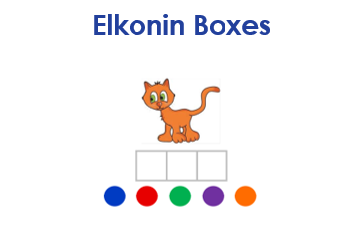
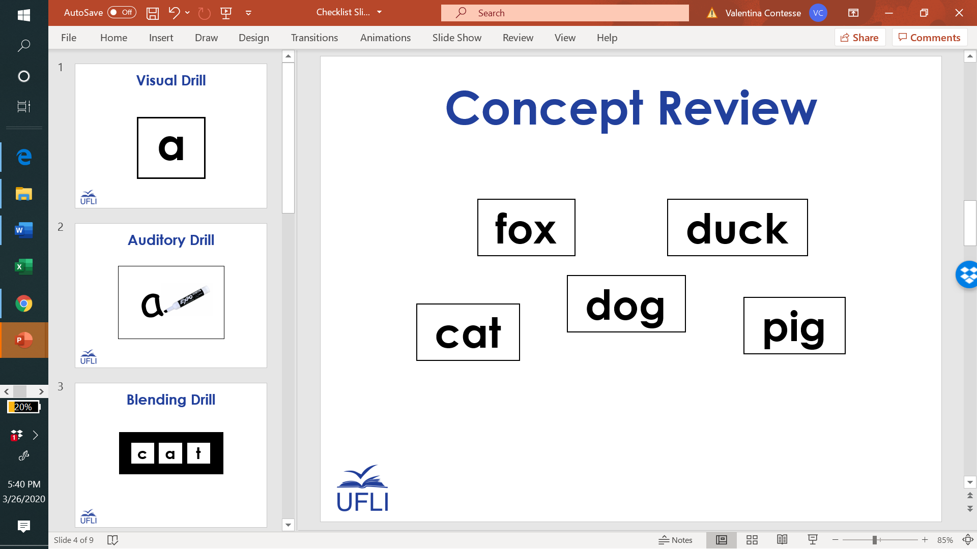
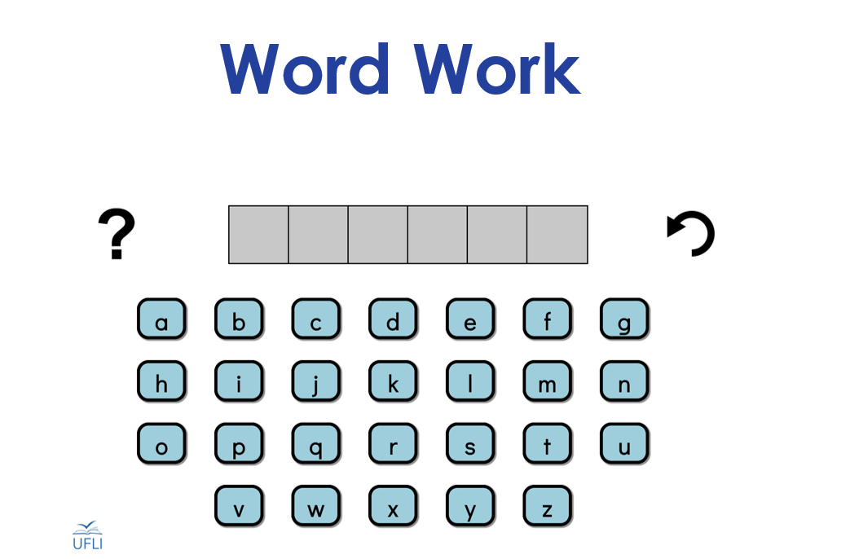
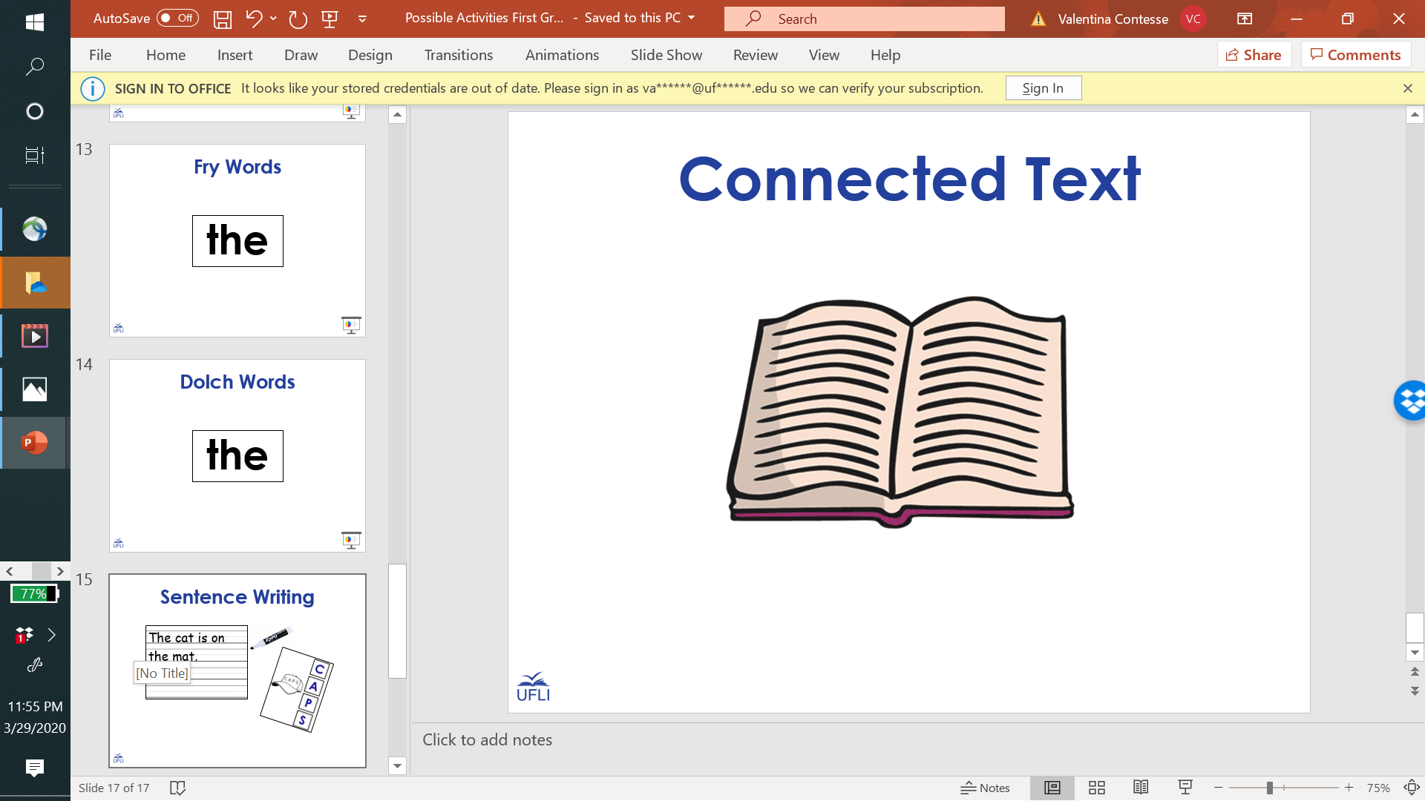
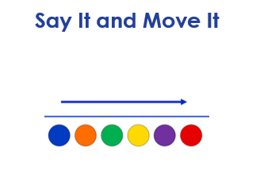
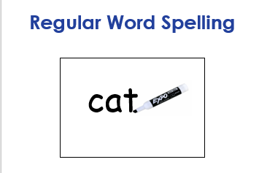
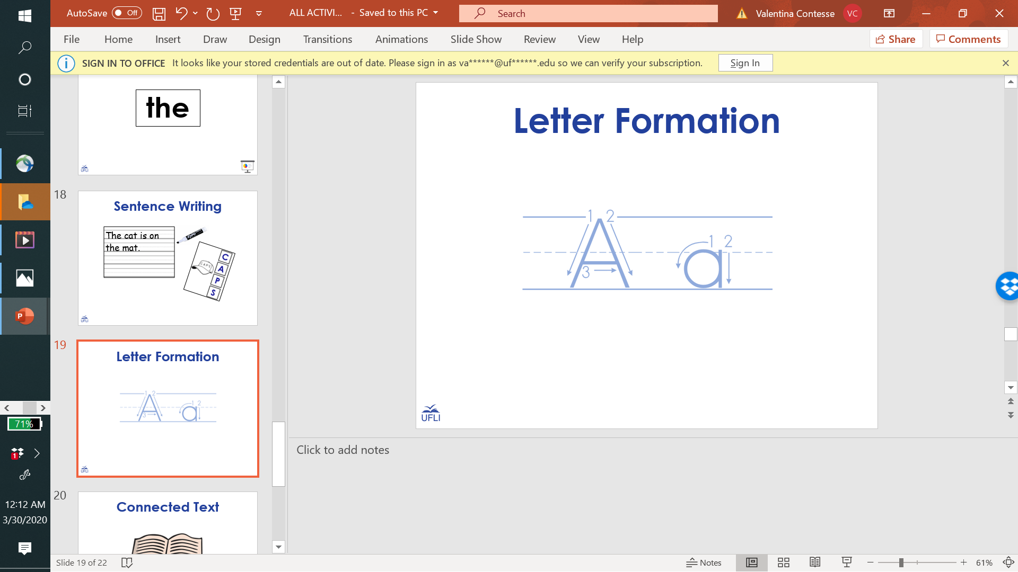
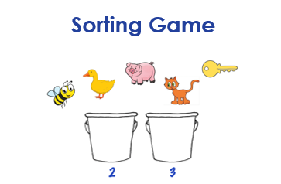
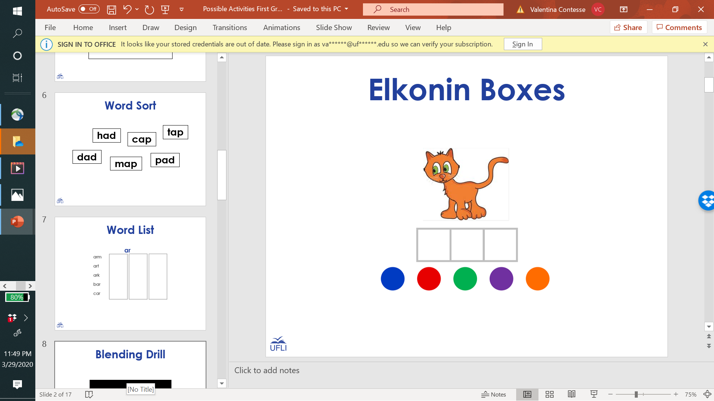
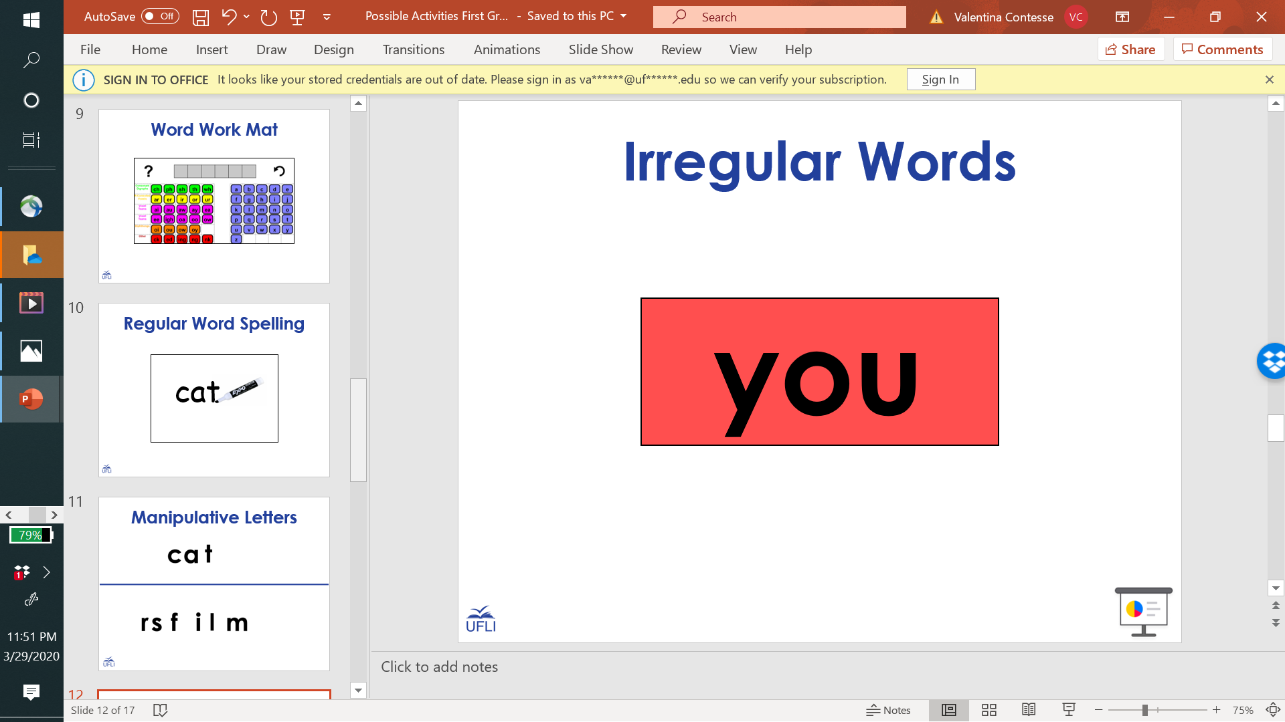
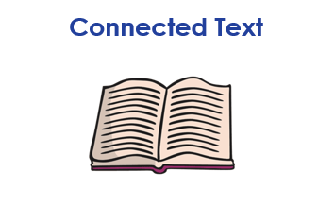
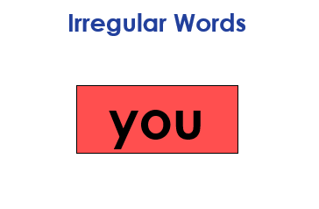
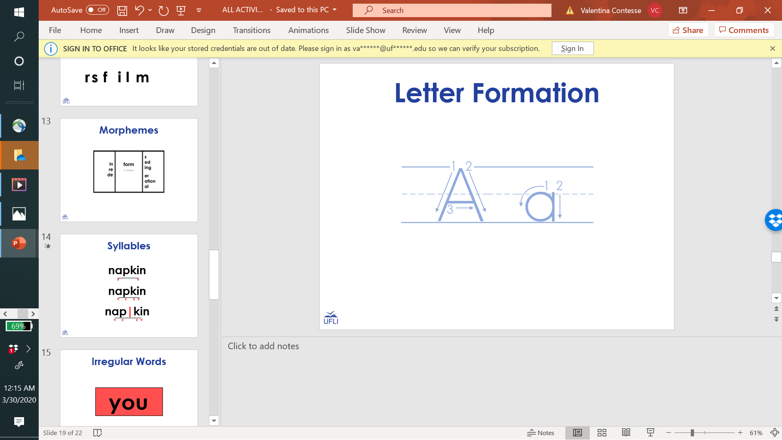
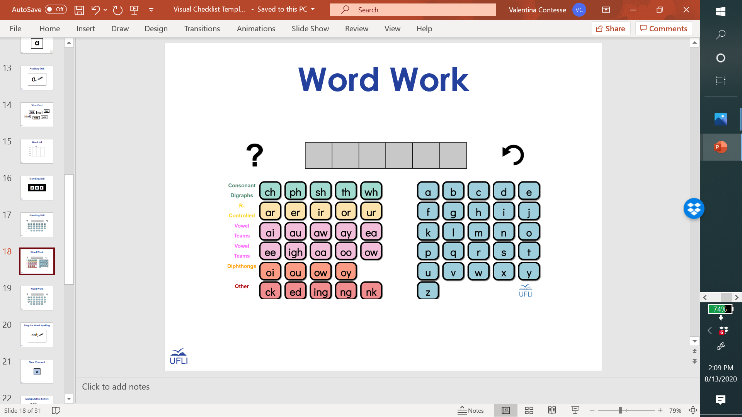
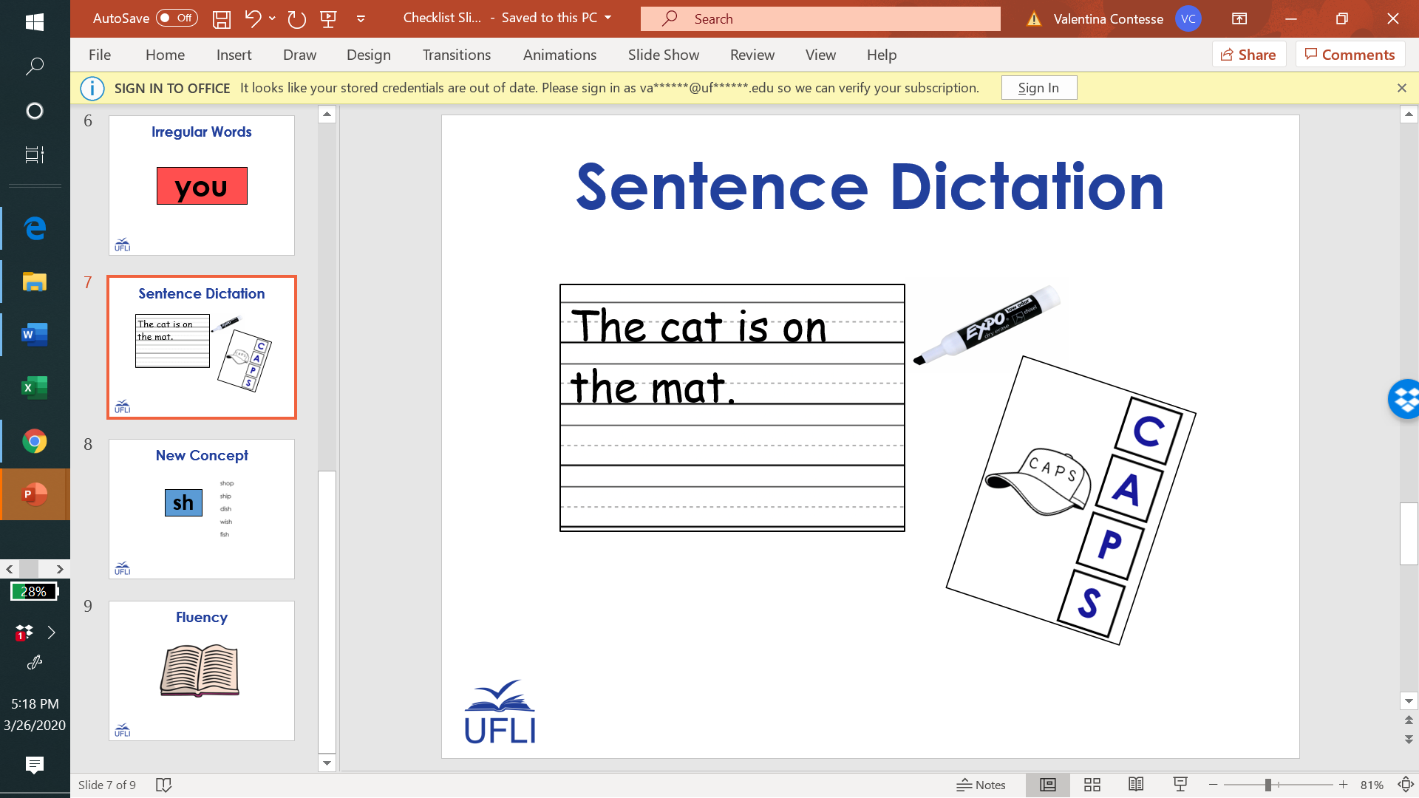

Slide 4
