Slide 1
Virtual Stickers
If you are using lesson checklists to keep your students apprised of the activities they’ve accomplished and what’s yet to come, try using virtual “stickers” instead of checkmarks to keep it more interesting and motivating.
Select an entire set of stickers, and copy them.
Paste them onto the lesson checklist template.
Add a sticker at the completion of each activity.

Slide 2






















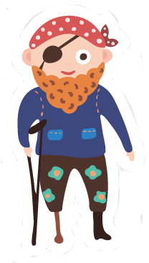
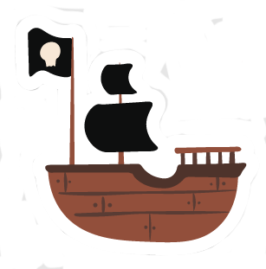
















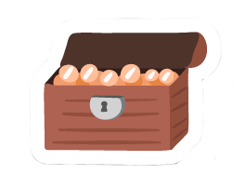

Slide 3







































Slide 4


















Slide 5
















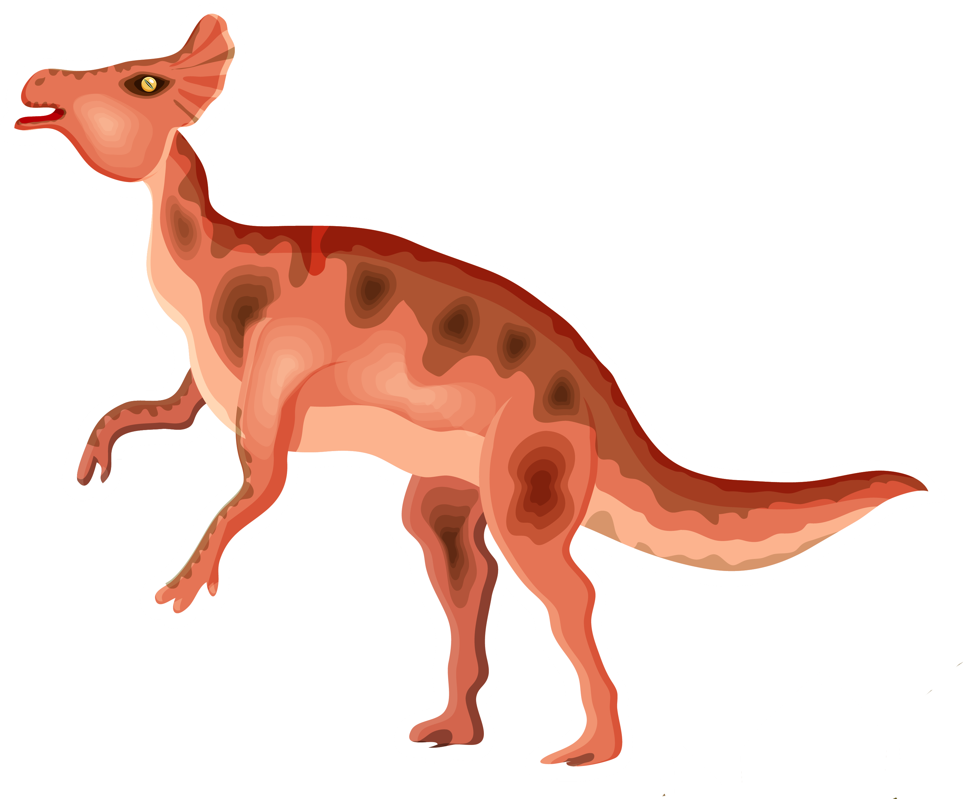
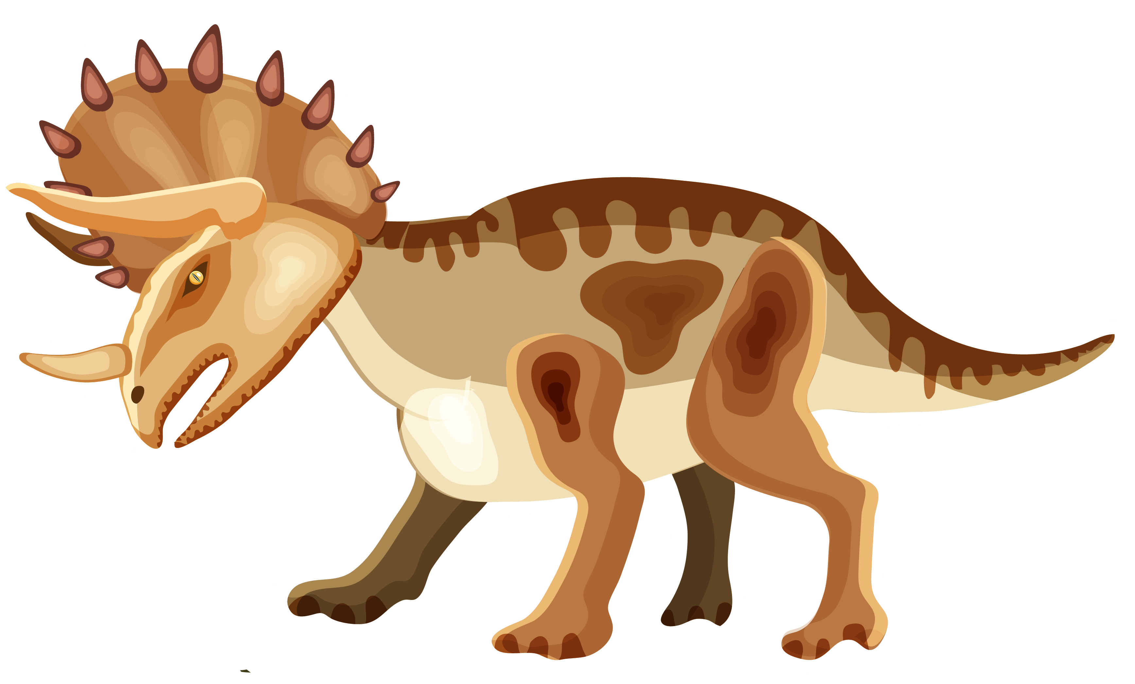





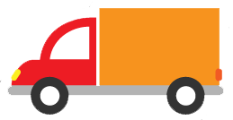
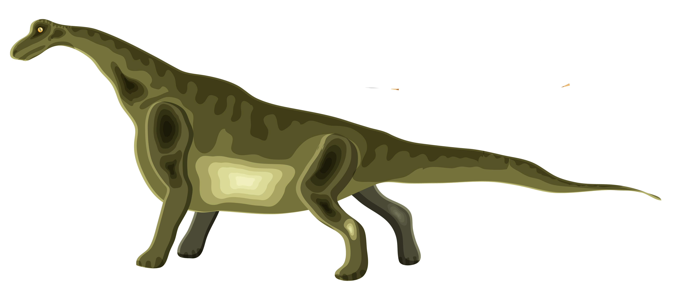







Slide 6

























