Slide 1
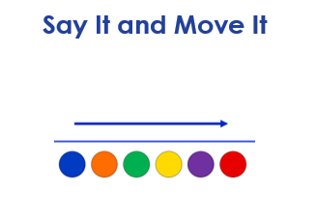
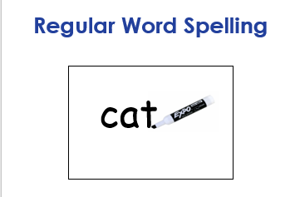
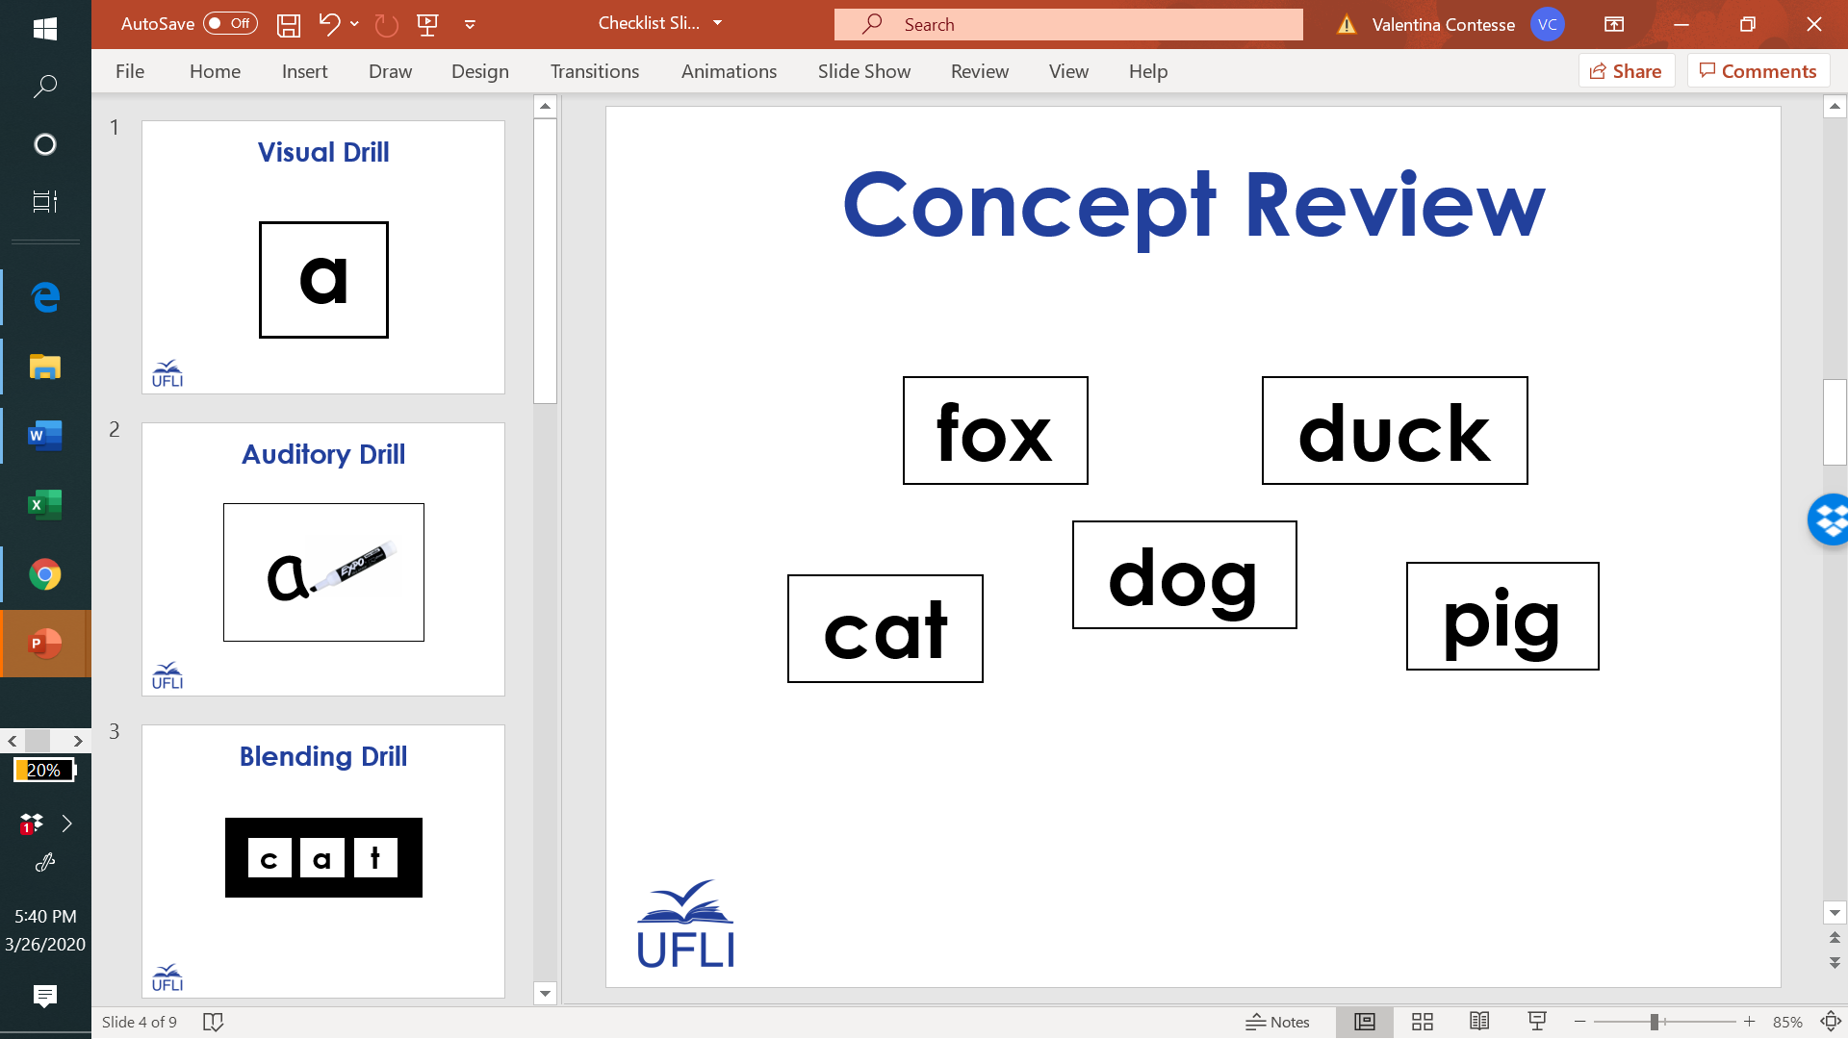
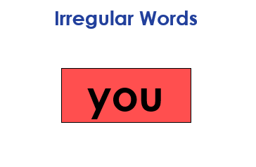

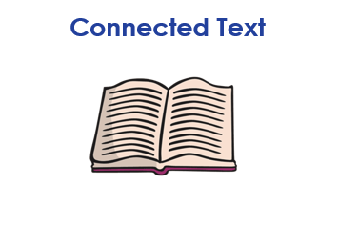

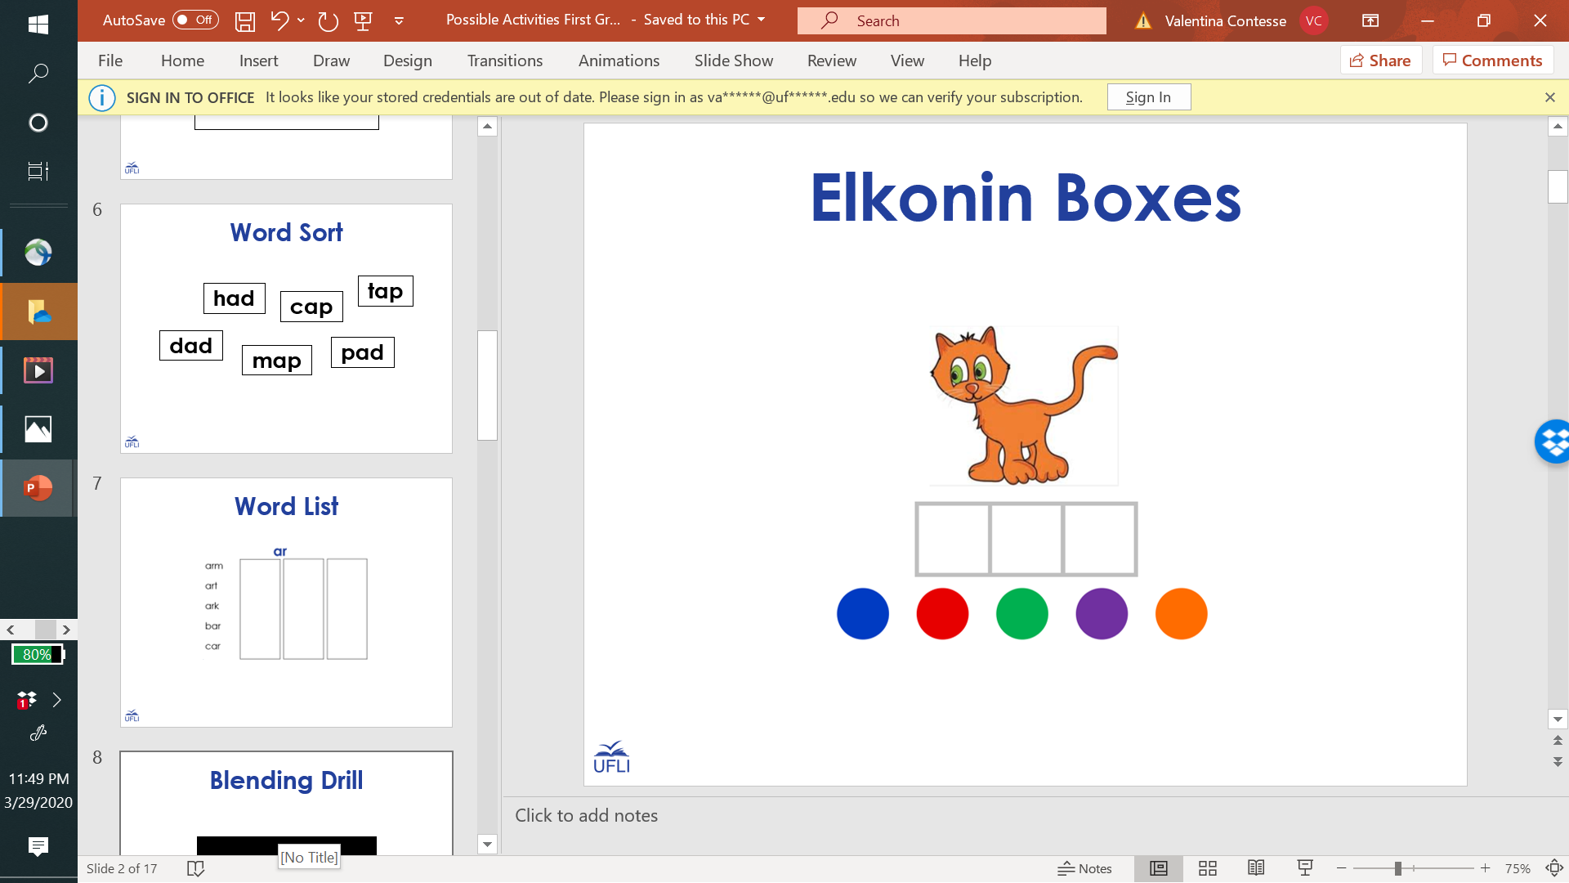
2nd Grade Sample Schedule
Stay in my area.
Follow directions the first time.
☺
Have fun!

Slide 2
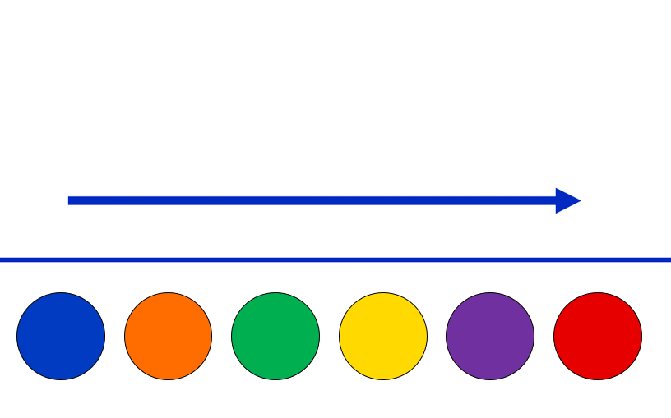
Say It and Move It

Slide 3
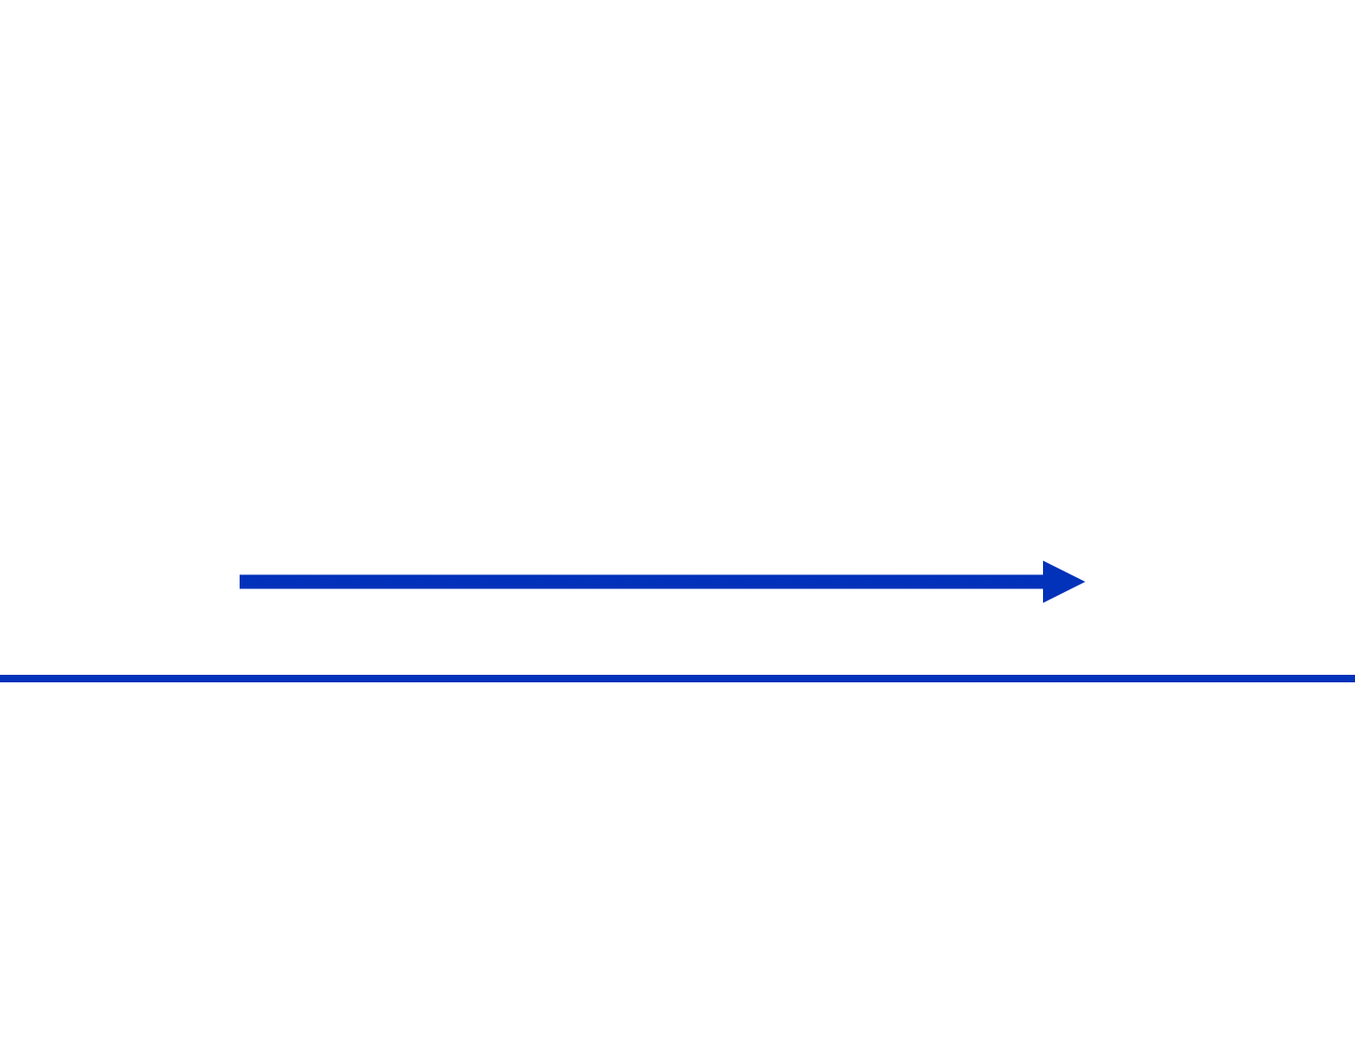
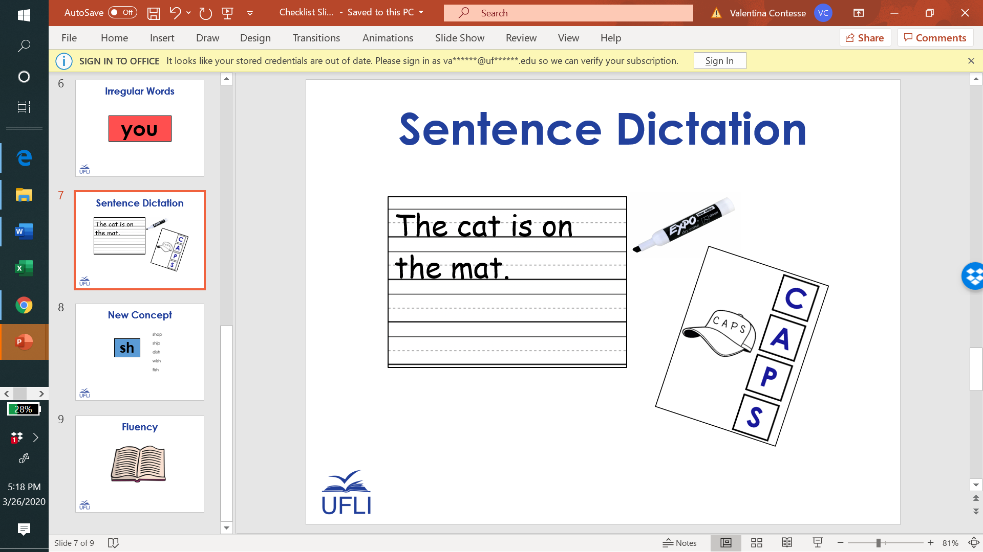

Slide 4

2nd Grade Sample Schedule
Stay in my area.
Follow directions the first time.
☺
Have fun!

Slide 5

Visual Drill
a

Slide 6
sh

Slide 7
ar

Slide 8
ai

Slide 9
ch

Slide 10
igh

Slide 11
ir

Slide 12
ee

Slide 13
ay

Slide 14
or

Slide 15
th
2

Slide 16
ea

Slide 17
ow

Slide 18
ur

Slide 19
oa

Slide 20
ph

Slide 21
er

Slide 22
ie

Slide 23
2nd Grade Sample Schedule
Stay in my area.
Follow directions the first time.
☺
Have fun!

Slide 24

Auditory Drill
a
Notes:
Options:
Students use whiteboard.
Students use “Whiteboard” screen sharing and “Annotate” options on videoconferencing platform.
Students use paper and writing tool.

Slide 25
2nd Grade Sample Schedule
Stay in my area.
Follow directions the first time.
☺
Have fun!

Slide 26
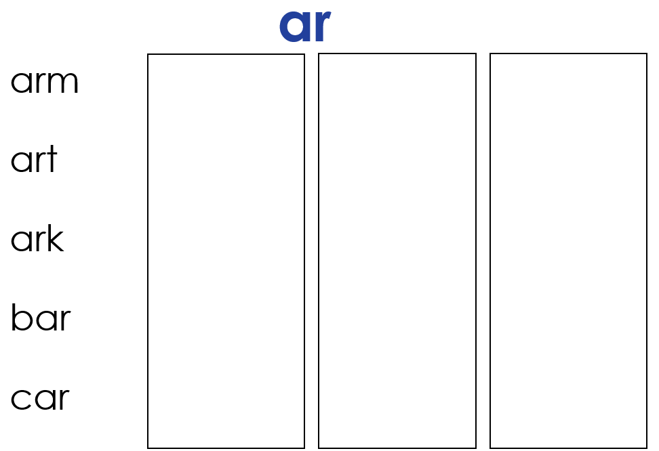
Word List

Slide 27
oi

Slide 28
oi
oi
Notes:
Visuals to review

Slide 29
oi -/oi/
joint
coin
join
boil
point
spoil
moist
broil

Slide 30
2nd Grade Sample Schedule
Stay in my area.
Follow directions the first time.
☺
Have fun!

Slide 31
Regular Word Spelling
cat

Slide 32
2nd Grade Sample Schedule
Stay in my area.
Follow directions the first time.
☺
Have fun!

Slide 33
Irregular Words
you

Slide 34
heart

Slide 35
poor

Slide 36
shoe

Slide 37
door

Slide 38
woman

Slide 39
floor

Slide 40
false

Slide 41
beautiful

Slide 42
every

Slide 43
cough

Slide 44
beauty

Slide 45
women

Slide 46
backward
Notes:
New

Slide 47
forward
Notes:
New

Slide 48
2nd Grade Sample Schedule
Stay in my area.
Follow directions the first time.
☺
Have fun!

Slide 49

Connected Text

Slide 50
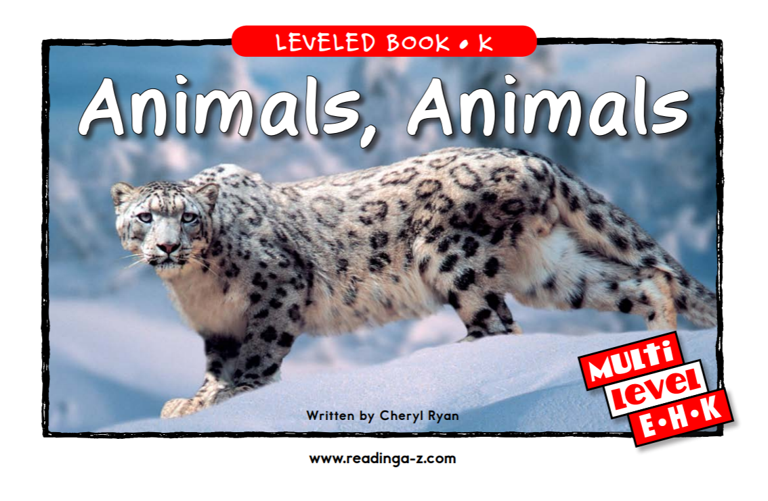

Slide 51
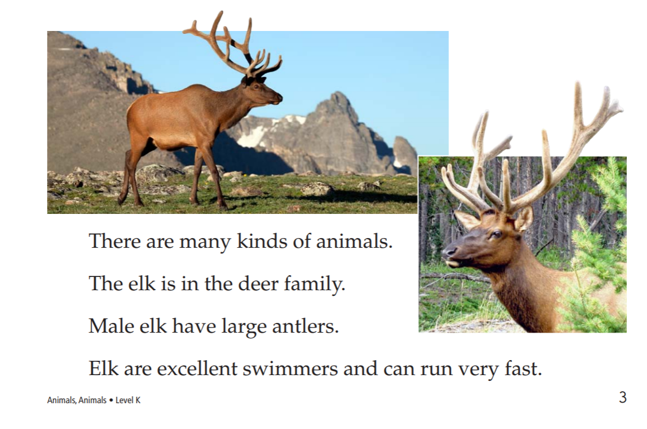

Slide 52
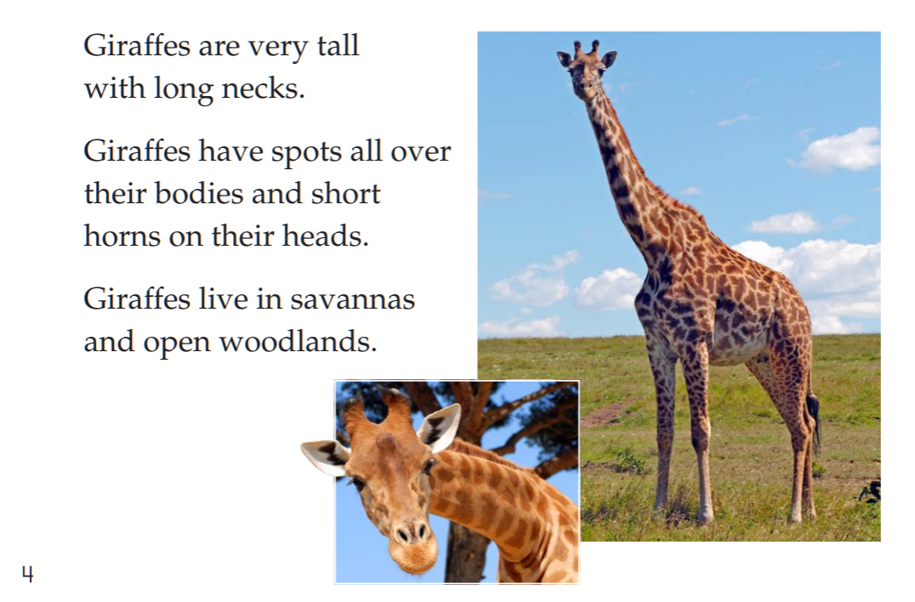

Slide 53
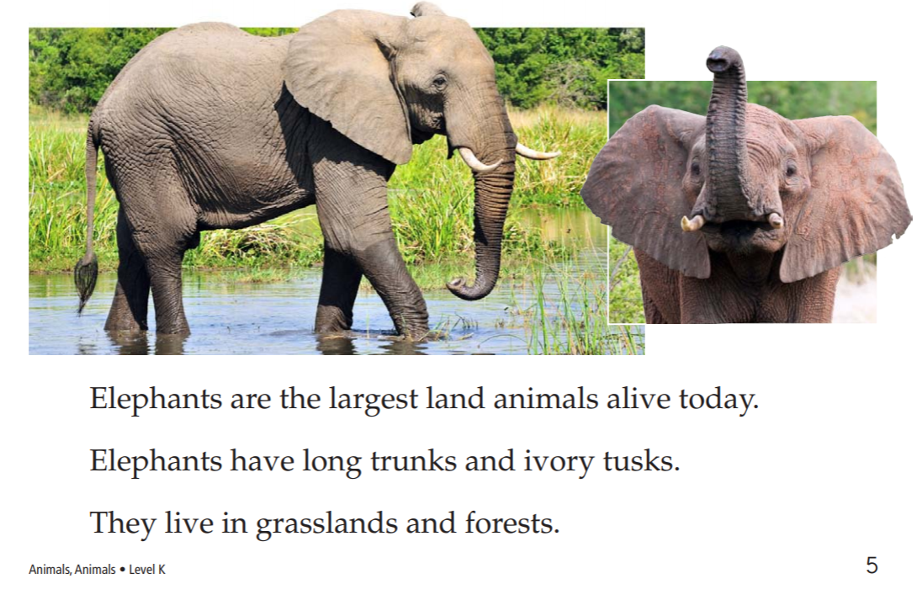

Slide 54
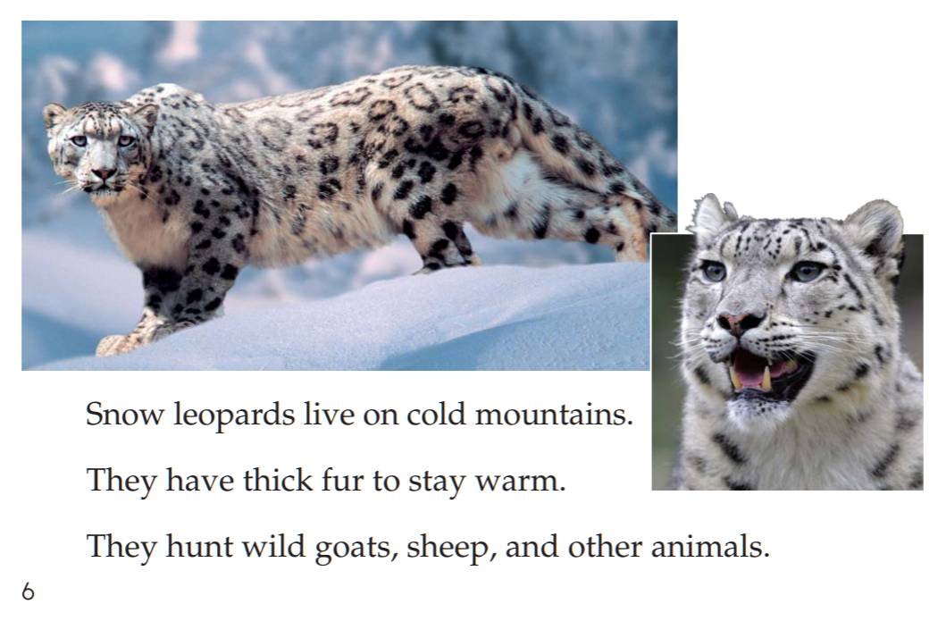

Slide 55
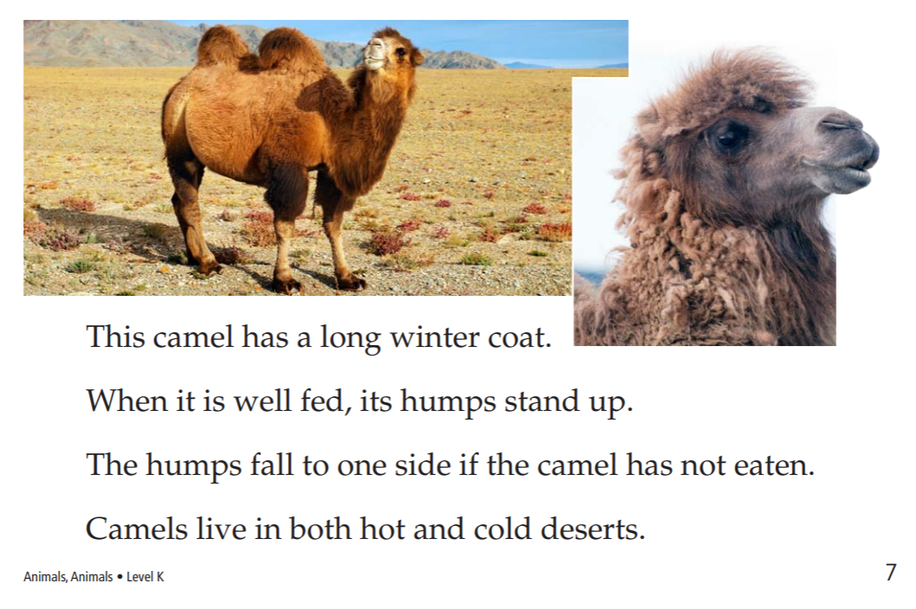

Slide 56
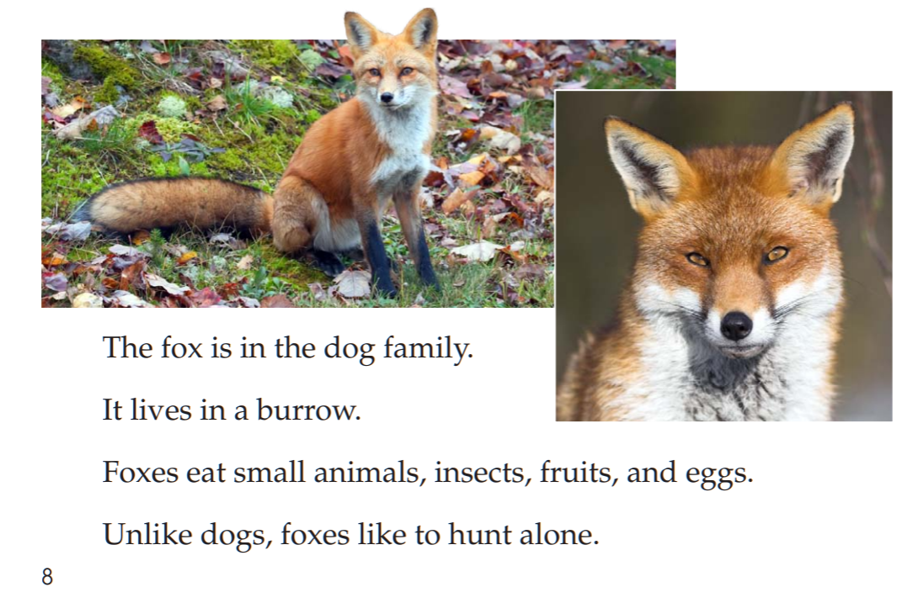

Slide 57
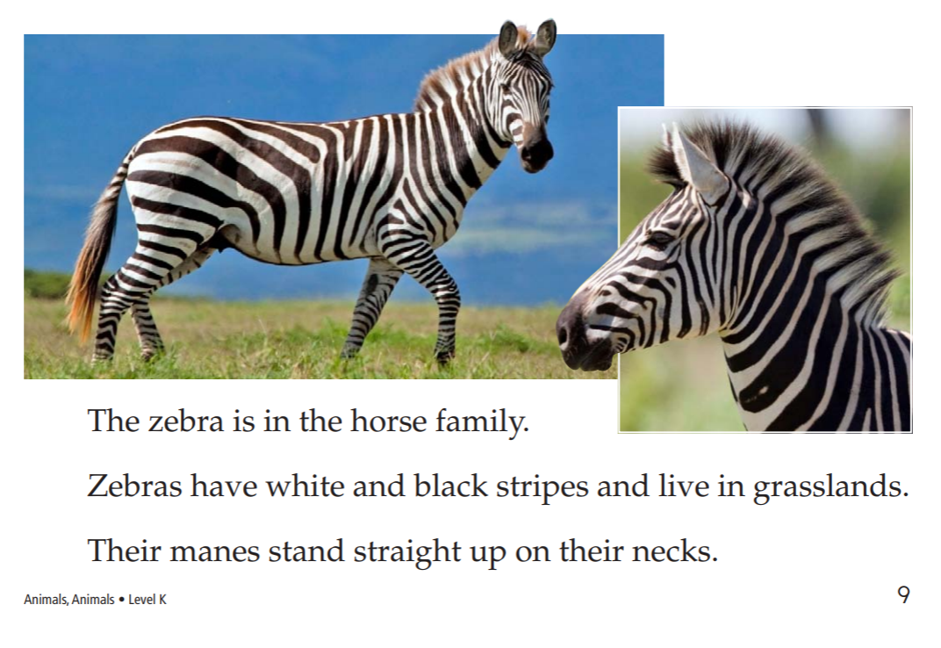

Slide 58
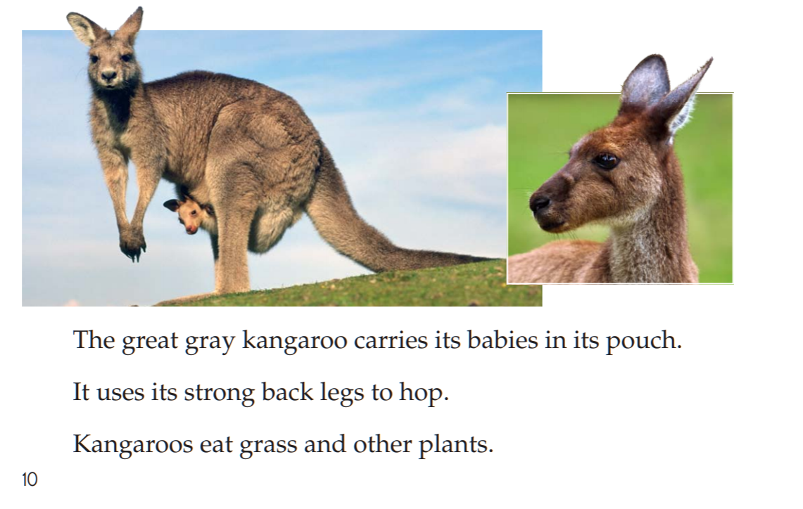

Slide 59
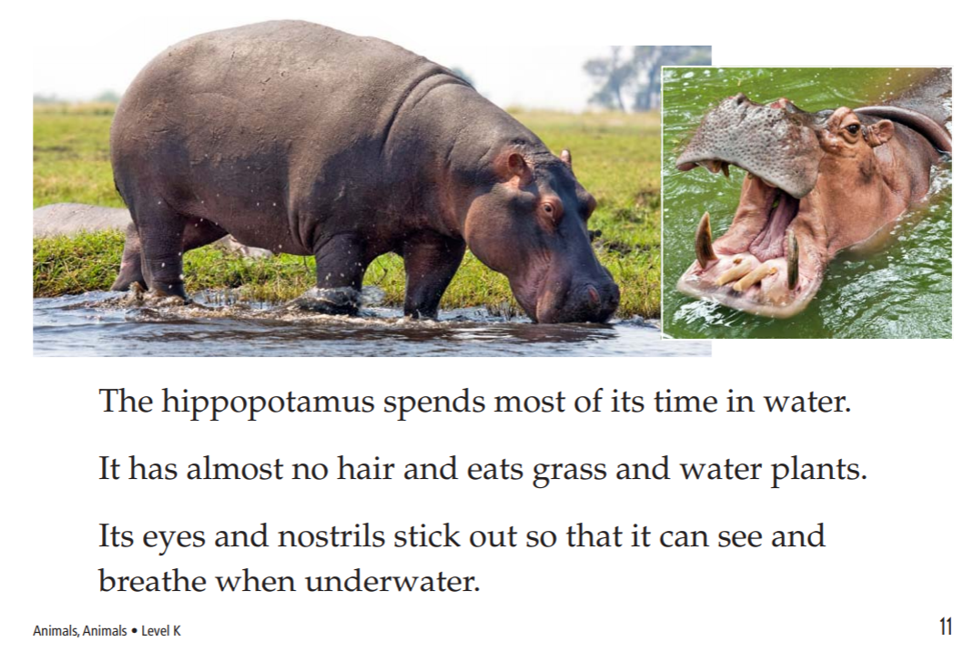

Slide 60
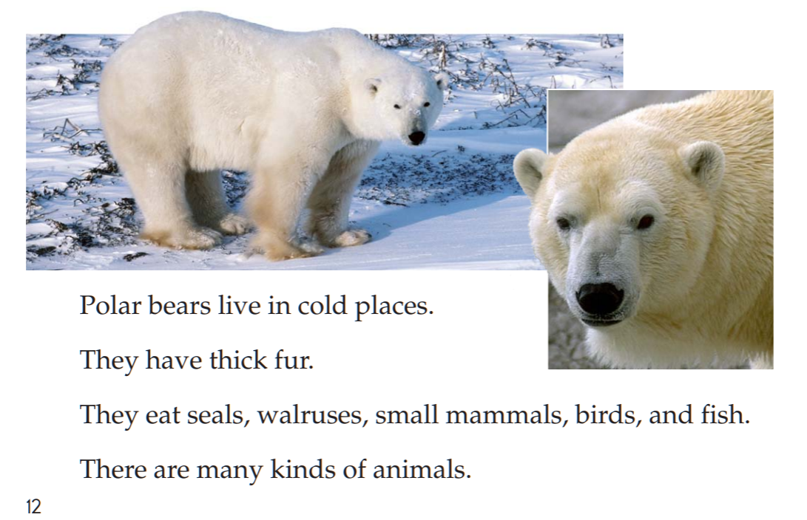

Slide 61
2nd Grade Sample Schedule
Stay in my area.
Follow directions the first time.
☺
Have fun!

Slide 62
You did it!
Insert reinforcing activity

