Slide 1


Schedule
Stay in my area.
Follow directions the first time.
☺
Have fun!

Slide 2
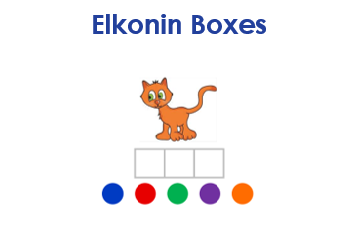
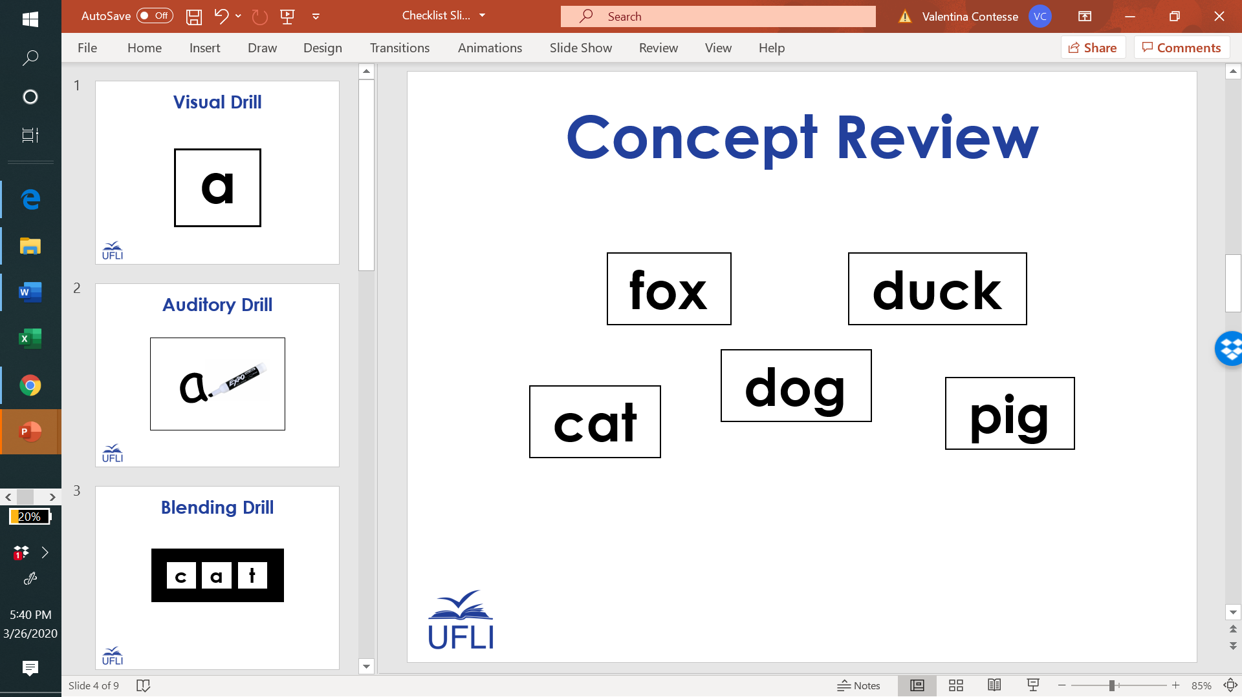
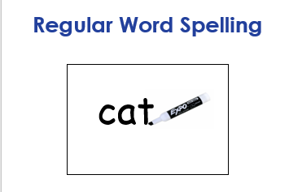
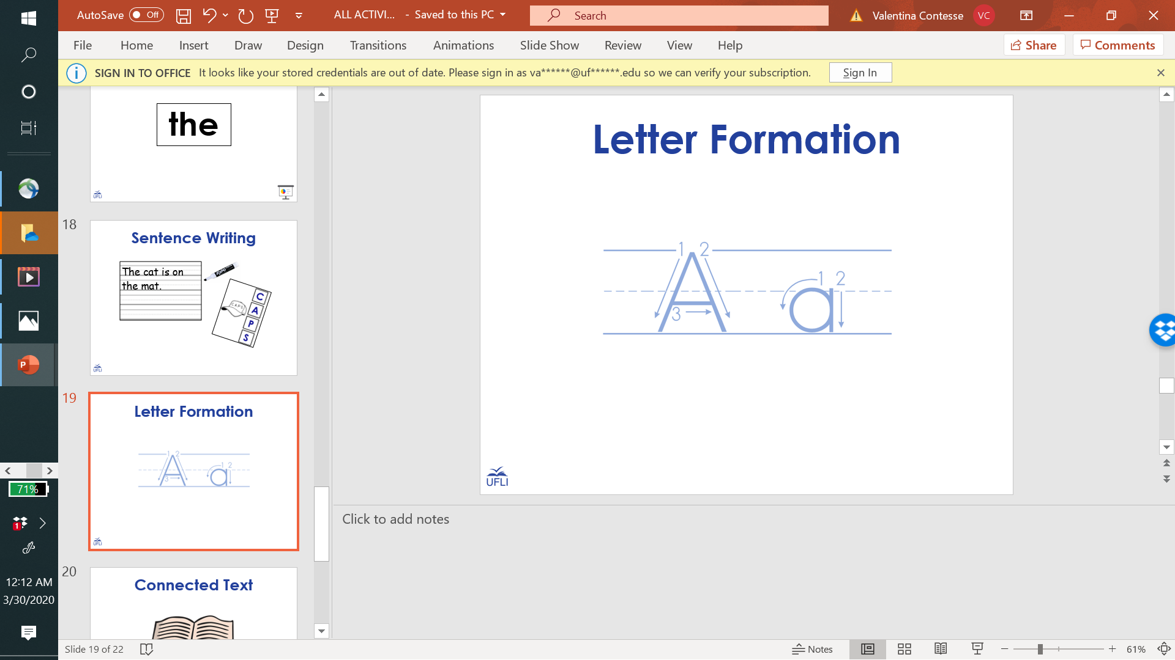
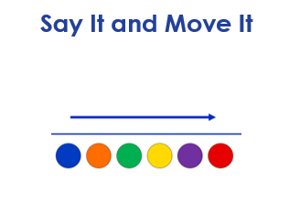
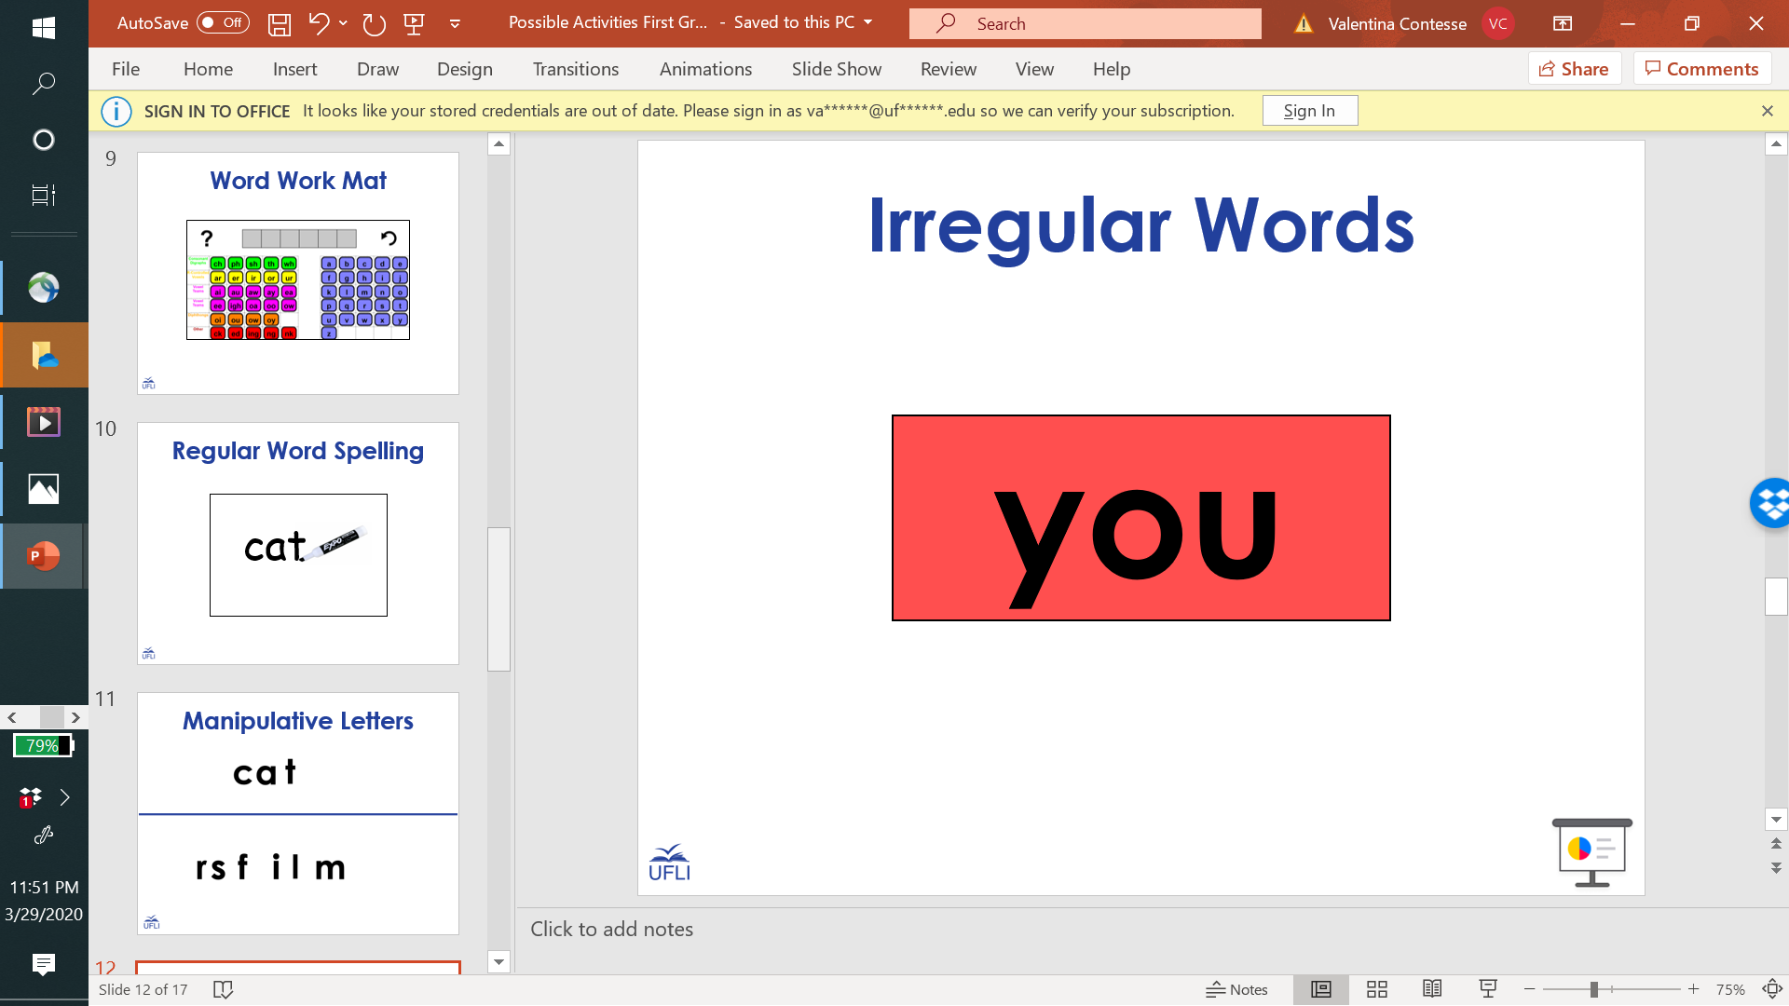
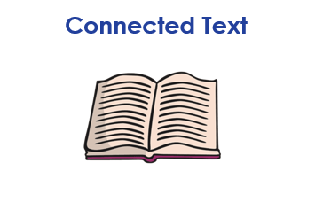
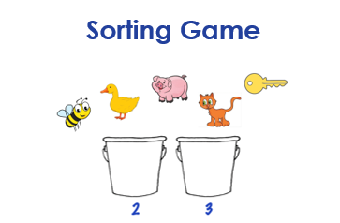
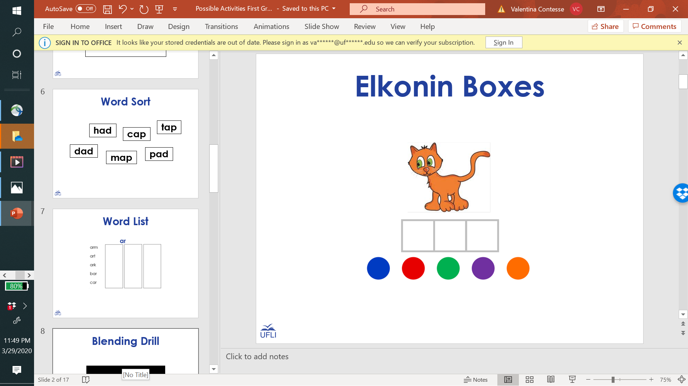
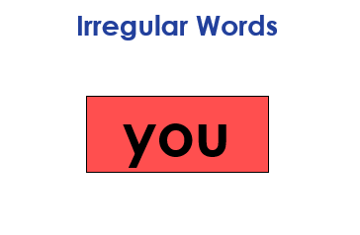
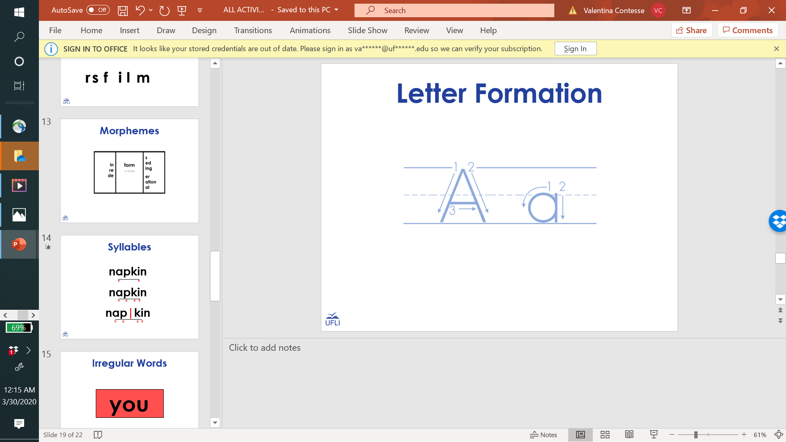
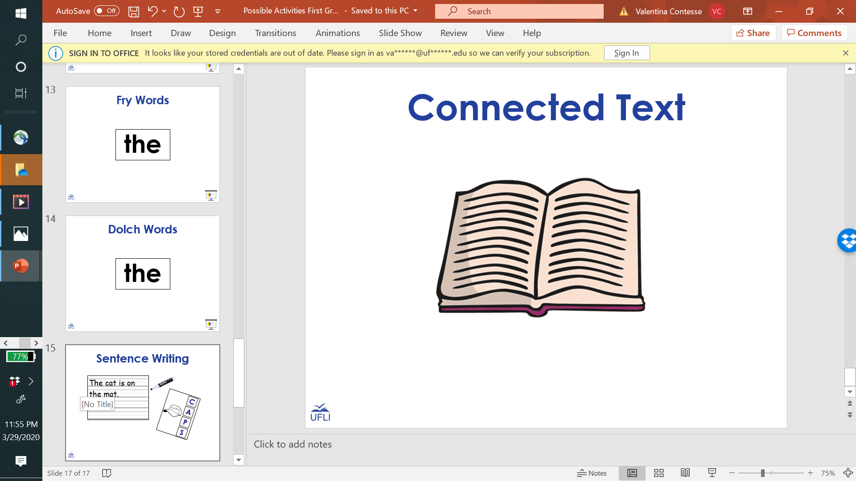
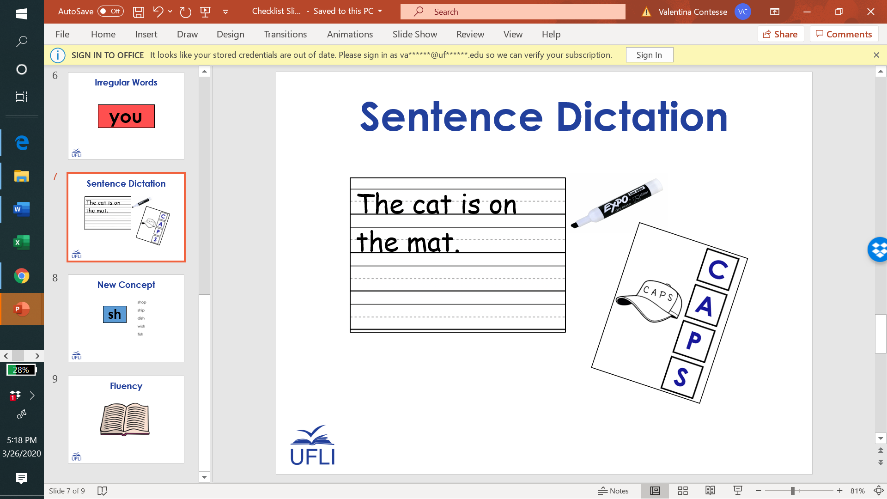

Slide 3


Slide 5
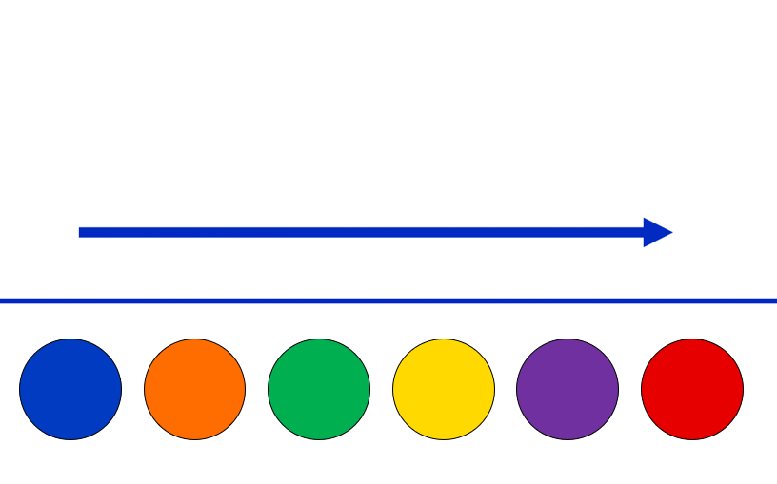
Say It and Move It

Slide 6
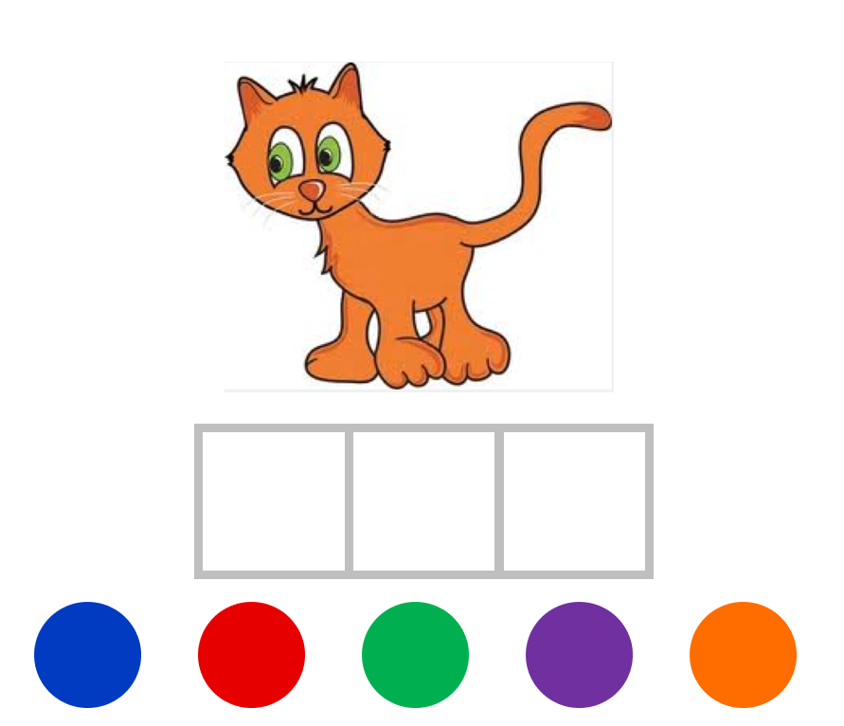
Elkonin Boxes

Slide 7
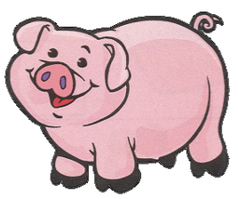


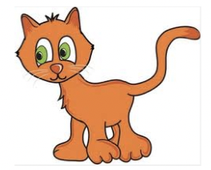

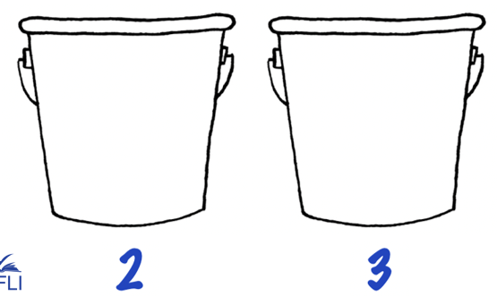
Sorting Game

Slide 8

Visual Drill
a

Slide 9
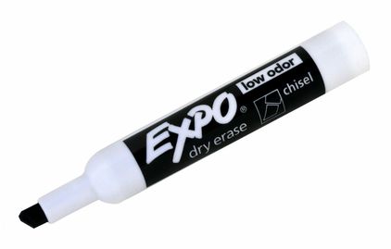
Auditory Drill
a
Notes:
Options:
Students use whiteboard.
Students use “Whiteboard” screen sharing and “Annotate” options on videoconferencing platform.
Students use paper and writing tool.

Slide 10
Word Sort
tap
had
cap
dad
pad
map

Slide 11
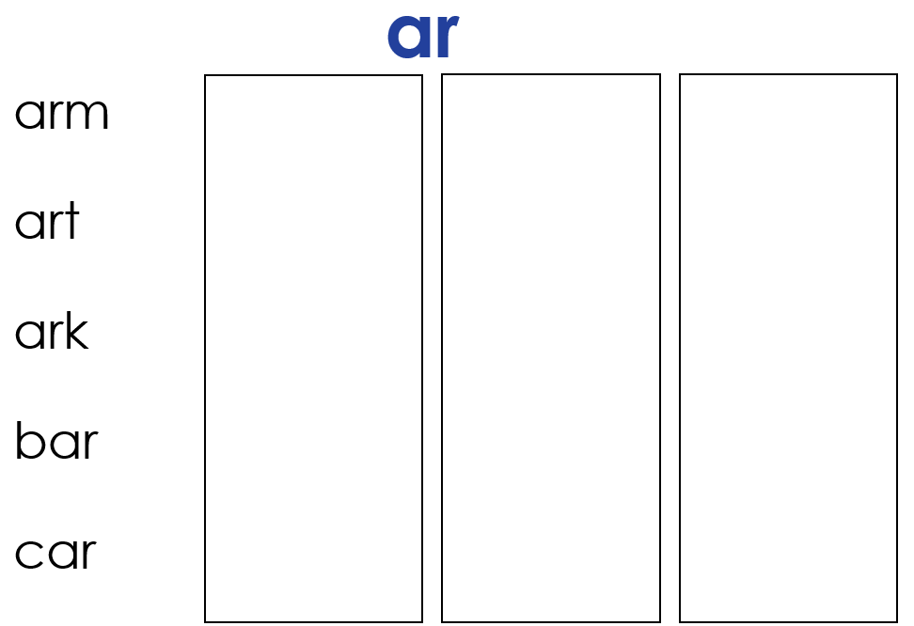
Word List

Slide 12
Blending Drill
c
a
t

Slide 13
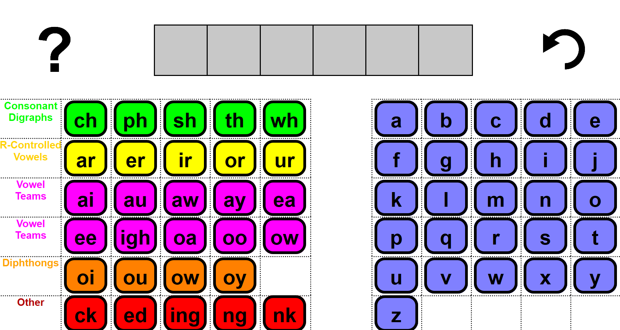
Word Work Mat
Notes:
https://research.dwi.ufl.edu/op.n/file/gc8nkxns914enc7d/embed?fbclid=IwAR1OiYiB6fERCg-3wSWOPc0QZh4cmzyZ7wdO7f__fU2c4trzyanvj1xebko

Slide 14
Regular Word Spelling
cat

Slide 15










Manipulative Letters

Slide 16
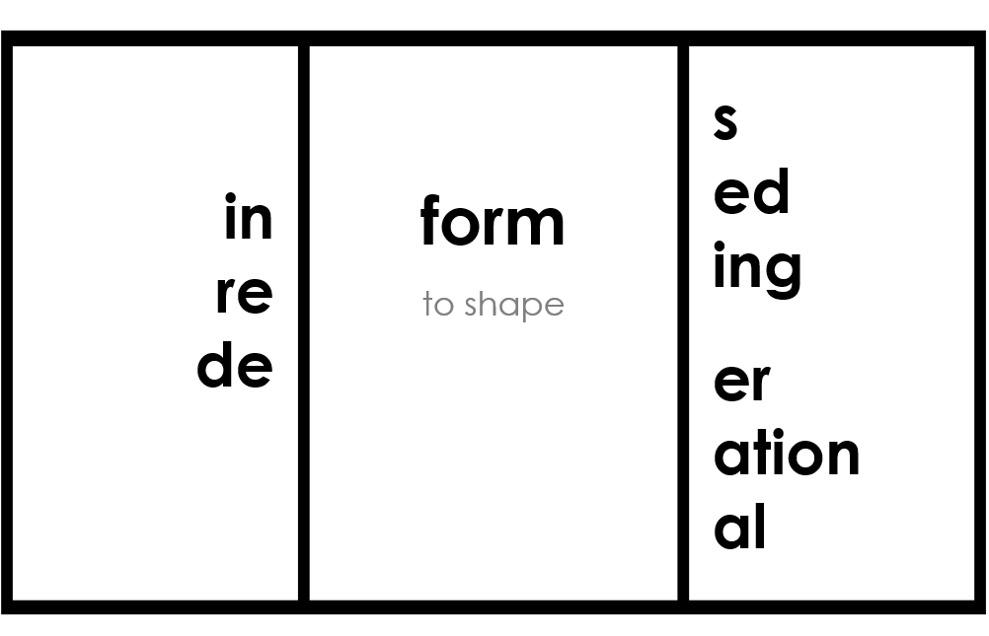
Morphemes

Slide 17
Syllables
napkin
v
v
napkin
v
c
c
v
nap|kin
v
c
c
v

Slide 18
Irregular Words
you

Slide 19
Fry Words
the

Slide 20
Dolch Words
the

Slide 21
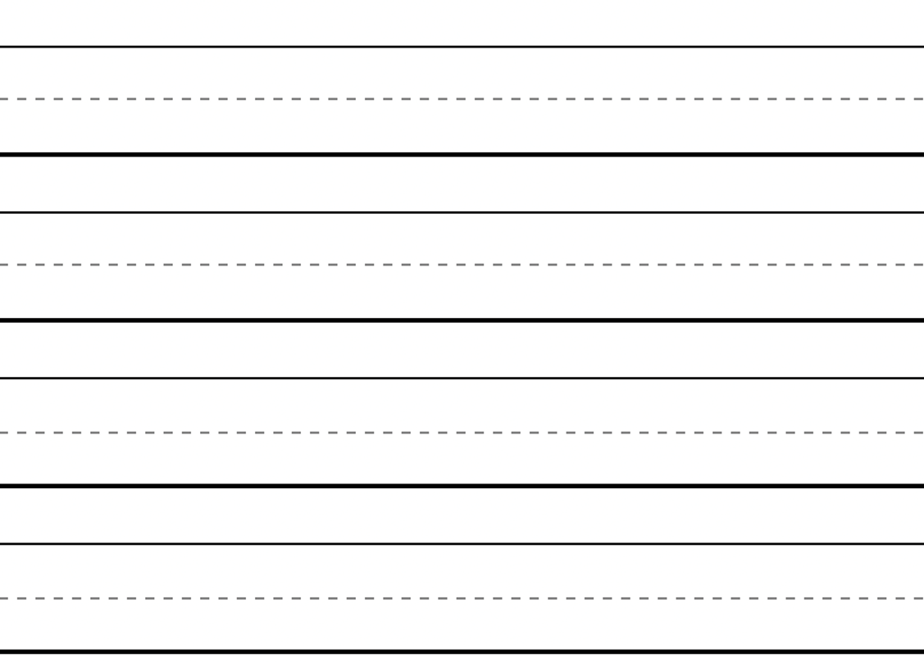
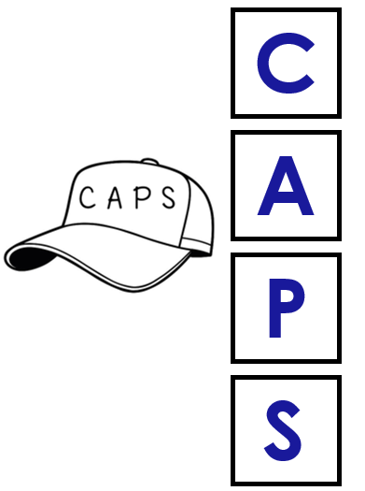
Sentence Writing
The cat is on
the mat.

Slide 22

Connected Text

Slide 23
You did it!
Insert reinforcing activity

