Slide 1
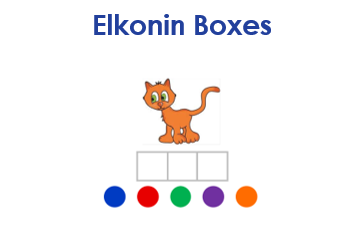
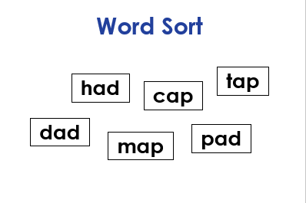

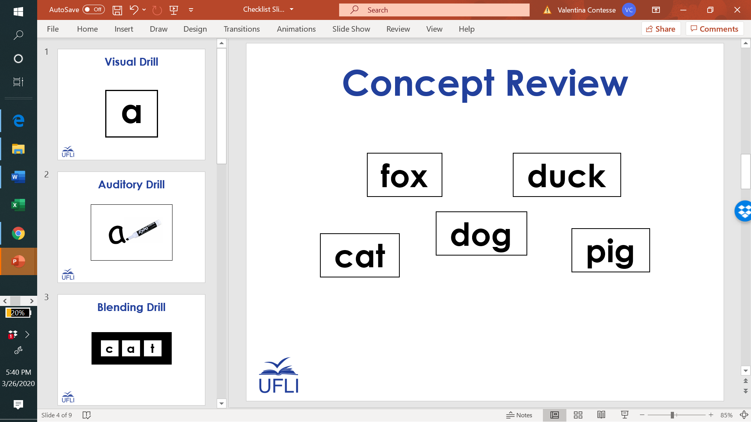
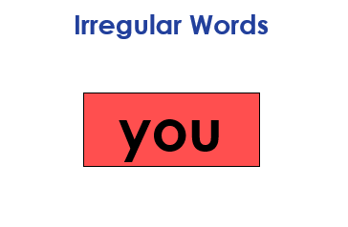

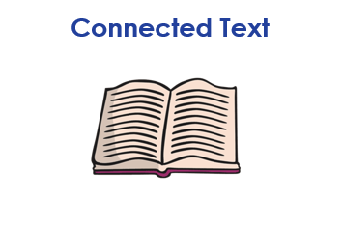
Kindergarten Sample Schedule
Stay in my area.
Follow directions the first time.
☺
Have fun!

Slide 2
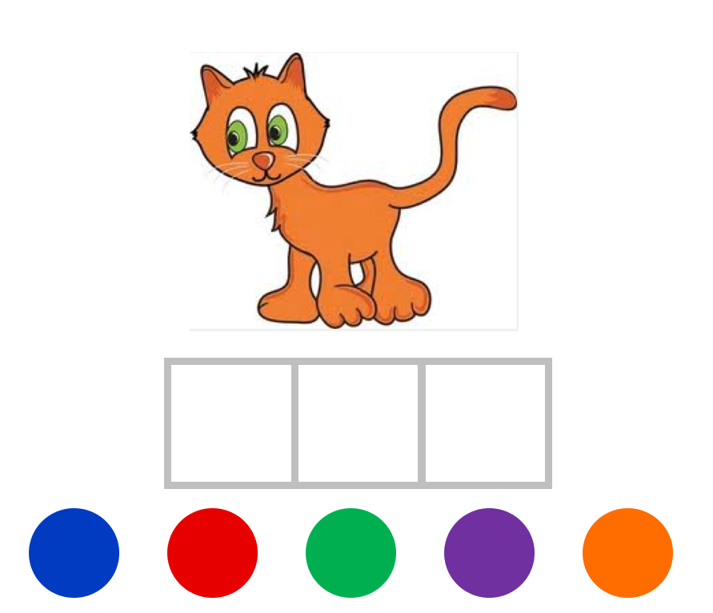
Elkonin Boxes

Slide 3

Notes:
bee

Slide 4

Notes:
bow

Slide 5
Notes:
cat

Slide 6
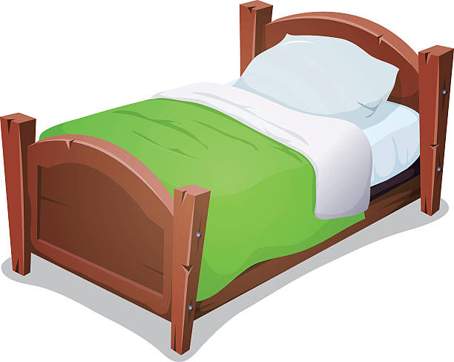
Notes:
bed

Slide 7
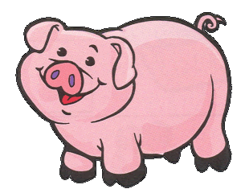
Notes:
pig

Slide 8

Kindergarten Sample Schedule
Stay in my area.
Follow directions the first time.
☺
Have fun!

Slide 9

Visual Drill
a

Slide 10
m

Slide 11
a

Slide 12
s

Slide 13
f

Slide 14
i

Slide 15
t

Slide 16
h

Slide 17
c

Slide 18
l

Slide 19
v

Slide 20
e

Slide 21
p

Slide 22
u

Slide 23
x

Slide 24
b

Slide 25
o

Slide 26
z

Slide 27
r

Slide 28
g

Slide 29
d

Slide 30
y

Slide 31
n

Slide 32
j

Slide 33
k

Slide 34
w

Slide 35
qu

Slide 36
Kindergarten Sample Schedule
Stay in my area.
Follow directions the first time.
☺
Have fun!

Slide 37
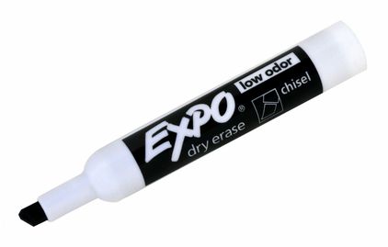
Auditory Drill
a
Notes:
Options:
Students use whiteboard.
Students use “Whiteboard” screen sharing and “Annotate” options on videoconferencing platform.
Students use paper and writing tool.

Slide 38
Kindergarten Sample Schedule
Stay in my area.
Follow directions the first time.
☺
Have fun!

Slide 39
Word Sort
tap
had
cap
dad
pad
map

Slide 40
a
Notes:
Visuals to review

Slide 41
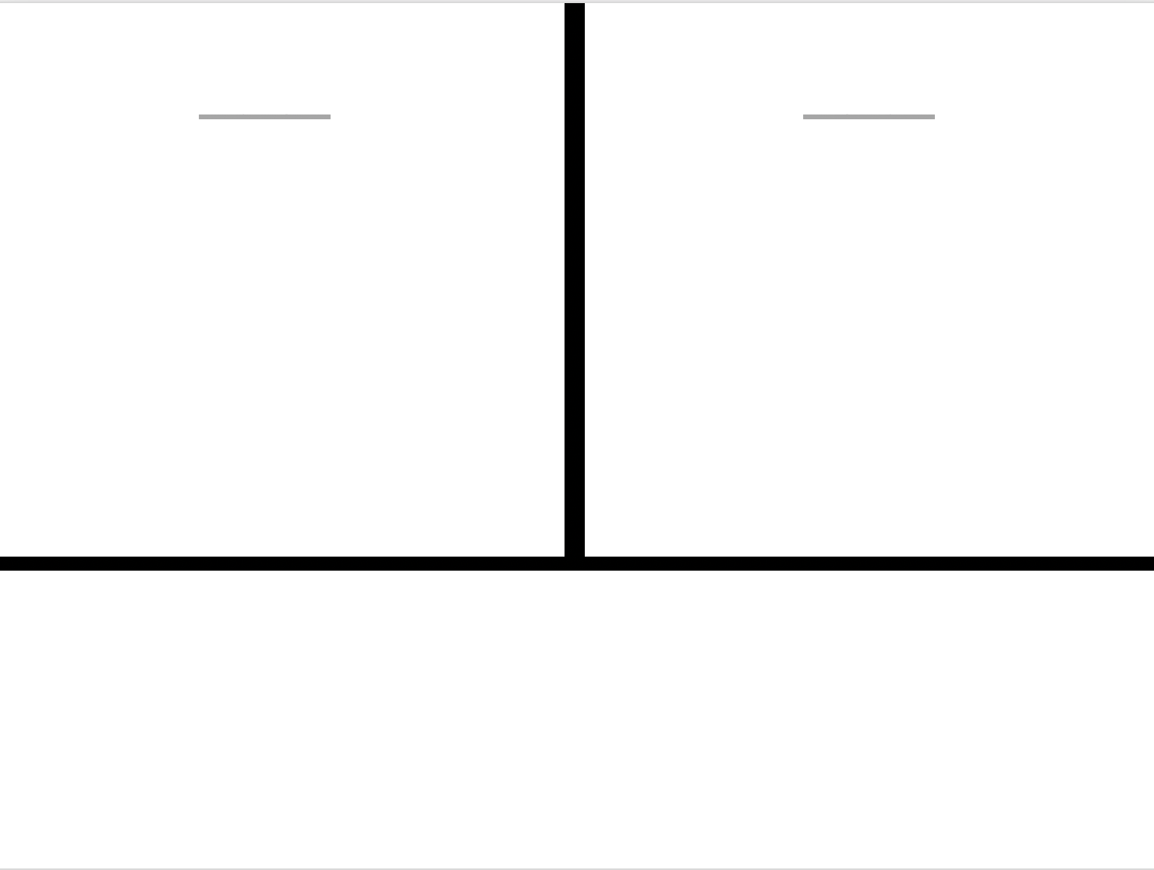
-ap
-at
cap
bat
lap
pat
fat
nap
cat
tap
zap
sat

Slide 42
Kindergarten Sample Schedule
Stay in my area.
Follow directions the first time.
☺
Have fun!

Slide 43
Irregular Words
you

Slide 44
the

Slide 45
is

Slide 46
his

Slide 47
as

Slide 48
has

Slide 49
you

Slide 50
to

Slide 51
do

Slide 52
for

Slide 53
of

Slide 54
said
Notes:
New

Slide 55
was
Notes:
New

Slide 56
Kindergarten Sample Schedule
Stay in my area.
Follow directions the first time.
☺
Have fun!

Slide 57

Connected Text

Slide 58
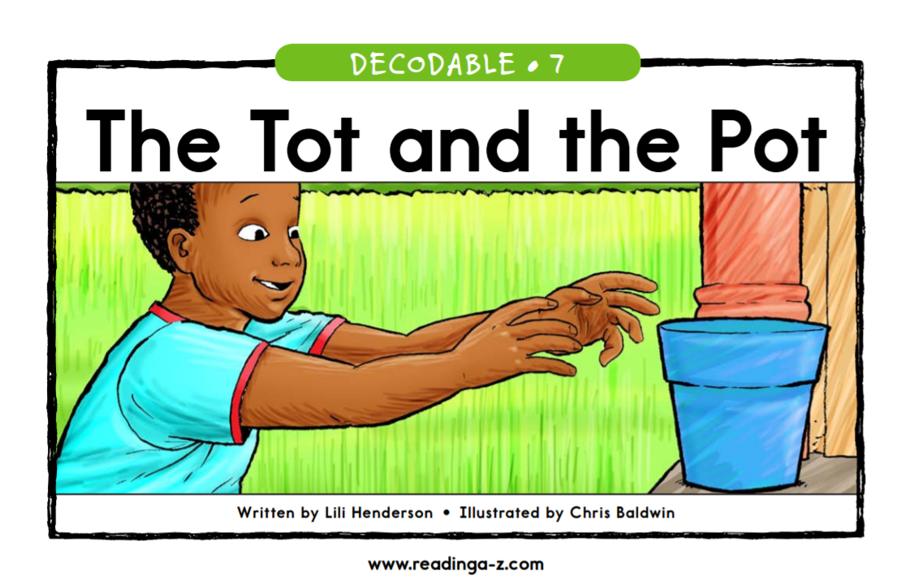

Slide 59
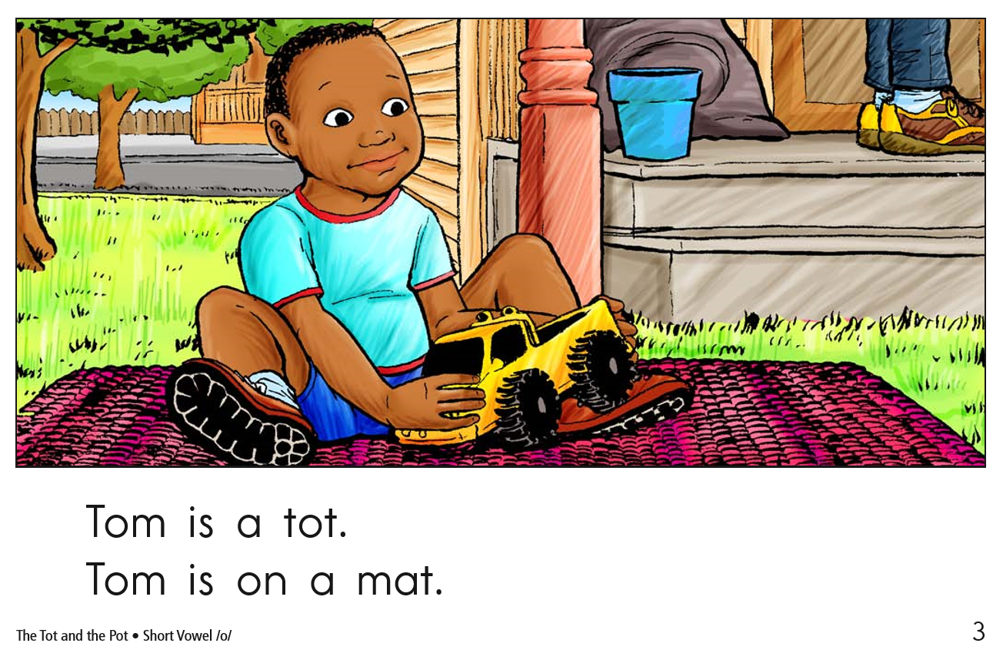

Slide 60
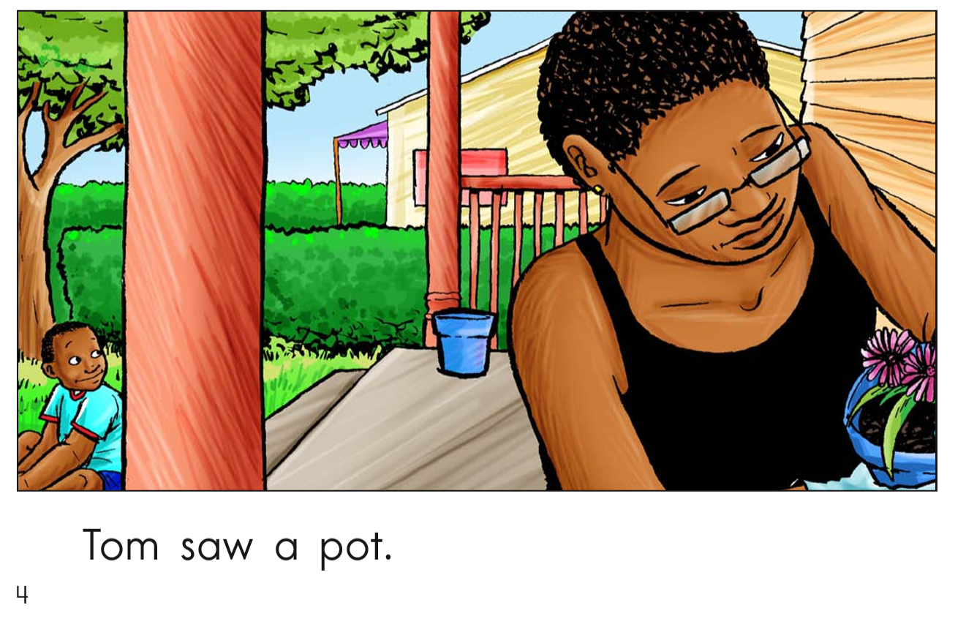

Slide 61
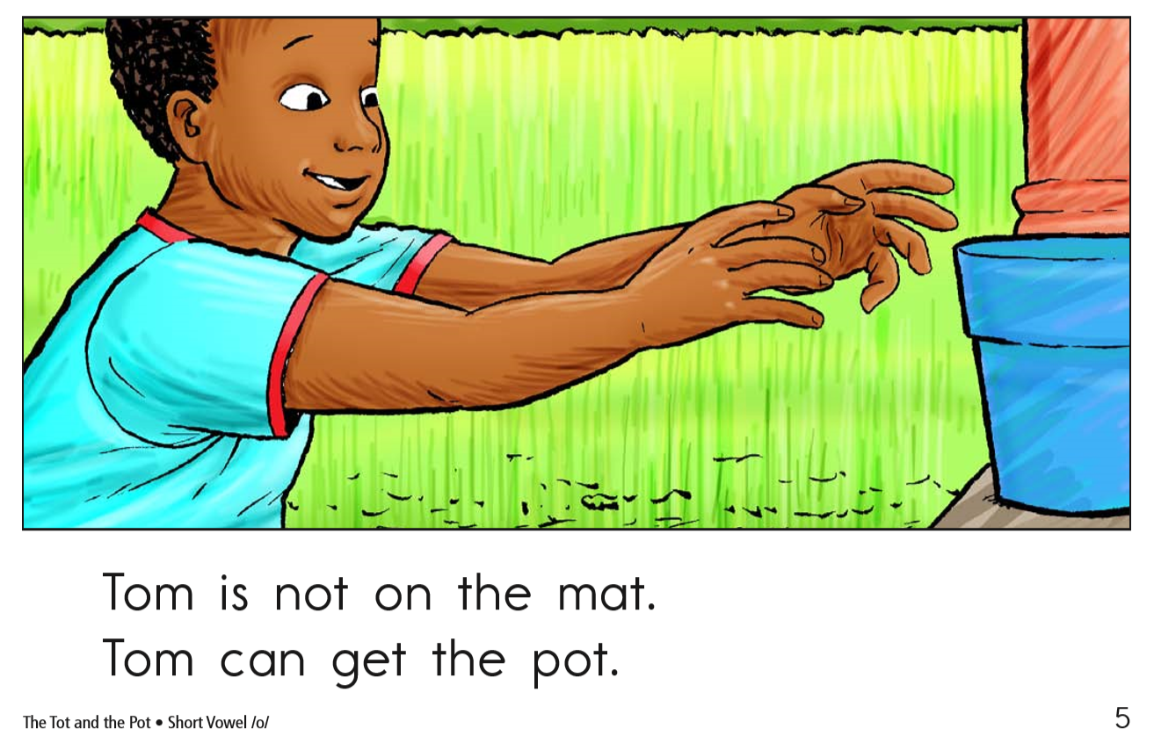

Slide 62
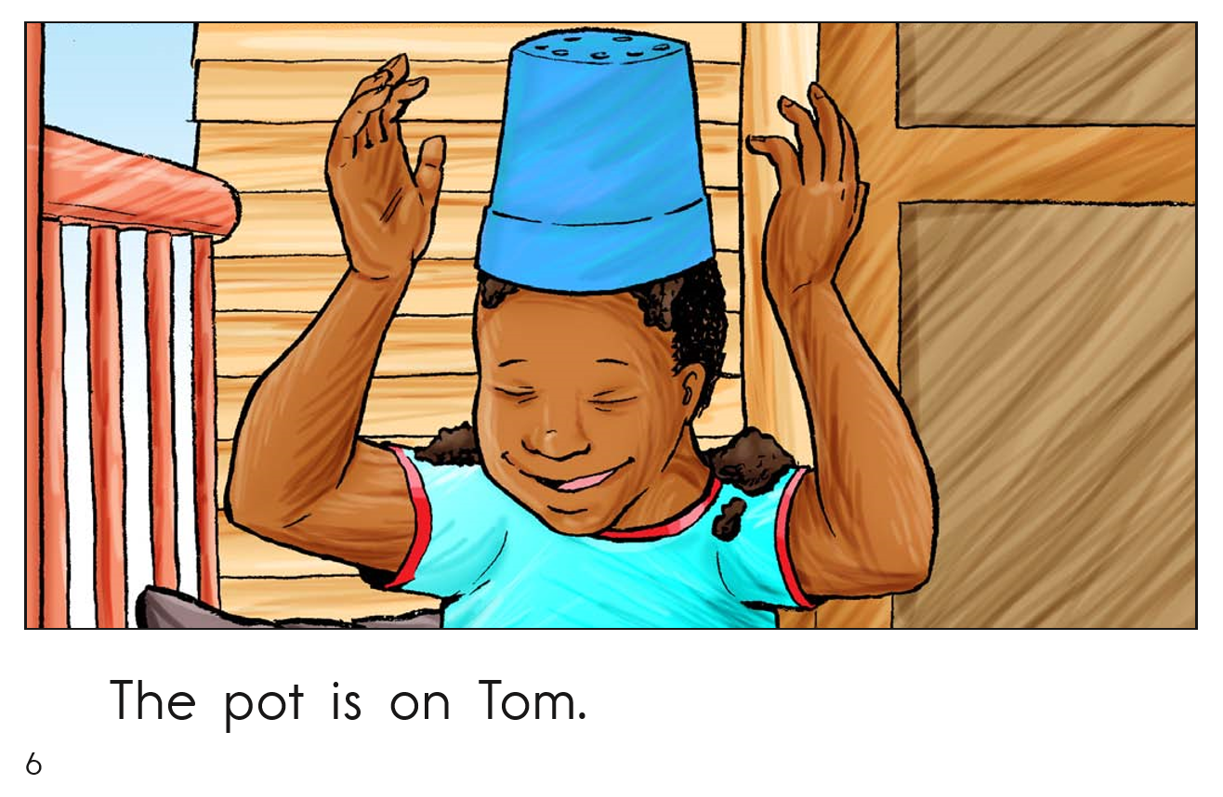

Slide 63
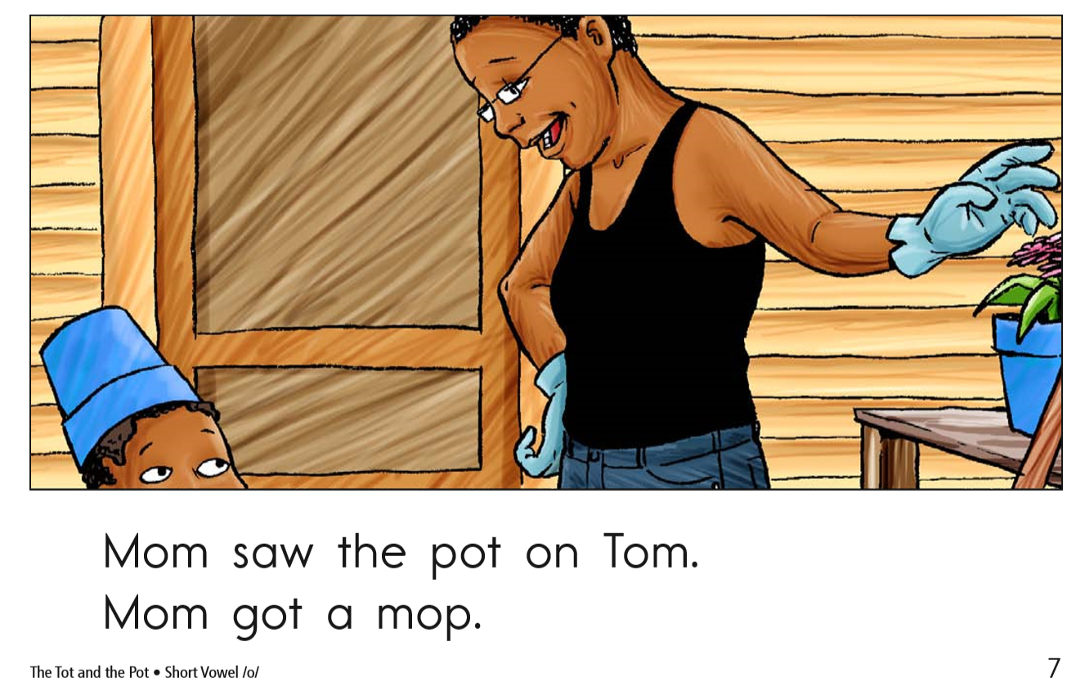

Slide 64
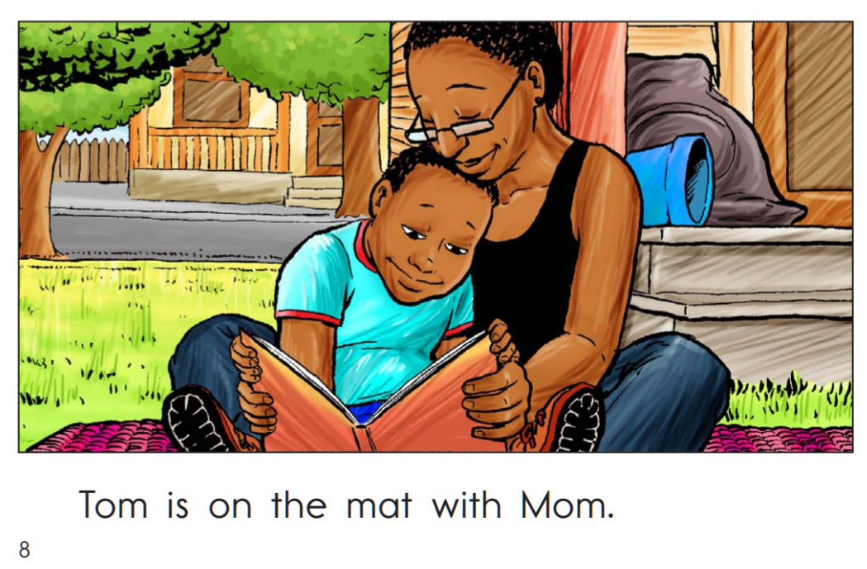

Slide 65
Kindergarten Sample Schedule
Stay in my area.
Follow directions the first time.
☺
Have fun!

Slide 66
You did it!
Insert reinforcing activity

