Slide 1
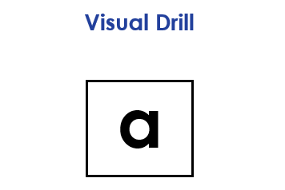
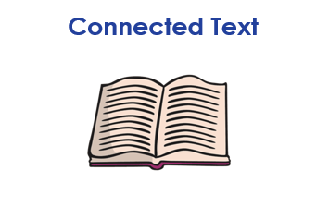
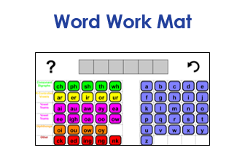
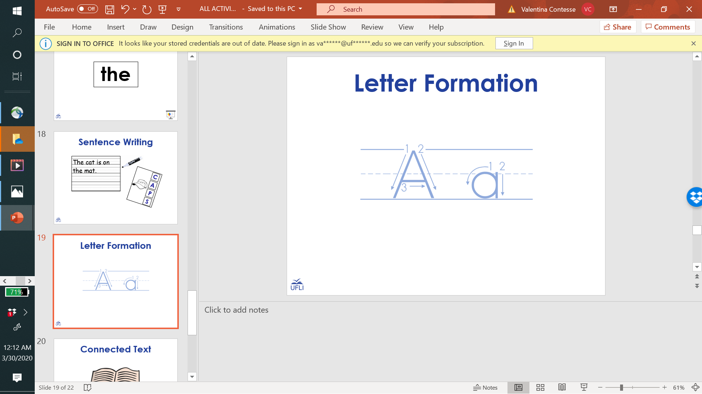

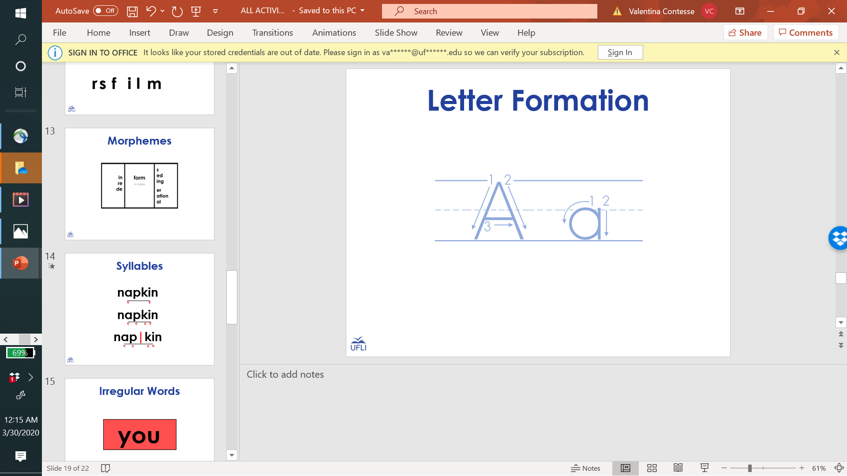

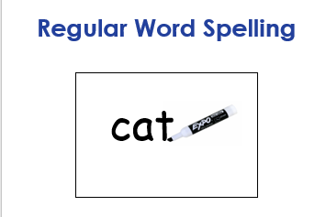
4th Grade Sample Schedule
Stay in my area.
Follow directions the first time.
☺
Have fun!

Slide 2

Visual Drill
a

Slide 3
Open Syllables

Slide 4
co

Slide 5
fi

Slide 6
de

Slide 7
hu

Slide 8
mo

Slide 9
cu

Slide 10
se

Slide 11
ba

Slide 12
do

Slide 13
va

Slide 14
pro

Slide 15
la

Slide 16
na

Slide 17
si

Slide 18
ti

Slide 19
hi

Slide 20
to

Slide 21
vi

Slide 22

4th Grade Sample Schedule
Stay in my area.
Follow directions the first time.
☺
Have fun!

Slide 23
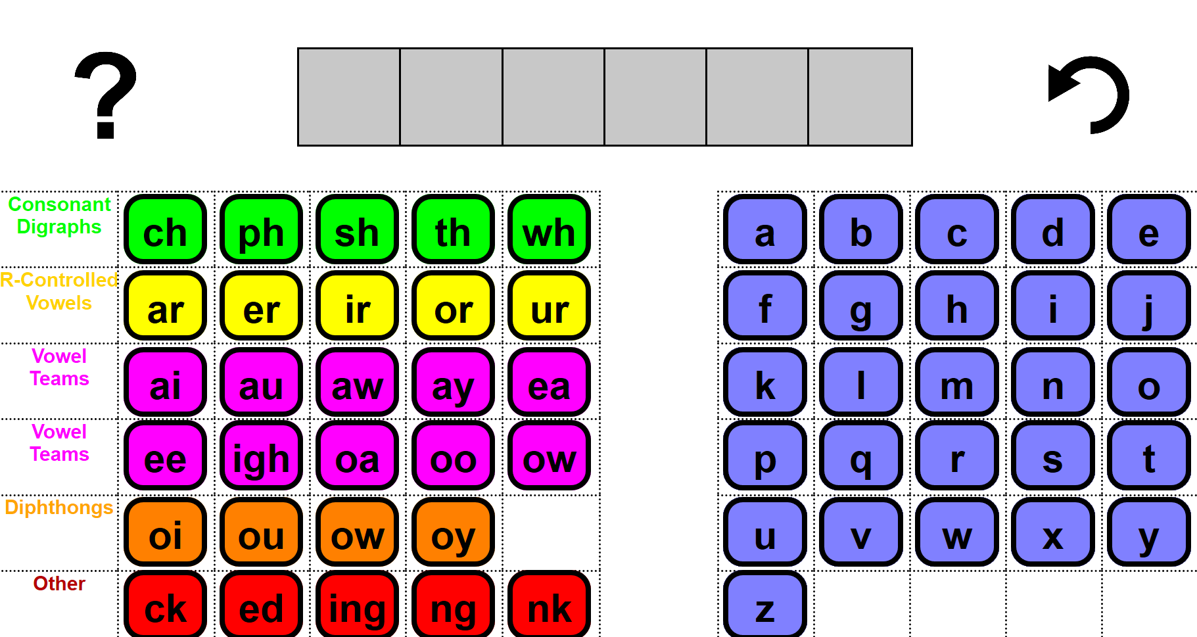
Word Work Mat
Notes:
https://research.dwi.ufl.edu/op.n/file/gc8nkxns914enc7d/embed?fbclid=IwAR1OiYiB6fERCg-3wSWOPc0QZh4cmzyZ7wdO7f__fU2c4trzyanvj1xebko

Slide 24
4th Grade Sample Schedule
Stay in my area.
Follow directions the first time.
☺
Have fun!

Slide 25
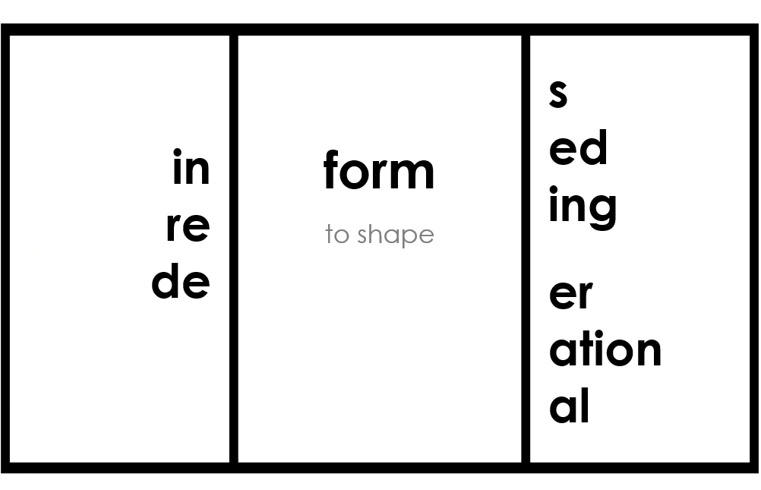
Morphemes

Slide 26

in
re
s
ed
ing
spect
to see, watch or observe
er, or
ion
able
ive
sus (under)
Notes:
spect is a bound morpheme meaning to see, watch or observe
inspect, respect, suspect, inspects, inspected, inspecting, inspector, inspection*, respects, respected, respecting, respecter, respectable, respective, suspects, suspected, suspecting, suspicion*

Slide 27
4th Grade Sample Schedule
Stay in my area.
Follow directions the first time.
☺
Have fun!

Slide 28

Regular Word Spelling
cat
Notes:
Options:
Students use whiteboard.
Students use “Whiteboard” screen sharing and “Annotate” options on videoconferencing platform.
Students use paper and writing tool.

Slide 29
4th Grade Sample Schedule
Stay in my area.
Follow directions the first time.
☺
Have fun!

Slide 30

Connected Text

Slide 31
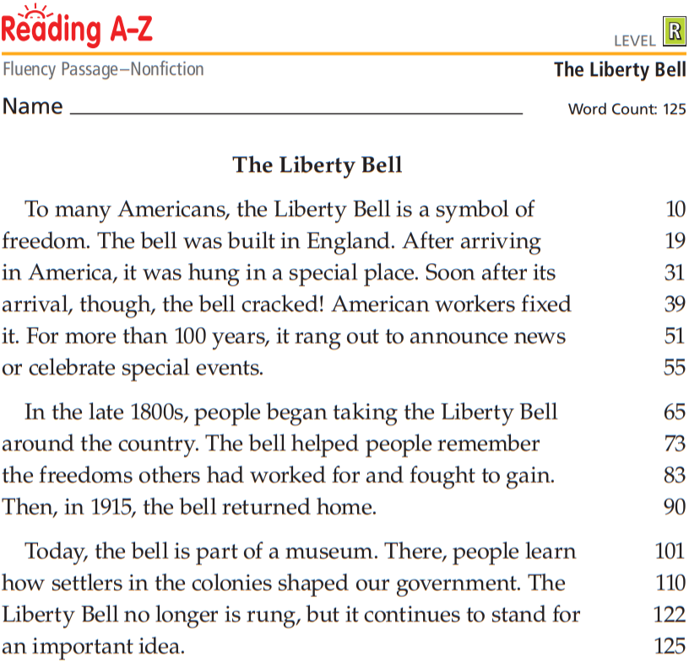
Notes:
One student reads aloud; other students can have a 1-minute doodle break or read with muted microphone
Use Teacher version to score

Slide 32
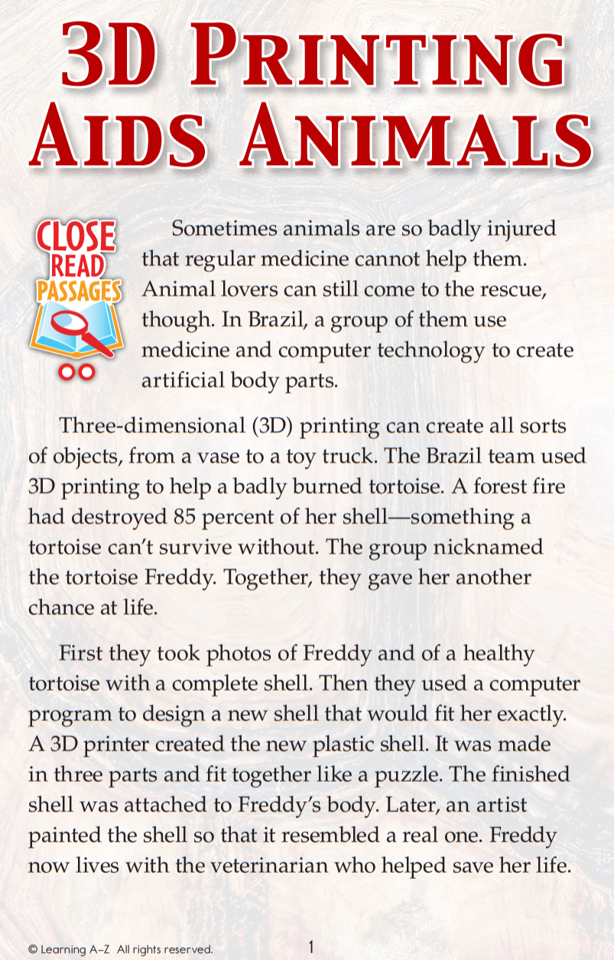

Slide 33
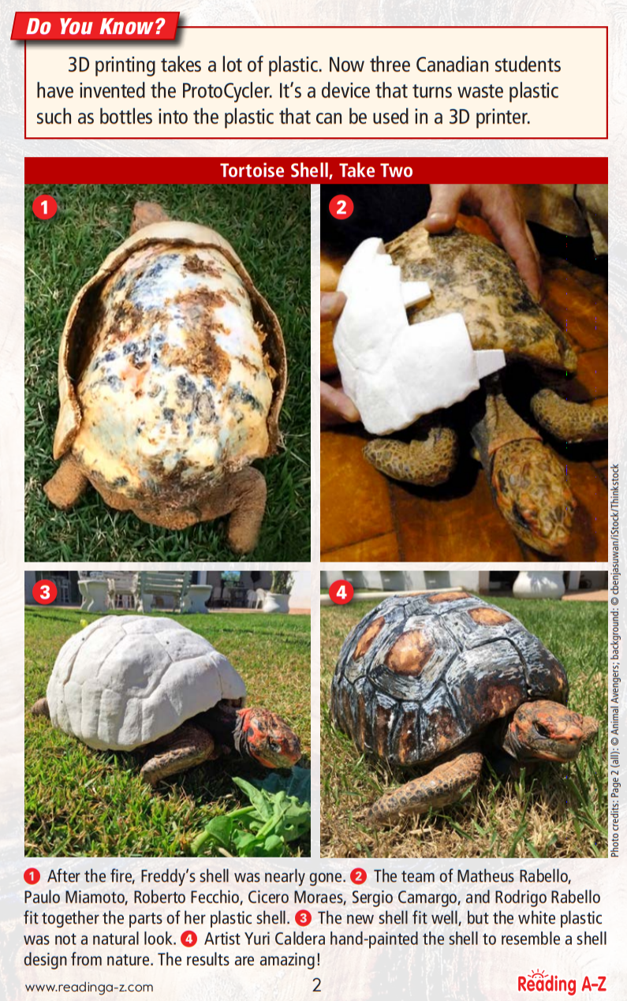

Slide 34
4th Grade Sample Schedule
Stay in my area.
Follow directions the first time.
☺
Have fun!

Slide 35
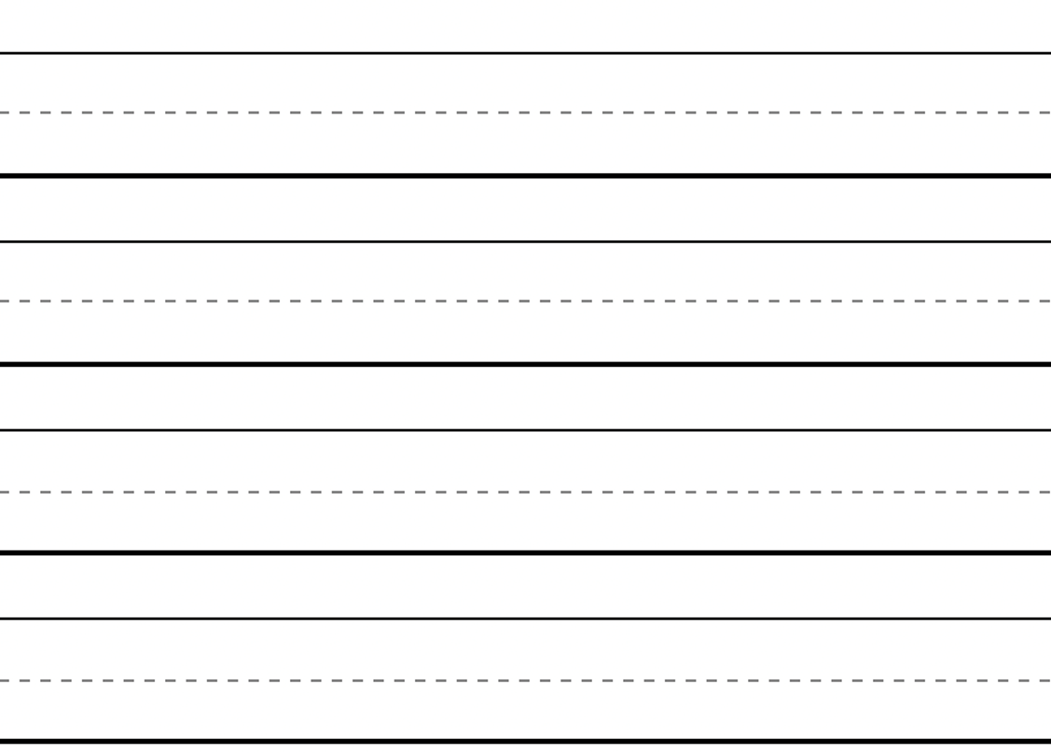
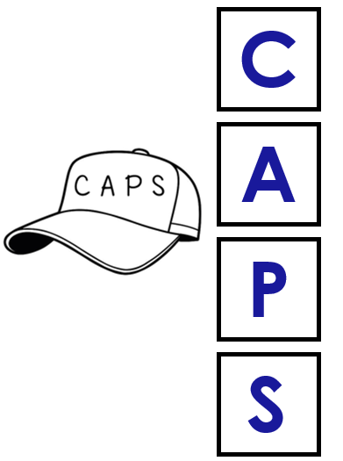
Sentence Writing
The cat is on
the mat.

Slide 36
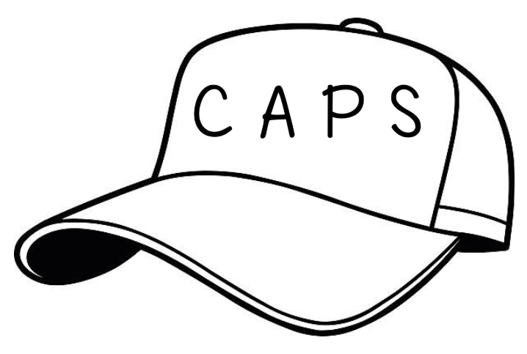
C
Capitalization
The dog runs.
A
Appearance
My sentence looks great!
P
Punctuation
. ? !
S
Spelling

Slide 37
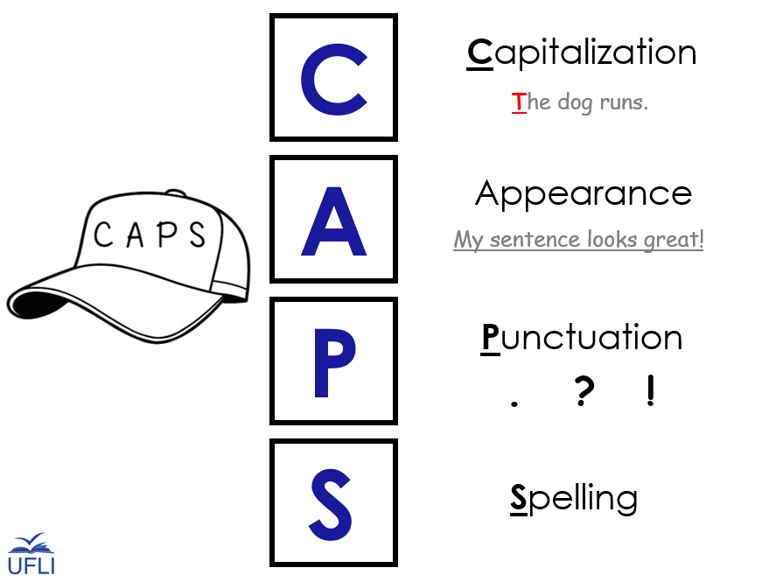

Slide 38
4th Grade Sample Schedule
Stay in my area.
Follow directions the first time.
☺
Have fun!

Slide 39
You did it!
Insert reinforcing activity

