Slide 1
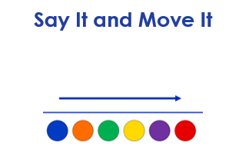
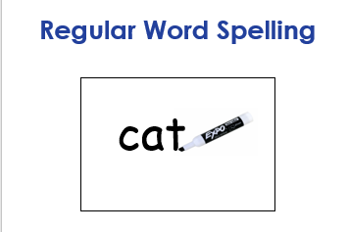
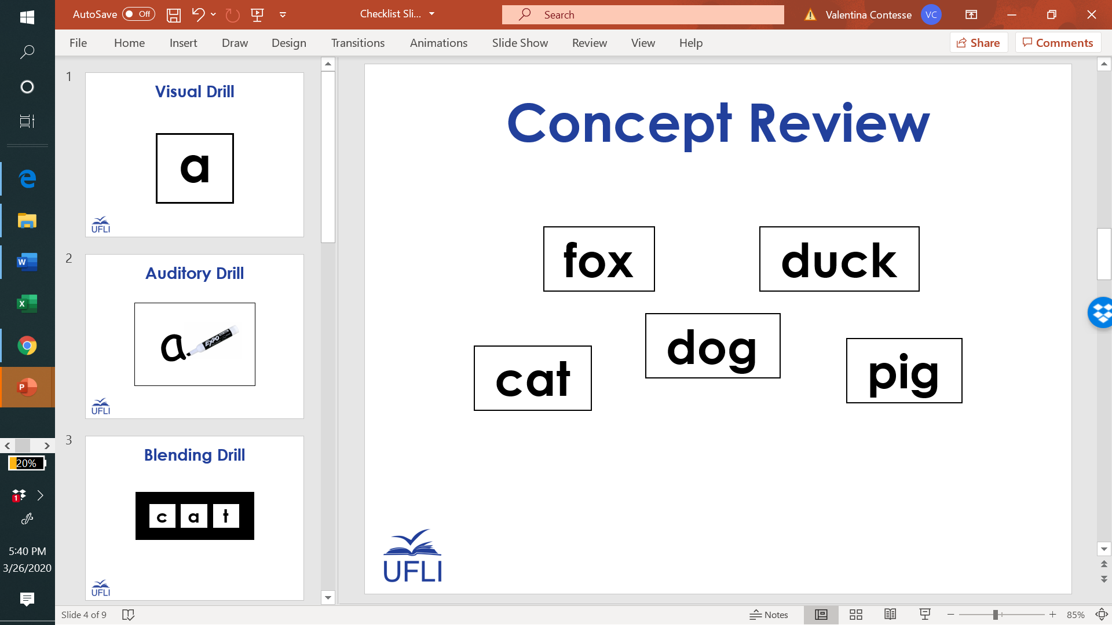
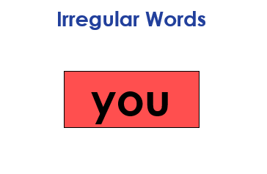

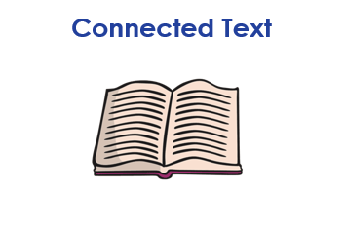

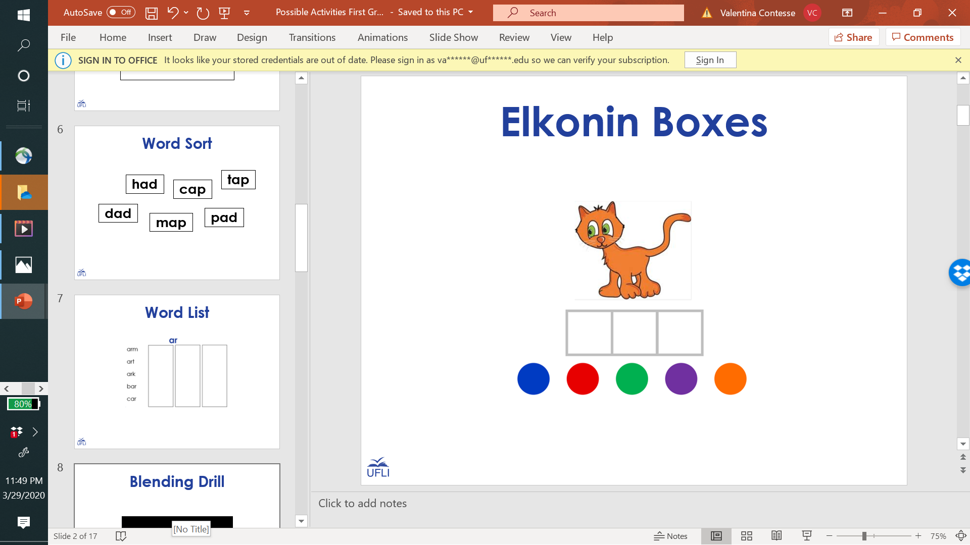
1st Grade Sample Schedule
Stay in my area.
Follow directions the first time.
☺
Have fun!

Slide 2
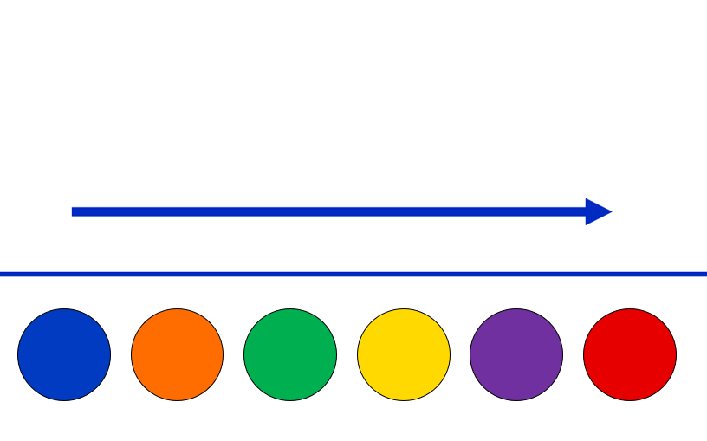
Say It and Move It

Slide 3
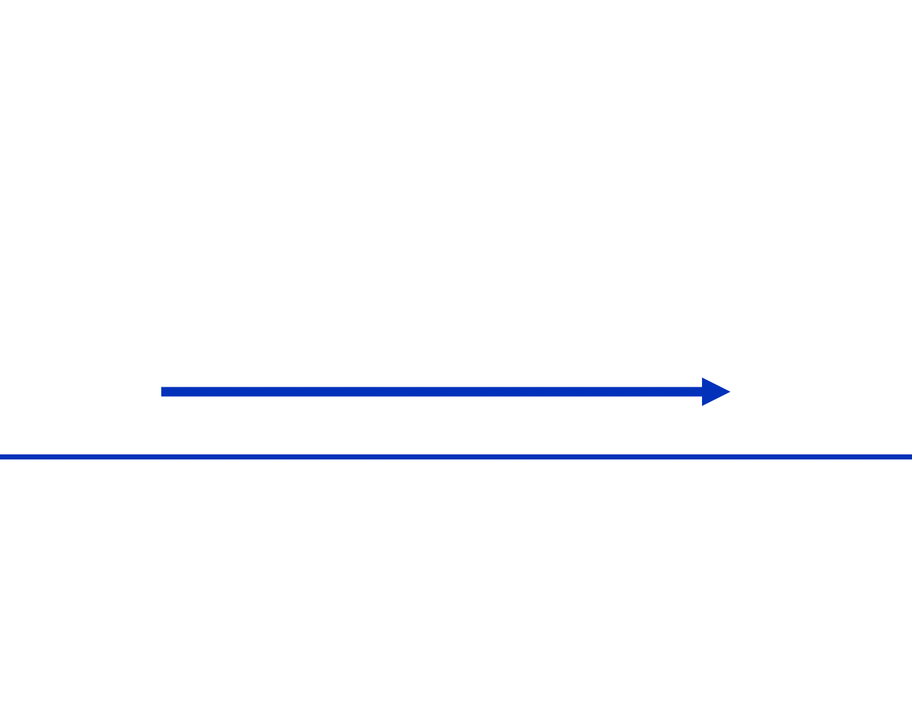
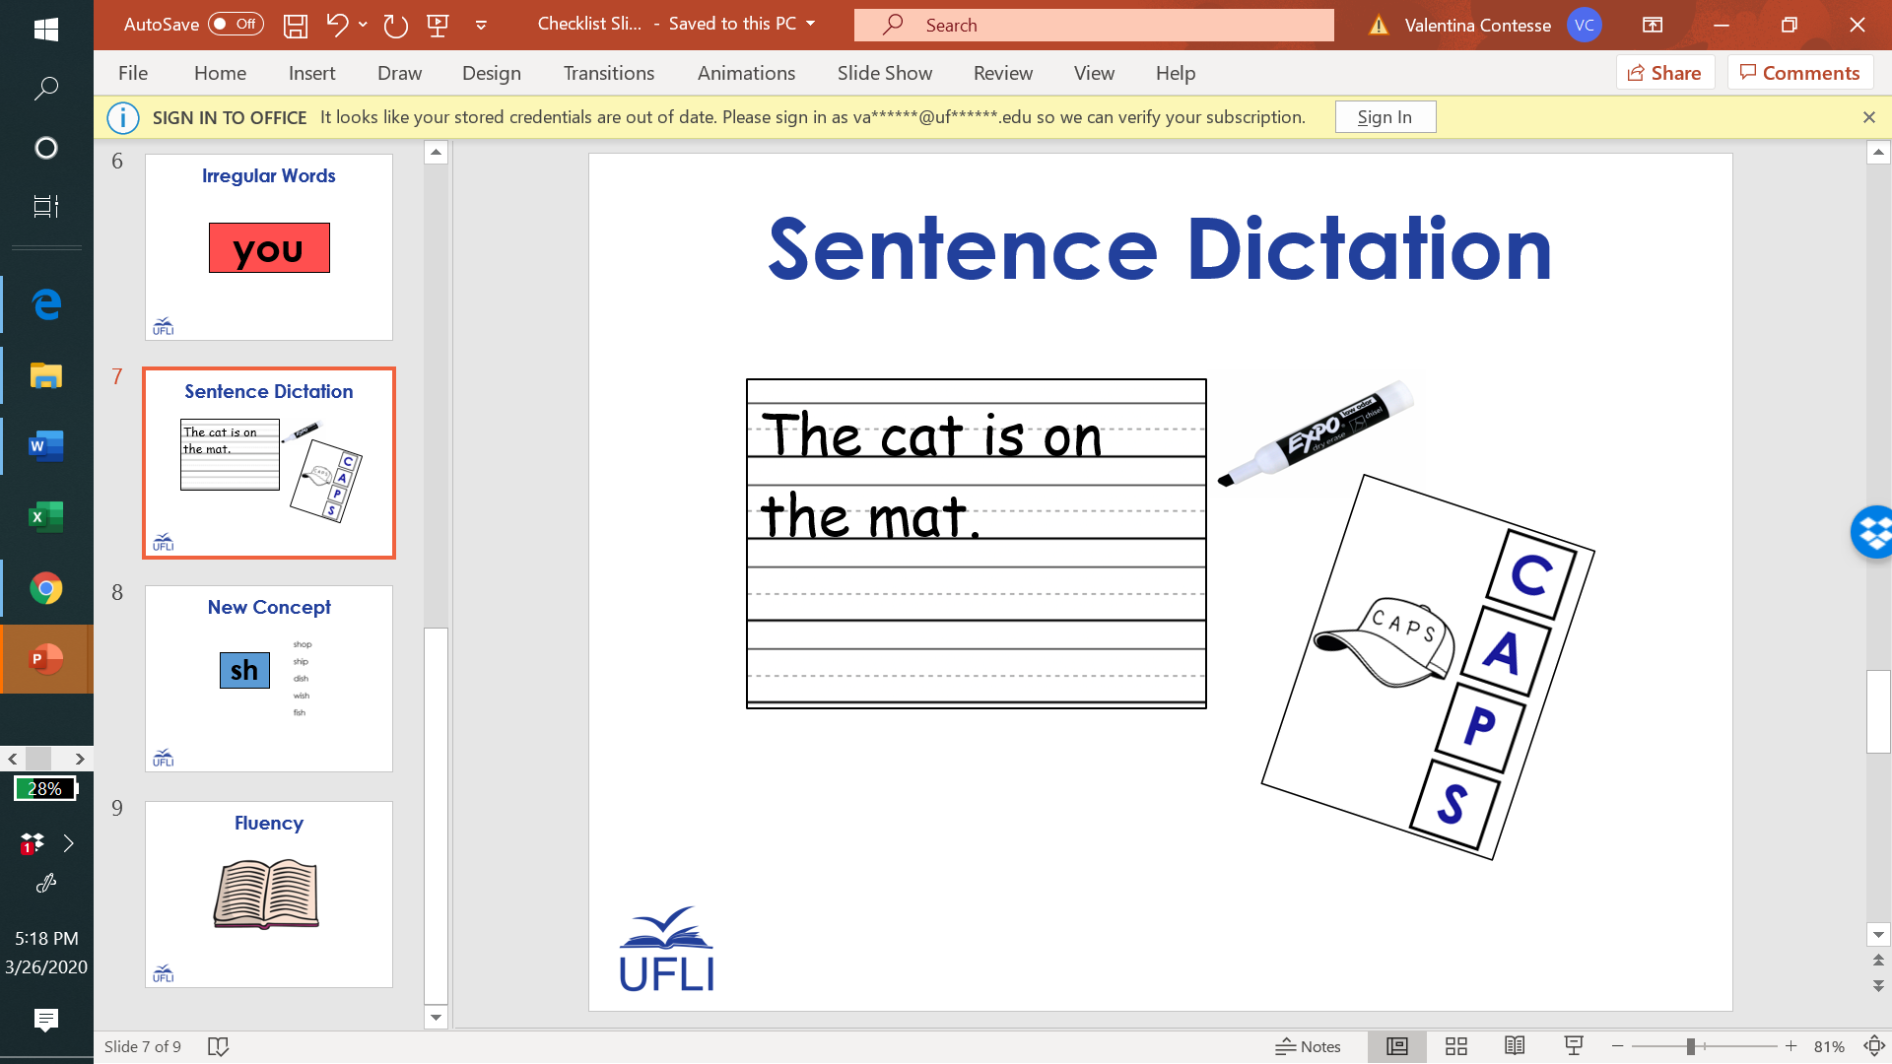

Slide 4

1st Grade Sample Schedule
Stay in my area.
Follow directions the first time.
☺
Have fun!

Slide 5

Visual Drill
a

Slide 6
e

Slide 7
sh

Slide 8
g

Slide 9
u

Slide 10
ar

Slide 11
ch

Slide 12
i

Slide 13
b

Slide 14
o

Slide 15
ir

Slide 16
a

Slide 17
w

Slide 18
or

Slide 19
d

Slide 20
th
2

Slide 21
y

Slide 22
ph

Slide 23
ur

Slide 24
qu

Slide 25
er

Slide 26
1st Grade Sample Schedule
Stay in my area.
Follow directions the first time.
☺
Have fun!

Slide 27
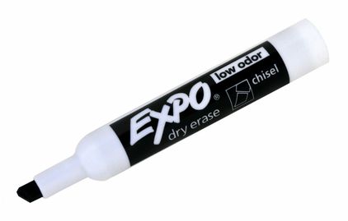
Auditory Drill
a
Notes:
Options:
Students use whiteboard.
Students use “Whiteboard” screen sharing and “Annotate” options on videoconferencing platform.
Students use paper and writing tool.

Slide 28
1st Grade Sample Schedule
Stay in my area.
Follow directions the first time.
☺
Have fun!

Slide 29
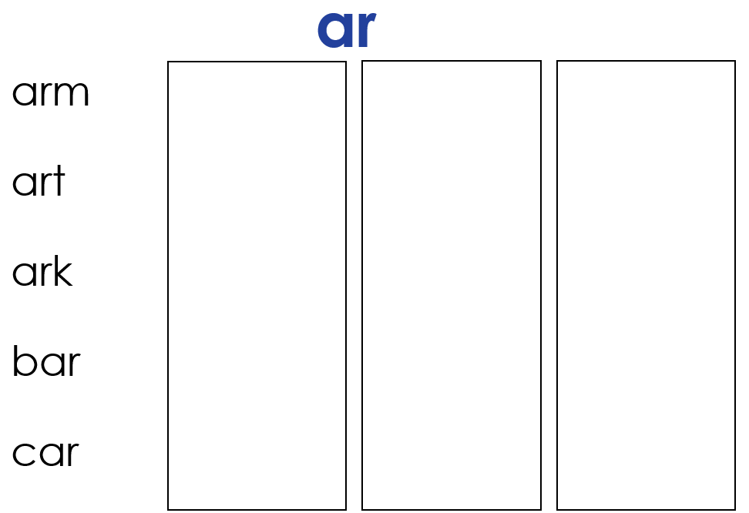
Word List

Slide 30
ai

Slide 31
ai
ai
Notes:
Visuals to review

Slide 32
ai- /ā/
aid
ail
aim
paint
train
bail
bait
brain
jail
strain
pail
trail
chain
claim
faint
fail
grain
mail
sprain
braid

Slide 33
1st Grade Sample Schedule
Stay in my area.
Follow directions the first time.
☺
Have fun!

Slide 34
Regular Word Spelling
cat
Notes:
Options:
Students use whiteboard.
Students use “Whiteboard” screen sharing and “Annotate” options on videoconferencing platform.
Students use paper and writing tool.

Slide 35
1st Grade Sample Schedule
Stay in my area.
Follow directions the first time.
☺
Have fun!

Slide 36
Irregular Words
you
Notes:
Can use any graphemes students are working on (individual letters, consonant digraphs, vowel teams, diphthongs, etc.)

Slide 37
very

Slide 38
where

Slide 39
give

Slide 40
four

Slide 41
have

Slide 42
live

Slide 43
work

Slide 44
fourth

Slide 45
word

Slide 46
world

Slide 47
forty

Slide 48
once
Notes:
New

Slide 49
today
Notes:
New

Slide 50
does
Notes:
New

Slide 51
1st Grade Sample Schedule
Stay in my area.
Follow directions the first time.
☺
Have fun!

Slide 52

Connected Text

Slide 53
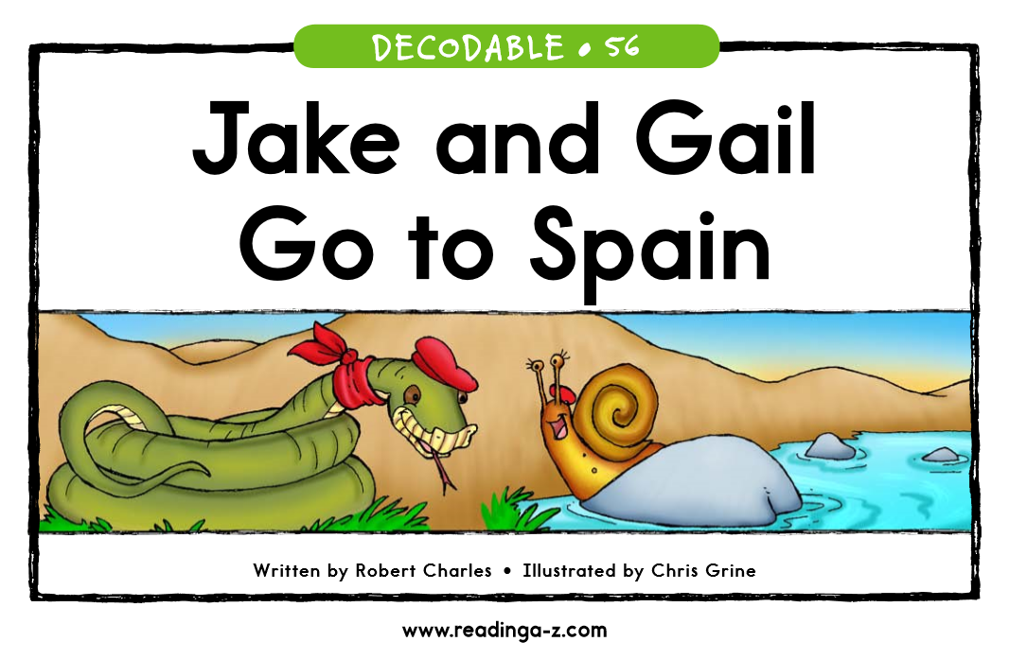

Slide 54
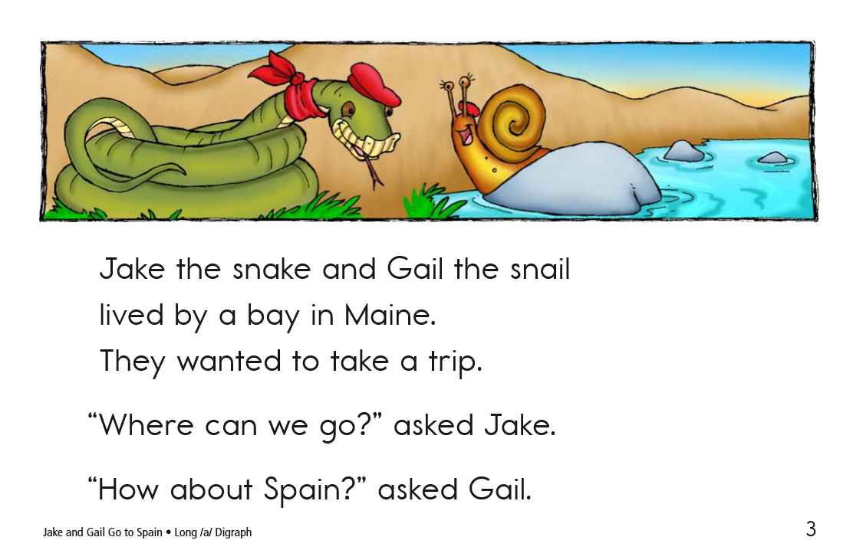

Slide 55
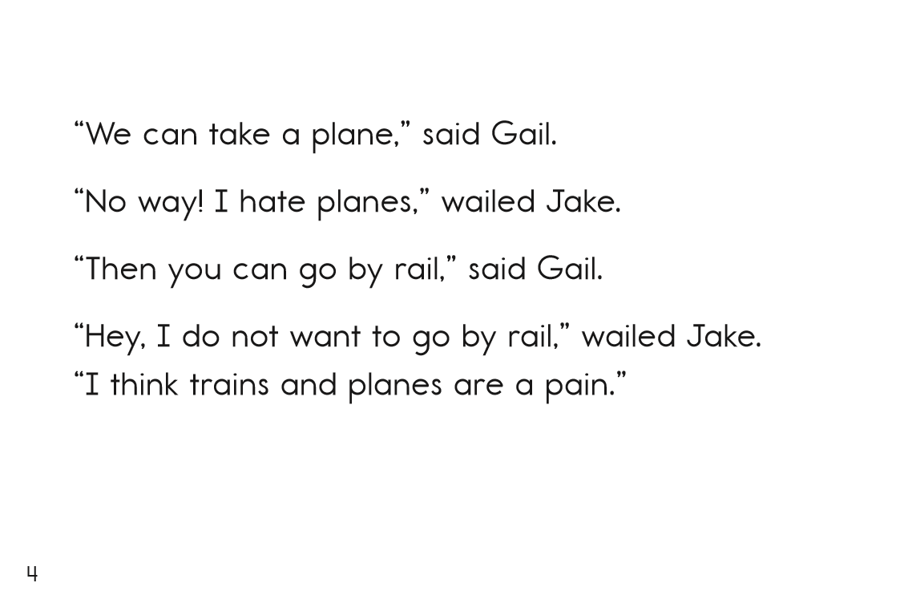

Slide 56
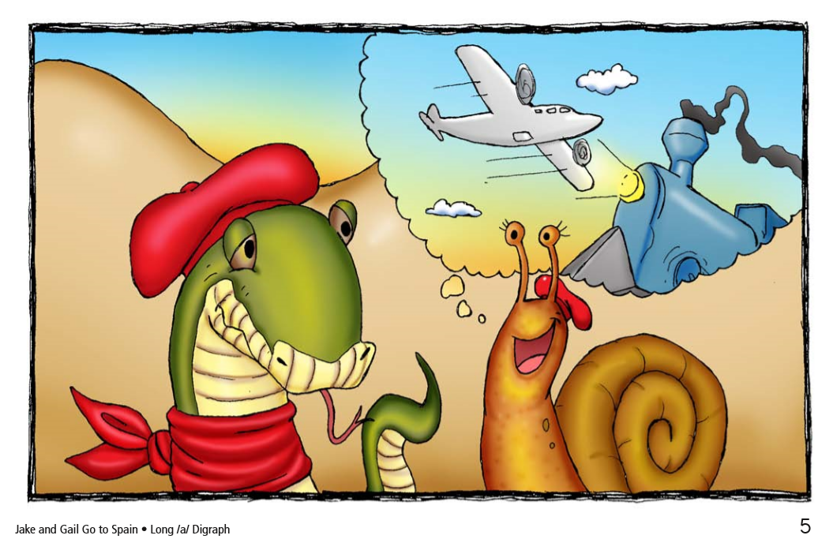

Slide 57
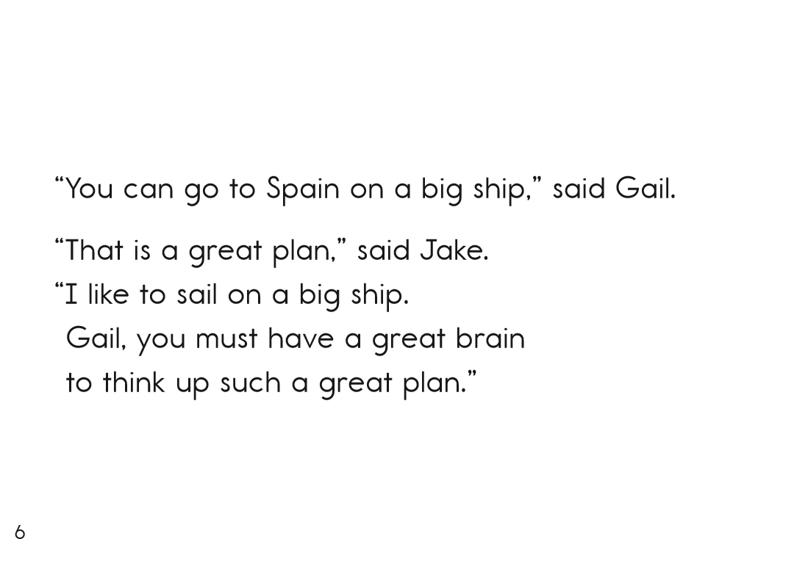

Slide 58
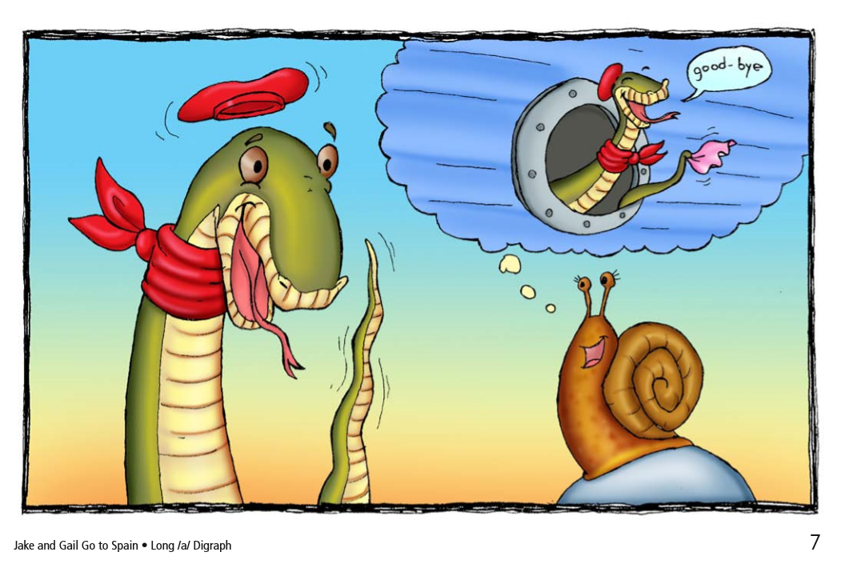

Slide 59
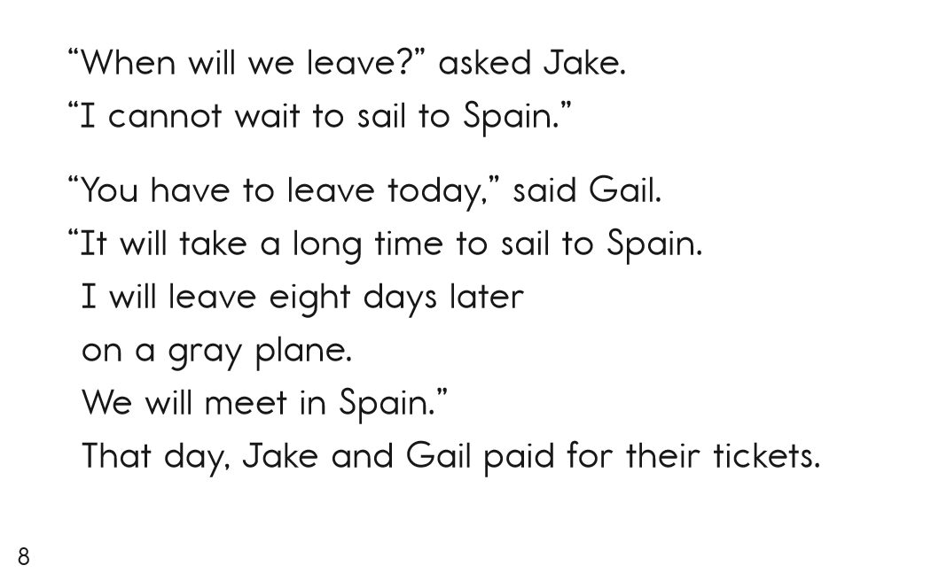

Slide 60
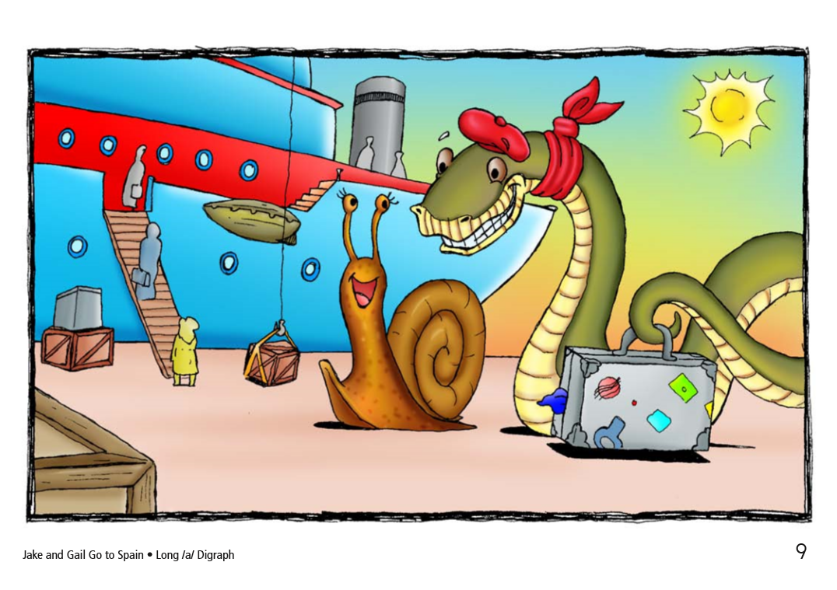

Slide 61
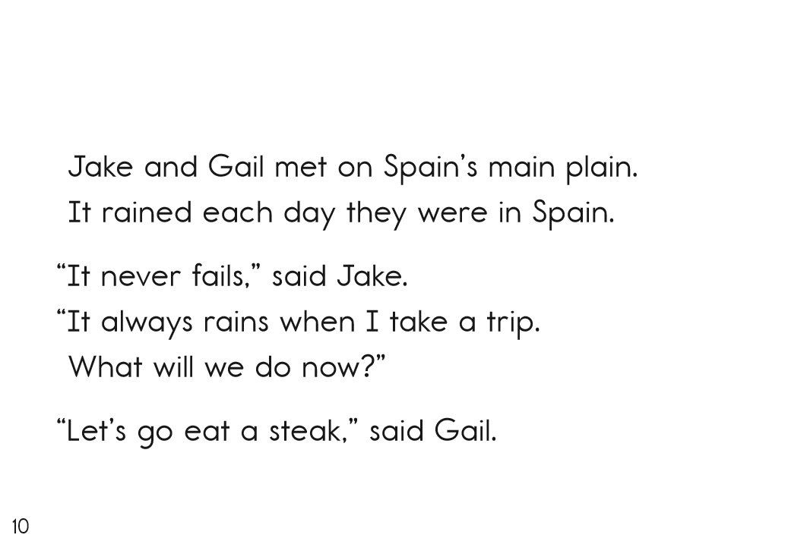

Slide 62
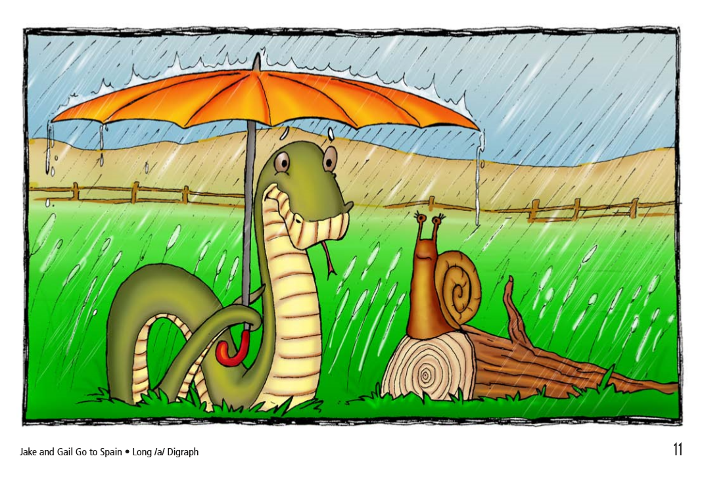

Slide 63
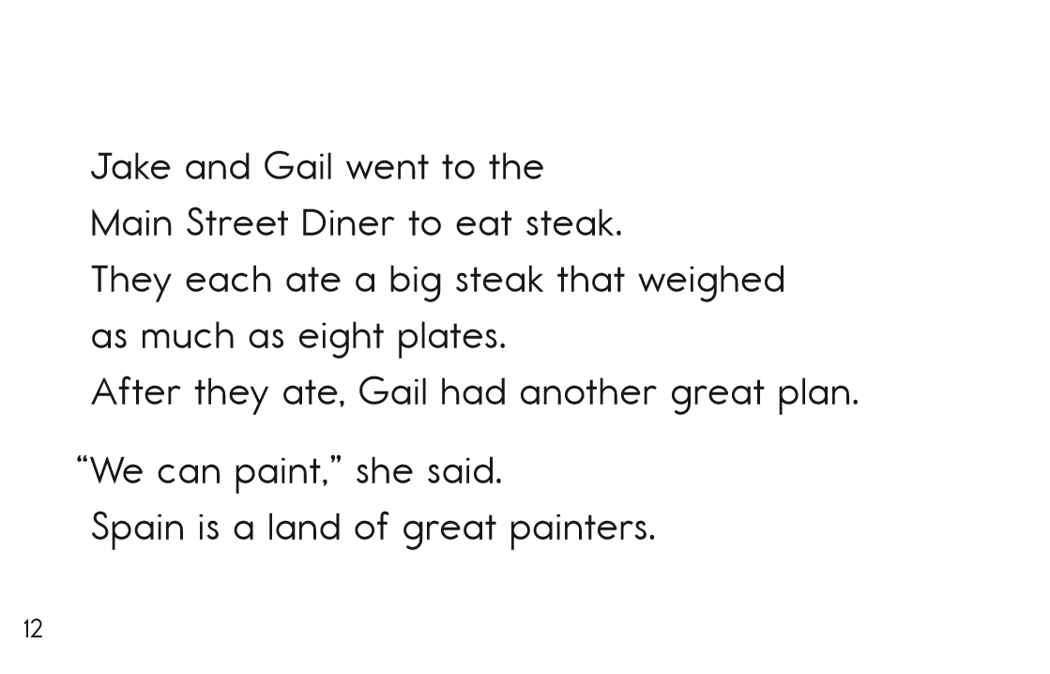

Slide 64
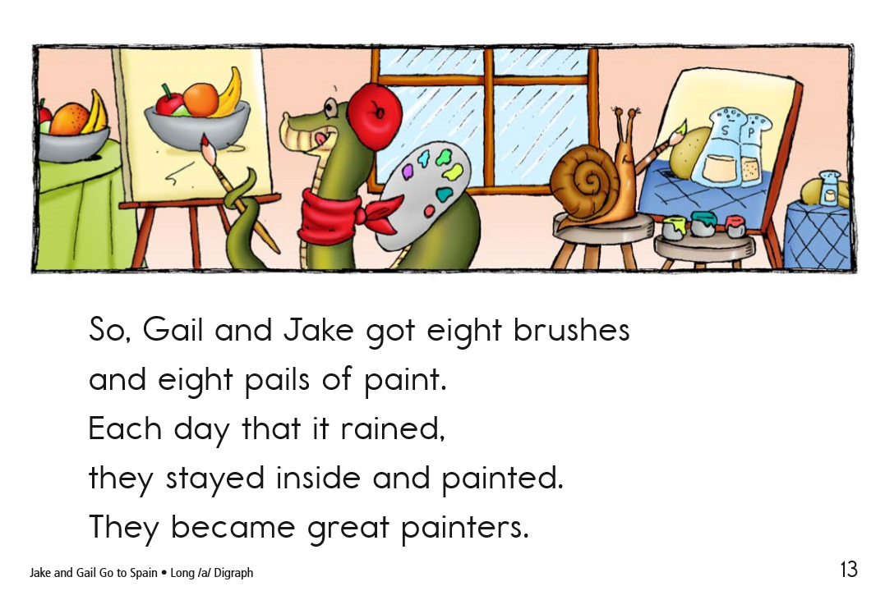

Slide 65
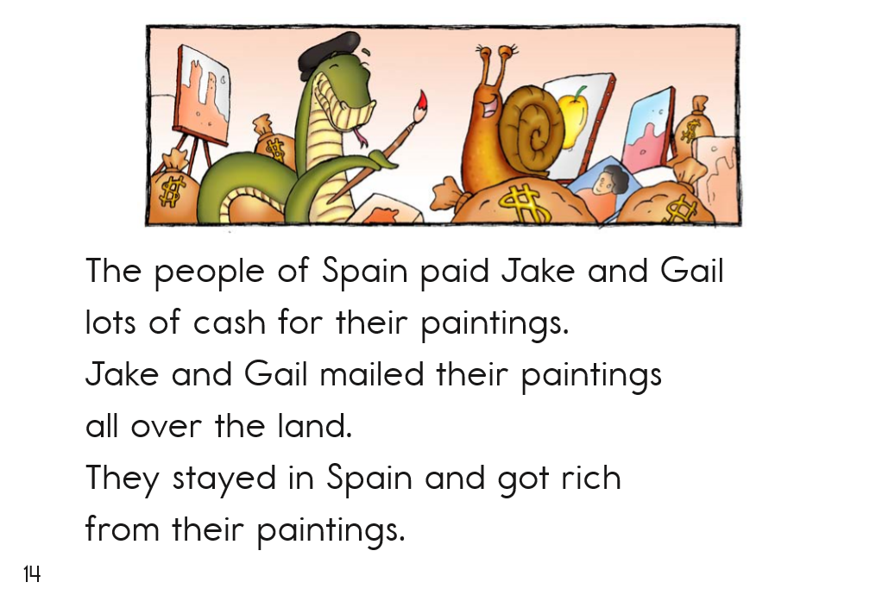

Slide 66
1st Grade Sample Schedule
Stay in my area.
Follow directions the first time.
☺
Have fun!

Slide 67
You did it!
Insert reinforcing activity

