Slide 1
5th Grade Sample Schedule
Stay in my area.
Follow directions the first time.
☺
Have fun!

Slide 2
Visual Drill
a

Slide 3
Morphemes – Prefixes

Slide 4
un

Slide 5
re

Slide 6
in

Slide 7
im

Slide 8
dis

Slide 9
en

Slide 10
em

Slide 11
non

Slide 12
over

Slide 13
mis

Slide 14
sub

Slide 15
pre

Slide 16
inter

Slide 17
fore

Slide 18
de

Slide 19
trans

Slide 20
super

Slide 21
semi

Slide 22
anti

Slide 23
mid

Slide 24
under

Slide 25
5th Grade Sample Schedule
Stay in my area.
Follow directions the first time.
☺
Have fun!

Slide 26
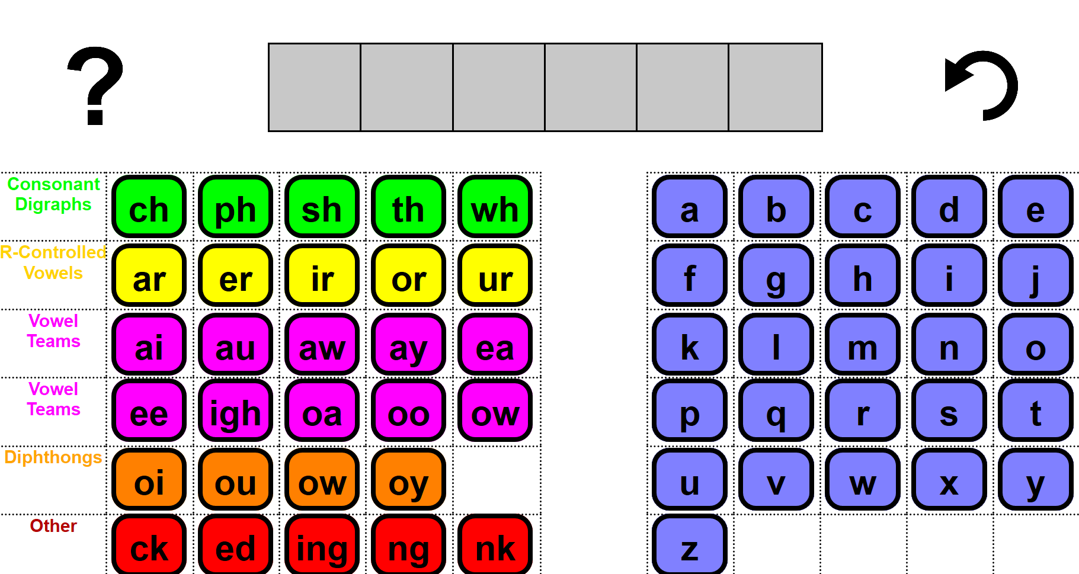
Word Work Mat
Notes:
https://research.dwi.ufl.edu/op.n/file/gc8nkxns914enc7d/embed?fbclid=IwAR1OiYiB6fERCg-3wSWOPc0QZh4cmzyZ7wdO7f__fU2c4trzyanvj1xebko

Slide 27
5th Grade Sample Schedule
Stay in my area.
Follow directions the first time.
☺
Have fun!

Slide 28
Morphemes

Slide 29
bio (life)
chrono(time)
hydro (water)
phono (light)
tele (distant)
thermo (heat)
ic (relating to)
scope
watch or see
Notes:
scope is a Greek morpheme meaning watch or see
bioscope, chronoscope, hydroscope, microscope, phonoscope, telescope, chronoscopic, hydroscopic, microscopic, telescopic (plus endoscope, endoscopic, horoscope, kaleidoscope)

Slide 30
5th Grade Sample Schedule
Stay in my area.
Follow directions the first time.
☺
Have fun!

Slide 31
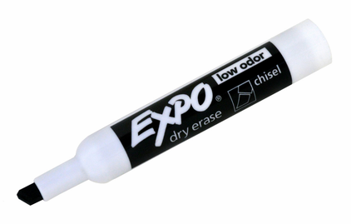
Regular Word Spelling
cat
Notes:
Options:
Students use whiteboard.
Students use “Whiteboard” screen sharing and “Annotate” options on videoconferencing platform.
Students use paper and writing tool.

Slide 32
5th Grade Sample Schedule
Stay in my area.
Follow directions the first time.
☺
Have fun!

Slide 33
Connected Text

Slide 34
Notes:
One student reads aloud; other students can have a 1-minute doodle break or read with muted microphone
Use Teacher version to score

Slide 37
5th Grade Sample Schedule
Stay in my area.
Follow directions the first time.
☺
Have fun!

Slide 38
Sentence Writing
The cat is on
the mat.

Slide 39
C
Capitalization
The dog runs.
A
Appearance
My sentence looks great!
P
Punctuation
. ? !
S
Spelling

Slide 41
5th Grade Sample Schedule
Stay in my area.
Follow directions the first time.
☺
Have fun!

Slide 42
You did it!
Insert reinforcing activity

