Slide 1
Expectations Clipart
It is important to establish and teach positively stated behavioral expectations during your first virtual instruction session. With virtual teaching, it may take longer to teach and practice expectations than in a classroom setting, so be prepared to repeat your explanations and practice expected behaviors a few extra times.
Reviewing and reinforcing behavioral expectations throughout lessons helps students consistently engage in appropriate behaviors.
When establishing your behavioral expectations, you should determine what behaviors will result in high levels of student engagement and a positive virtual learning environment.
These expectations should be clear and as concise as possible.

Slide 2
Expectations Clipart
Some students may benefit from visuals for these expectations. Use this clipart as a visual support when teaching and reviewing expectations throughout your lesson.
Choose/establish what expectations you want to teach/reinforce.
Choose positive language to state these expectations.
Add clipart to support students’ understanding of these expectations (you will need to resize to fit on your slide).

Slide 3






Slide 4

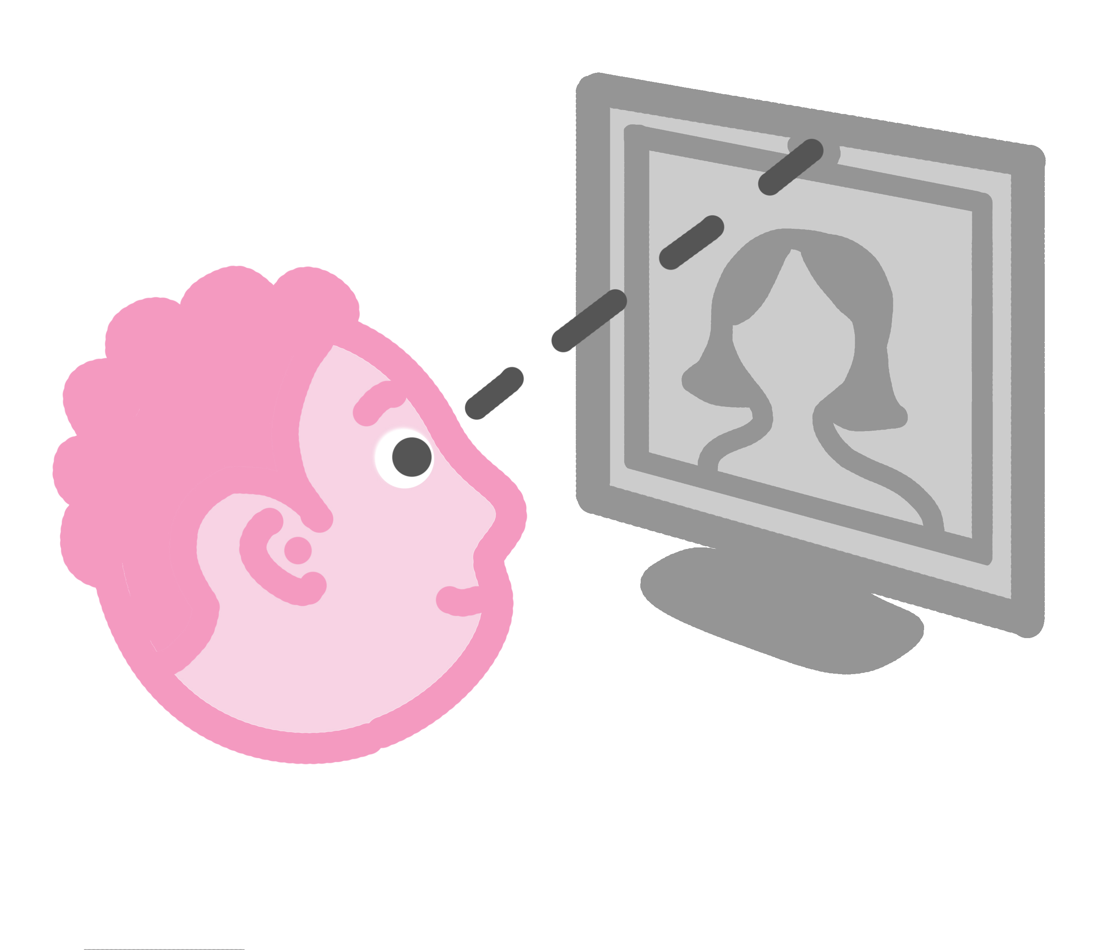
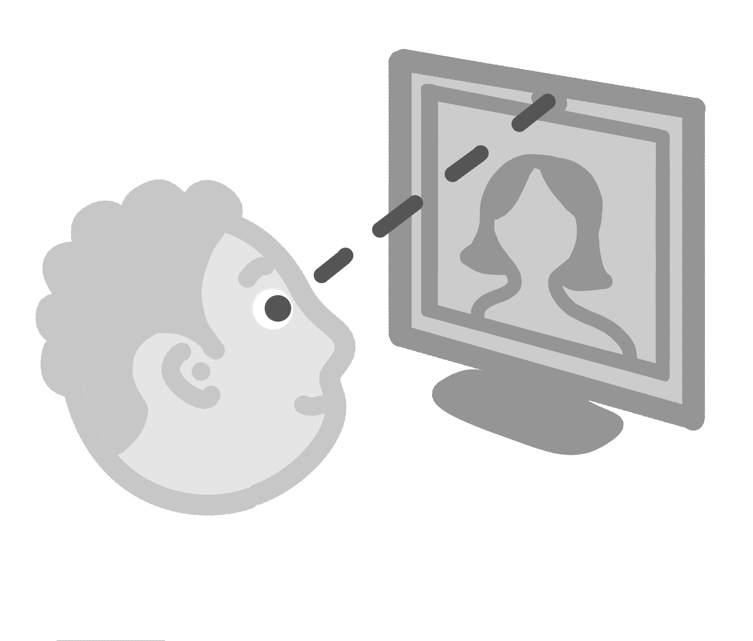
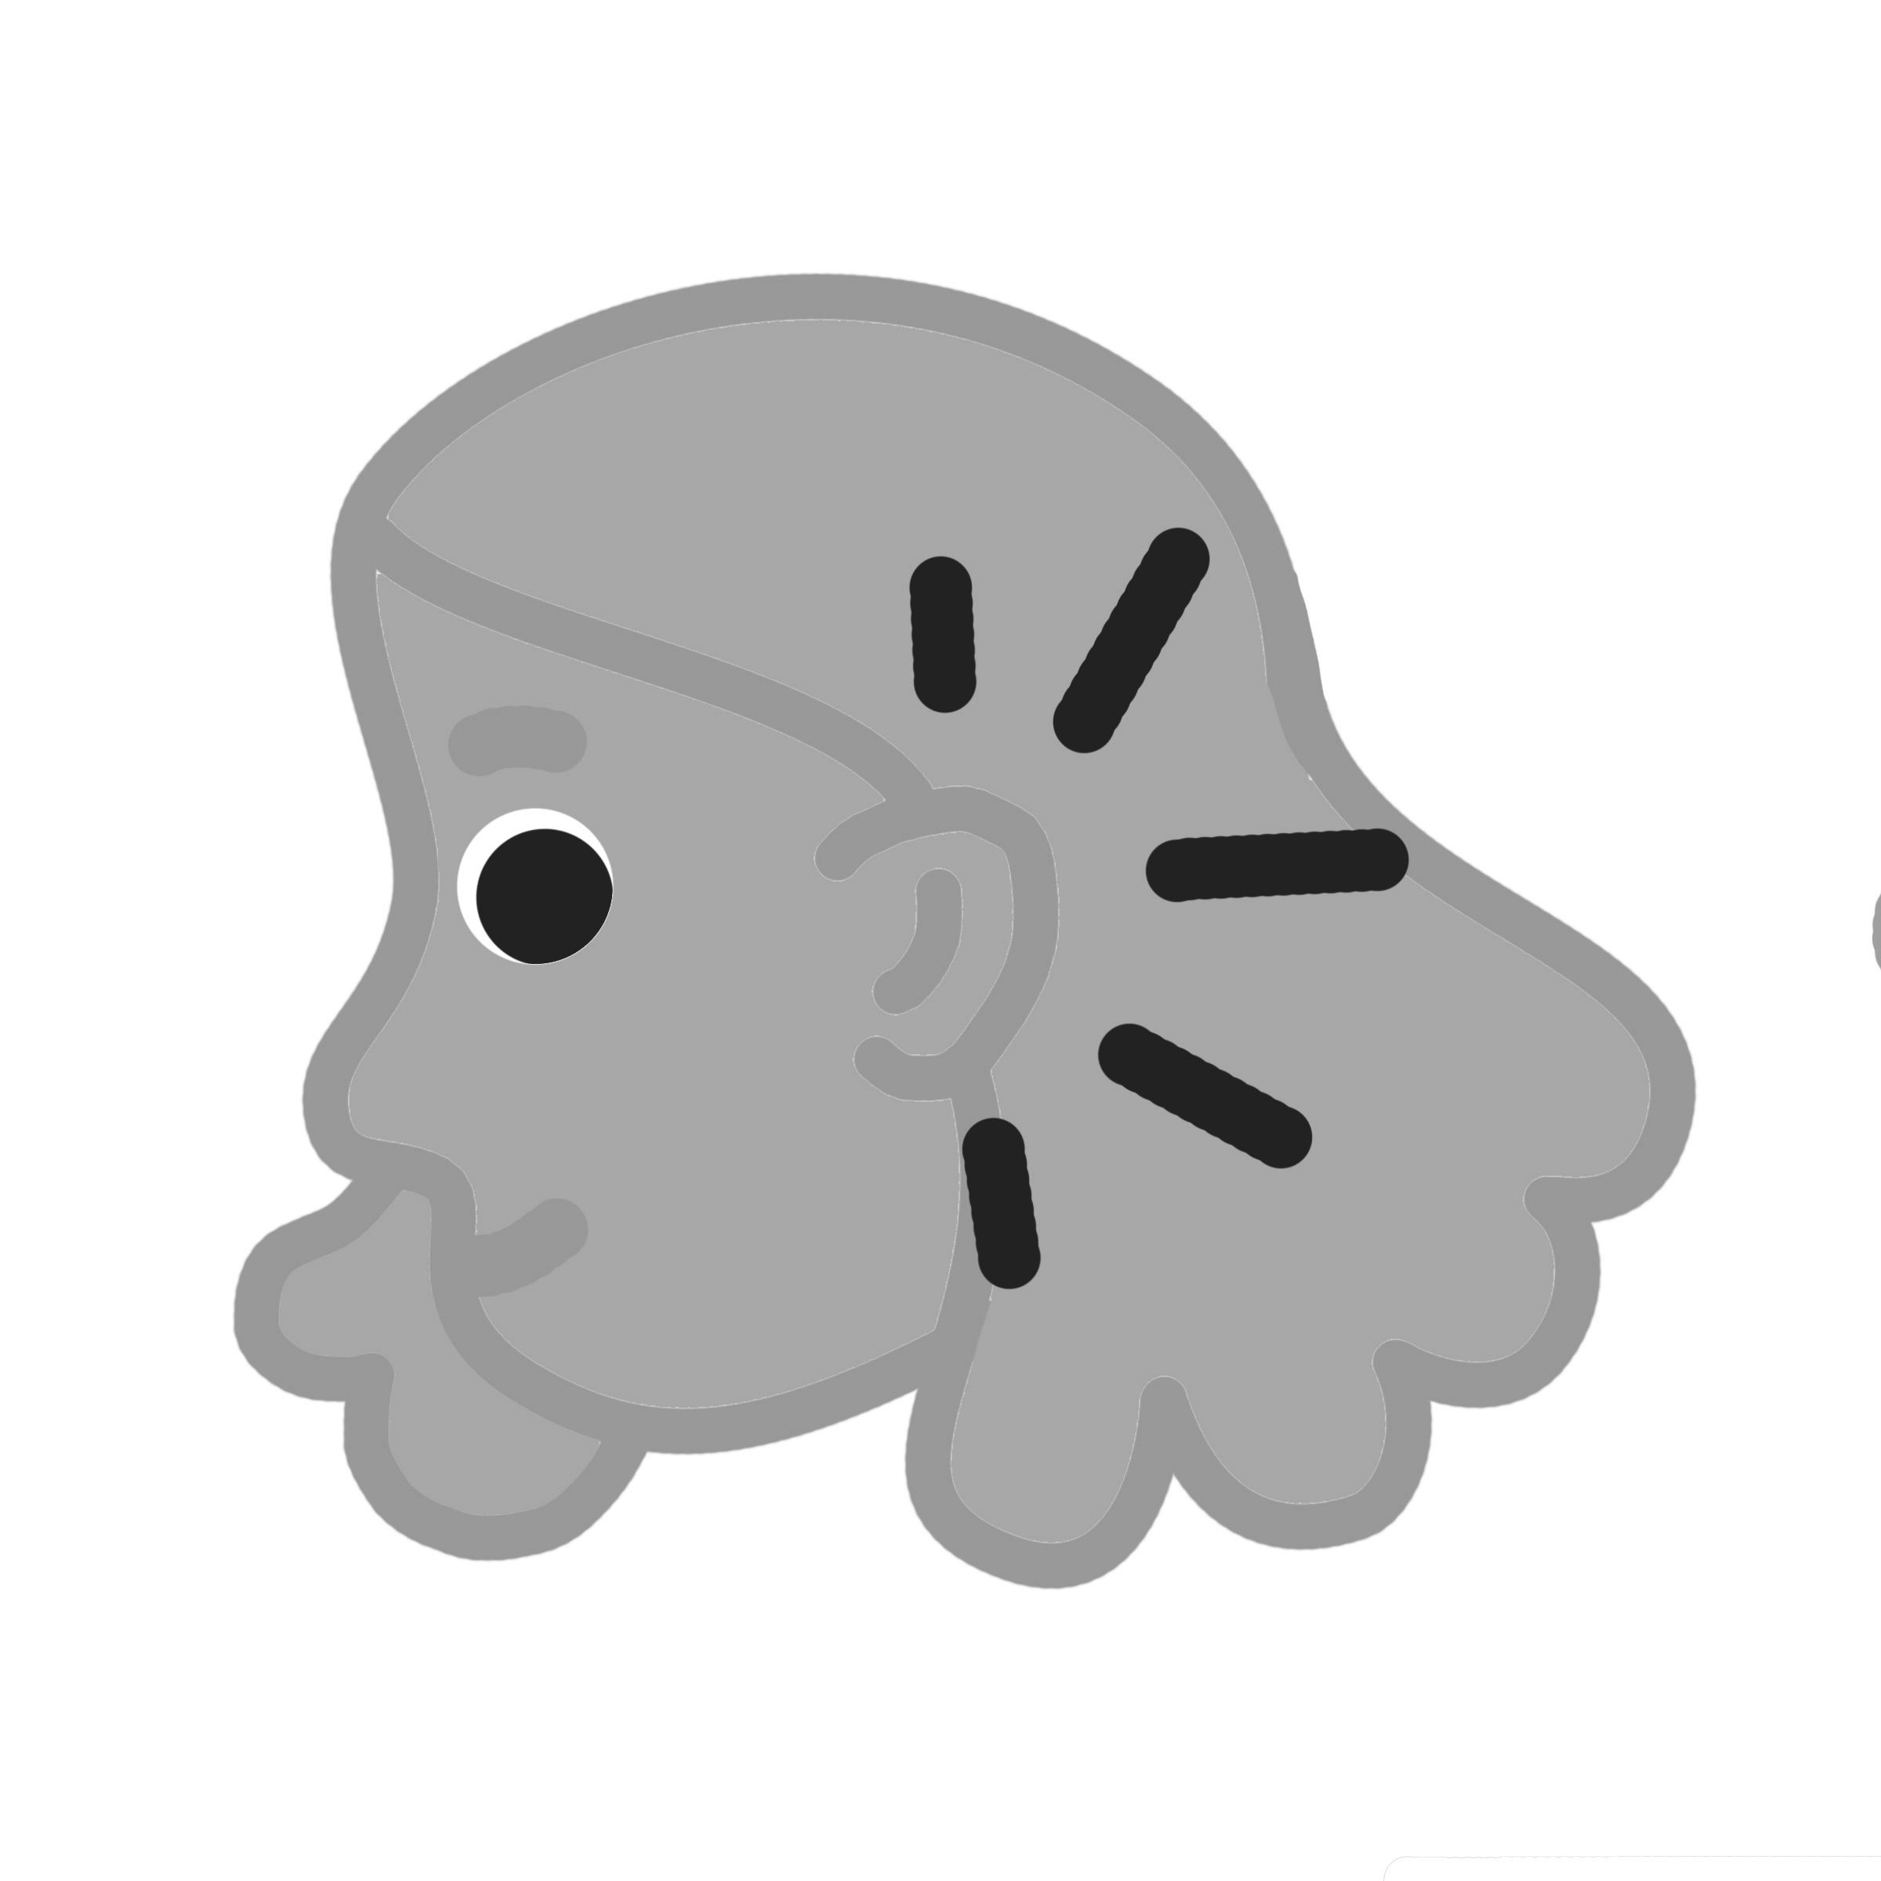

Slide 5
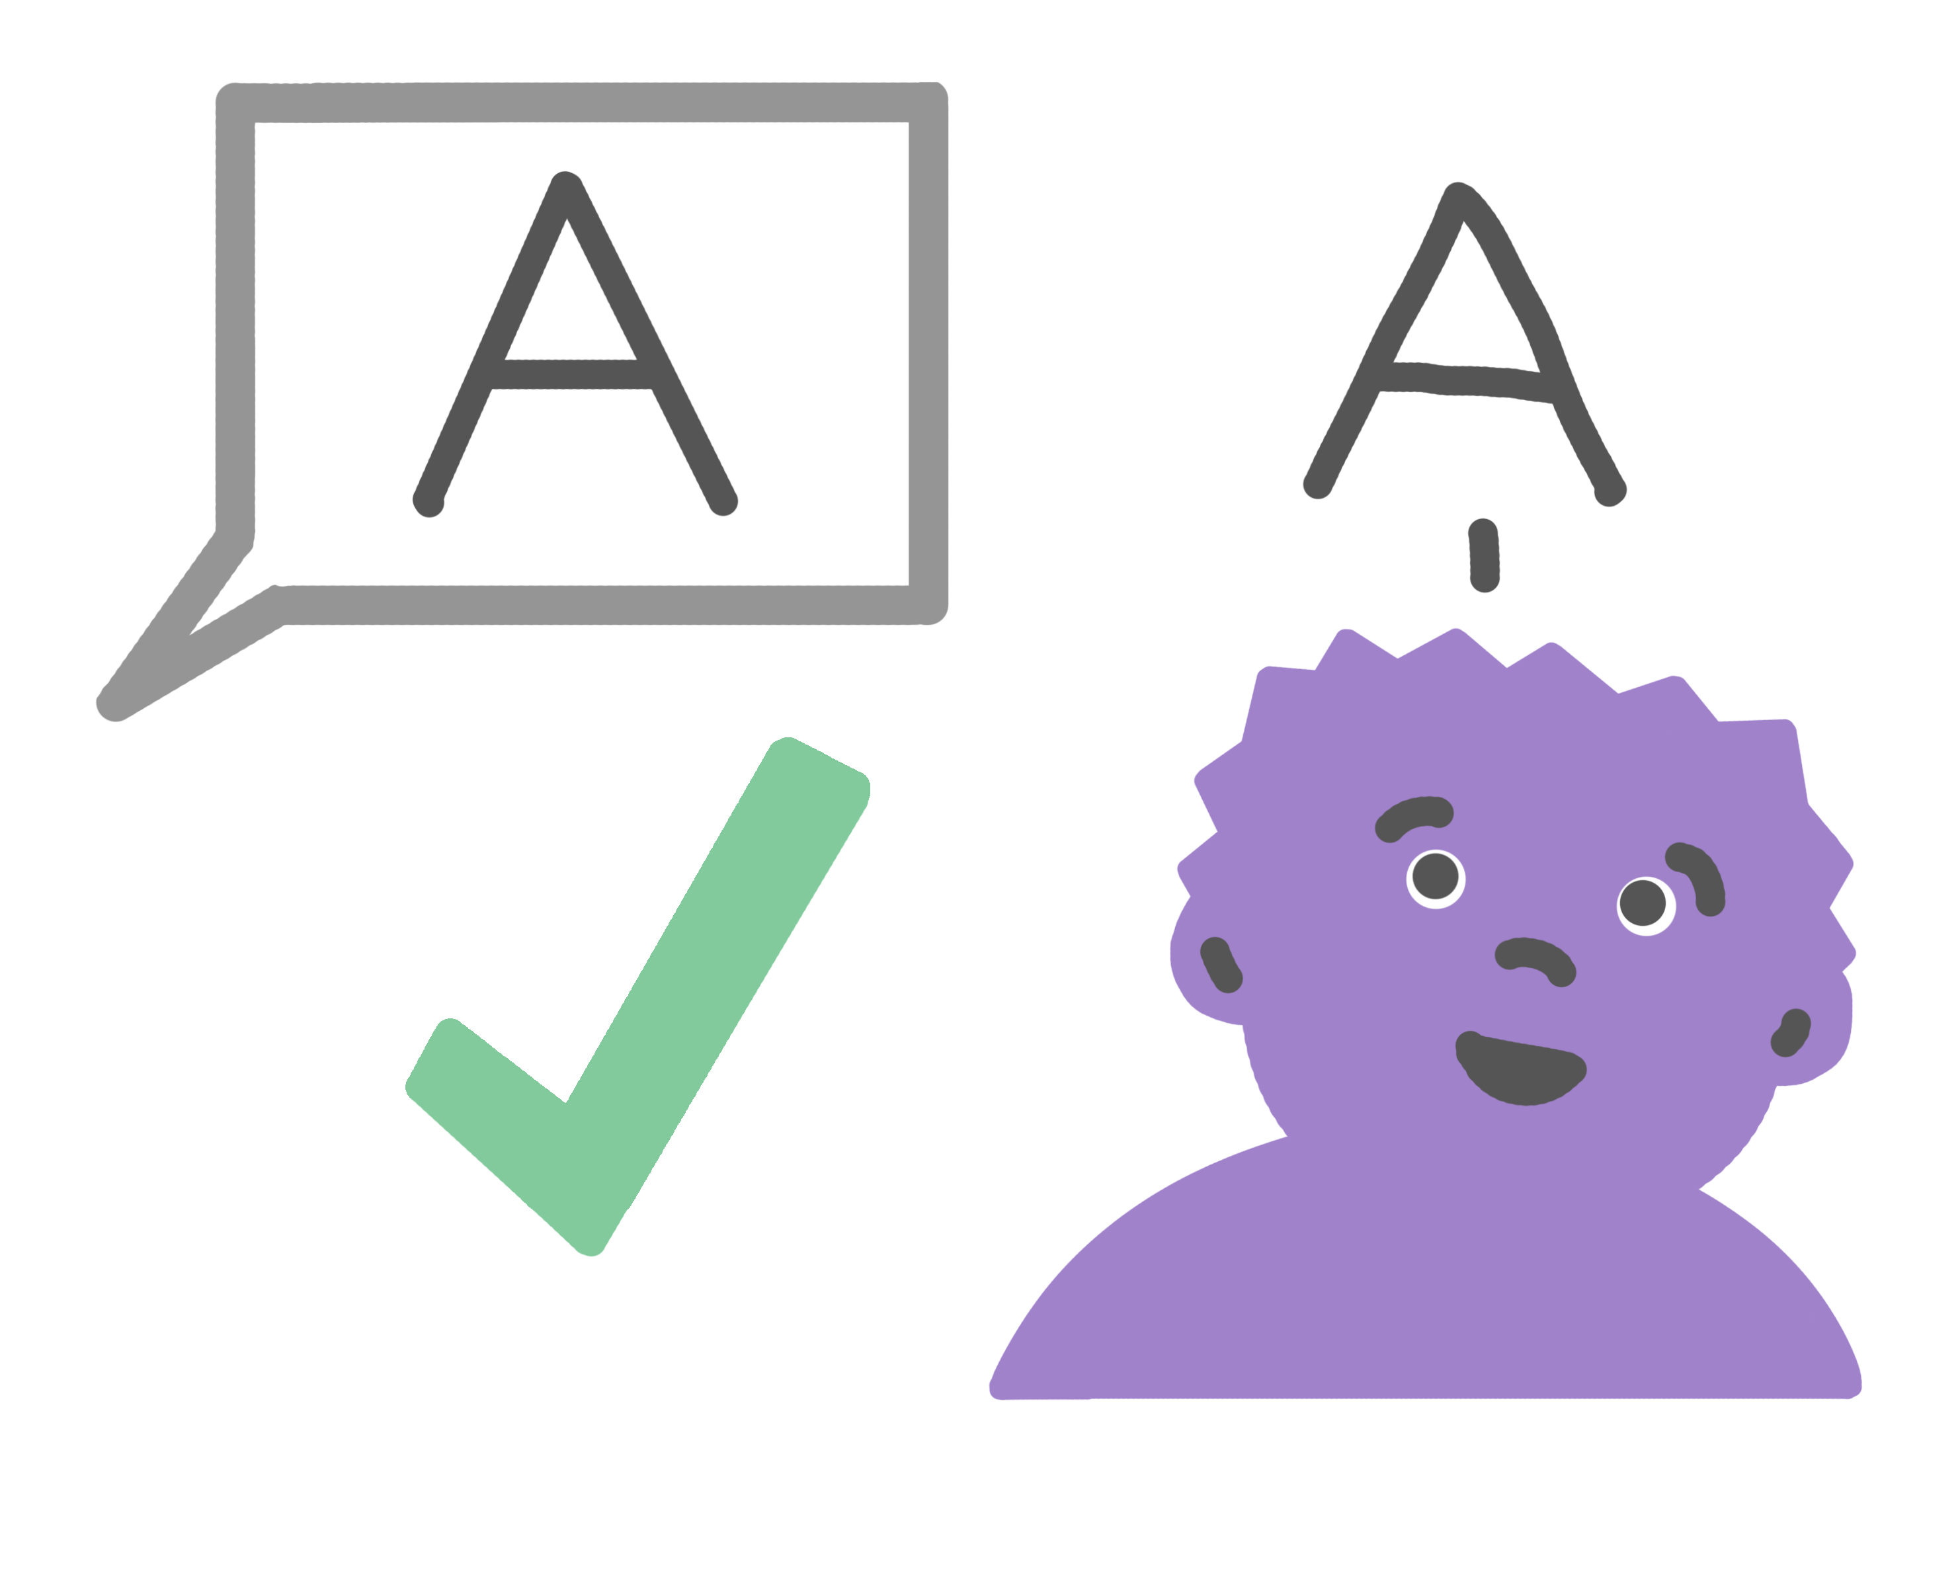
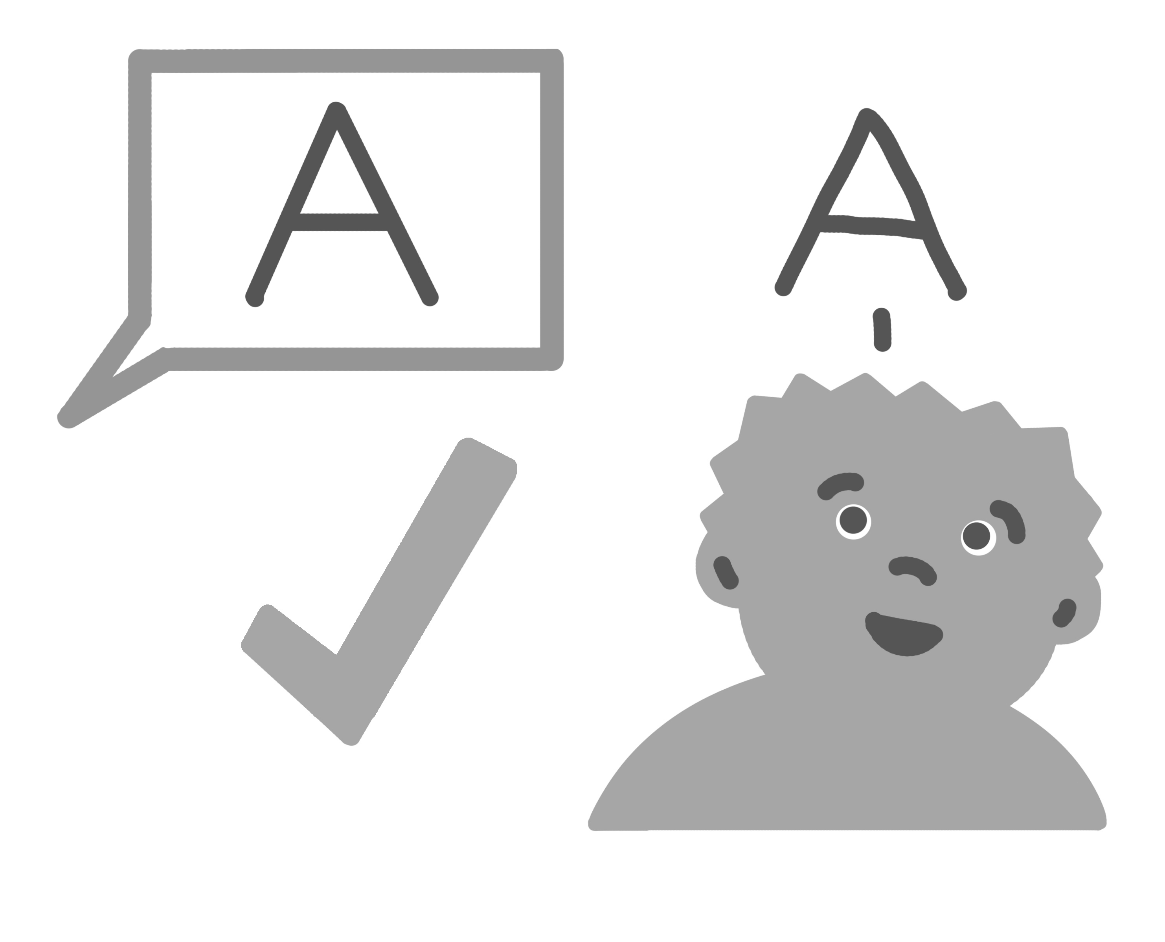
Example Expectations:
Stay in your learning area.
Follow teacher directions the first time.
Raise a quiet hand.
Have materials nearby.
Tip:
Reinforce behavioral expectations by using behavior-specific praise.
Thank you for raising a quiet hand!

Slide 6
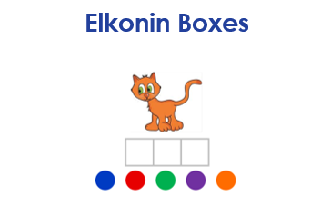
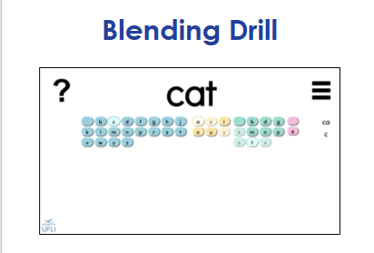
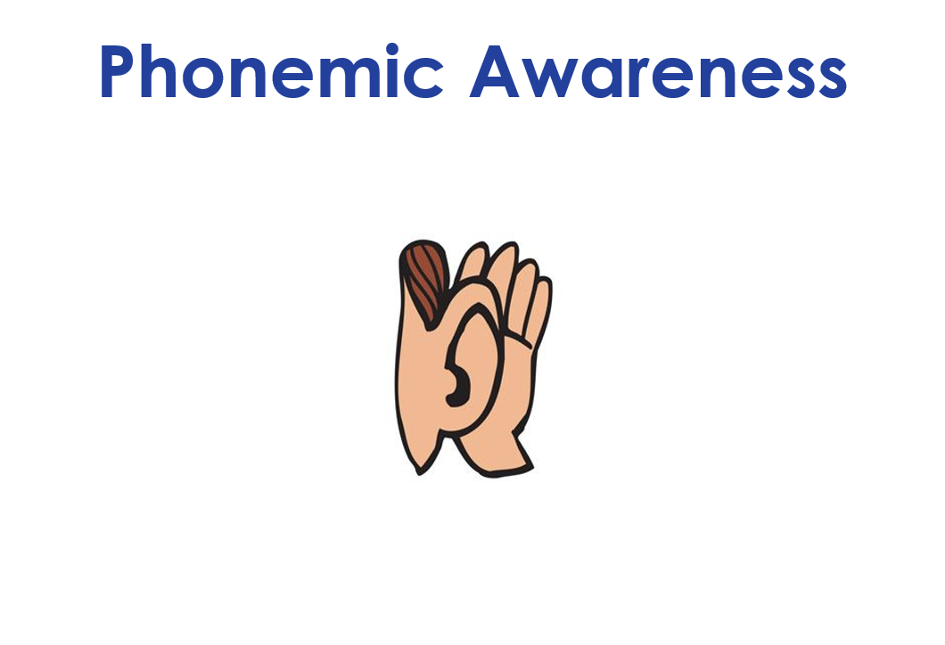
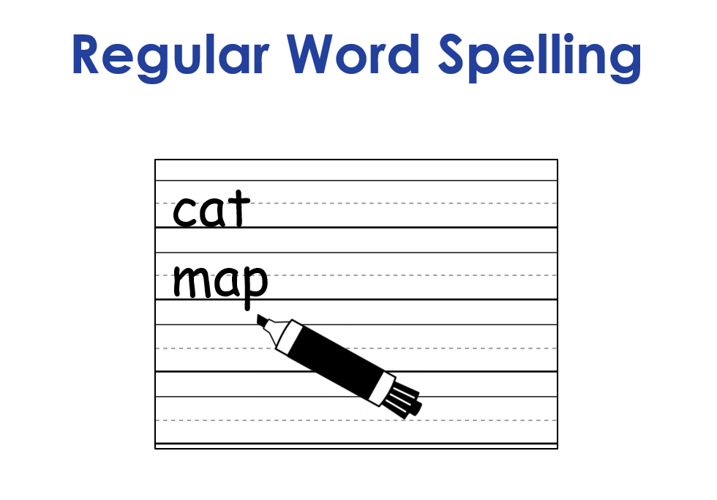
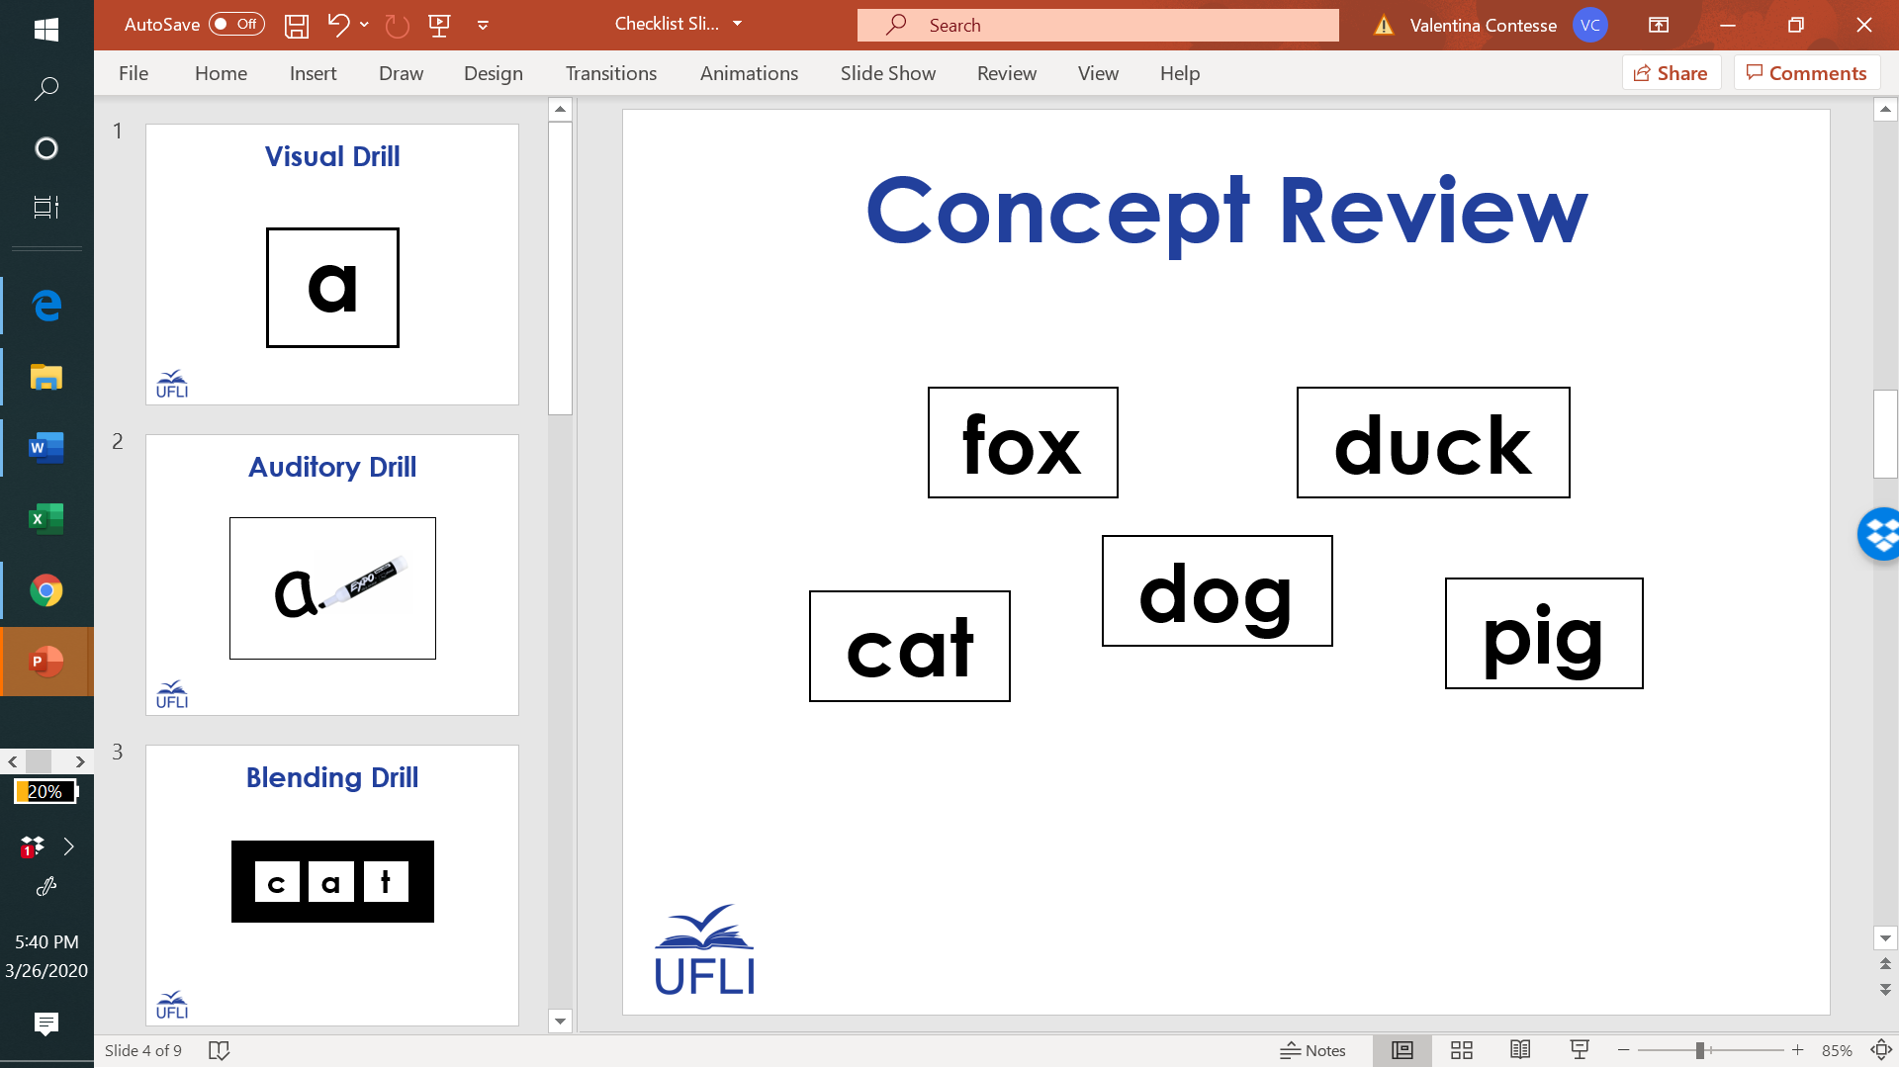
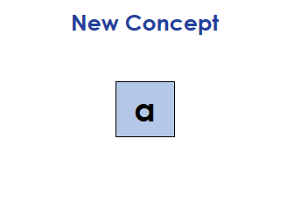
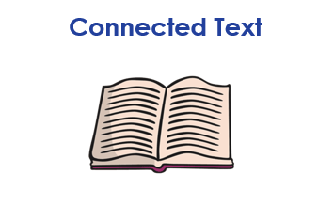
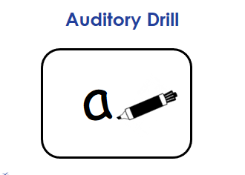
Our Schedule
Look at the camera.
Follow teacher directions the first time.
Raise a quiet hand.
See Visual Schedule Resource
Notes:
Example

